Slide 1


Slide 2
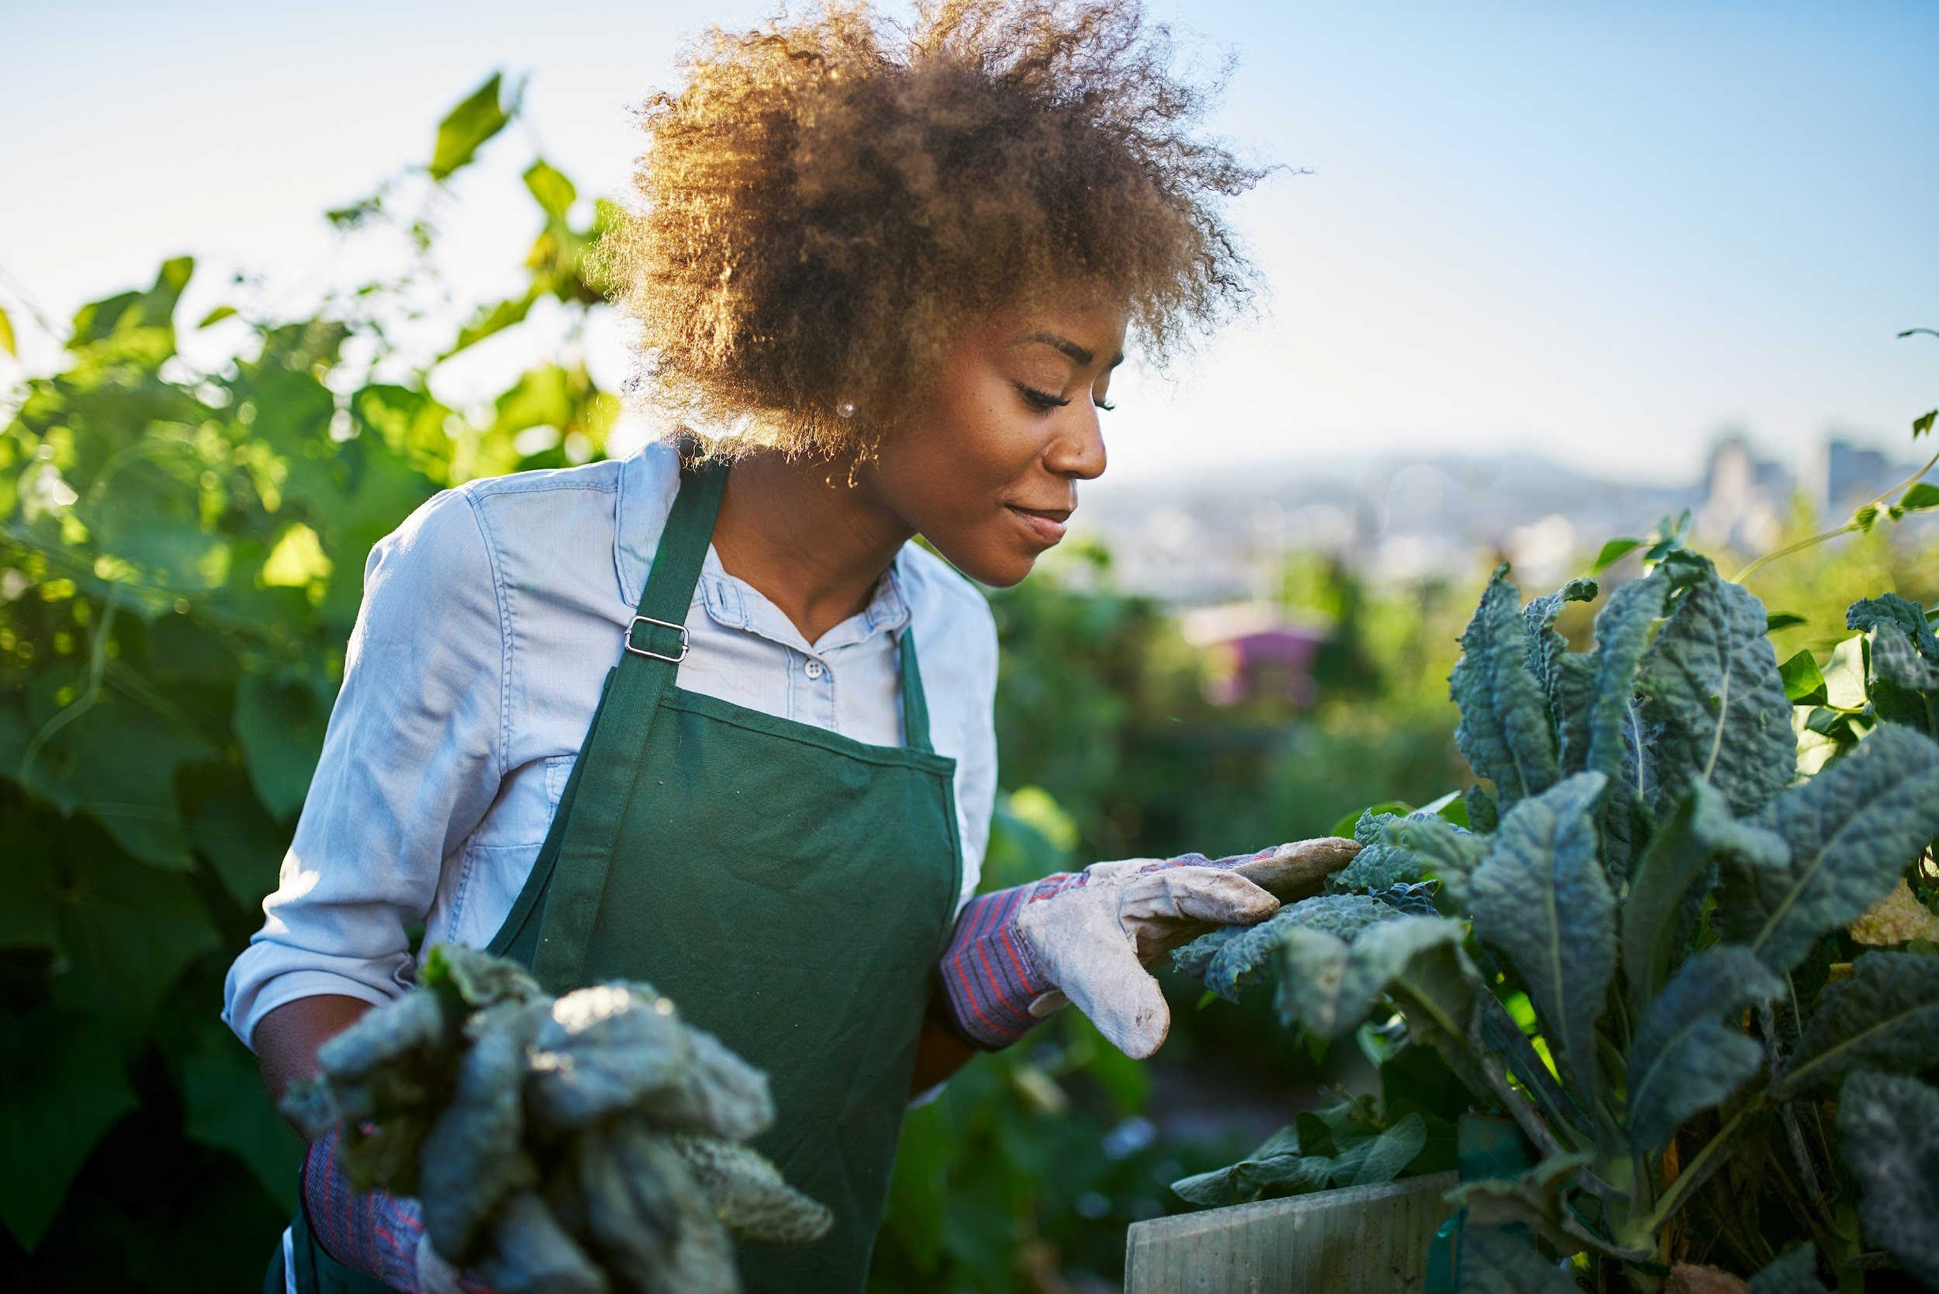
ch.9
Community Power

Slide 3
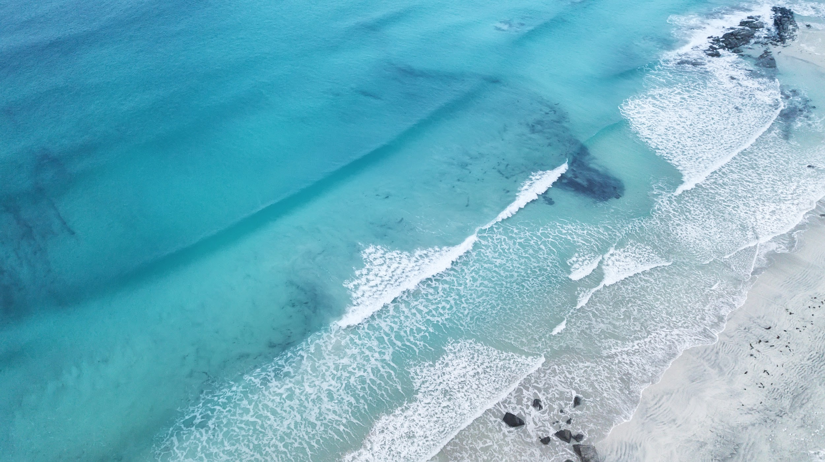
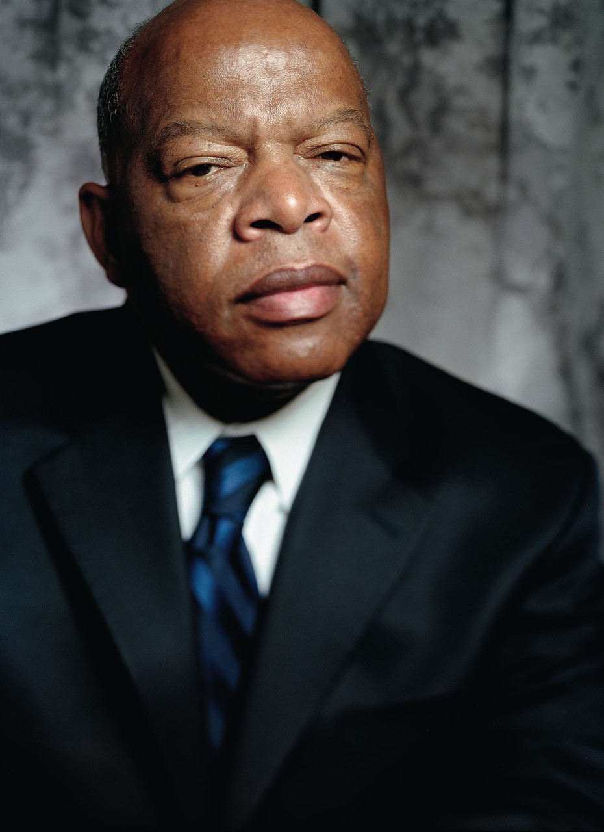
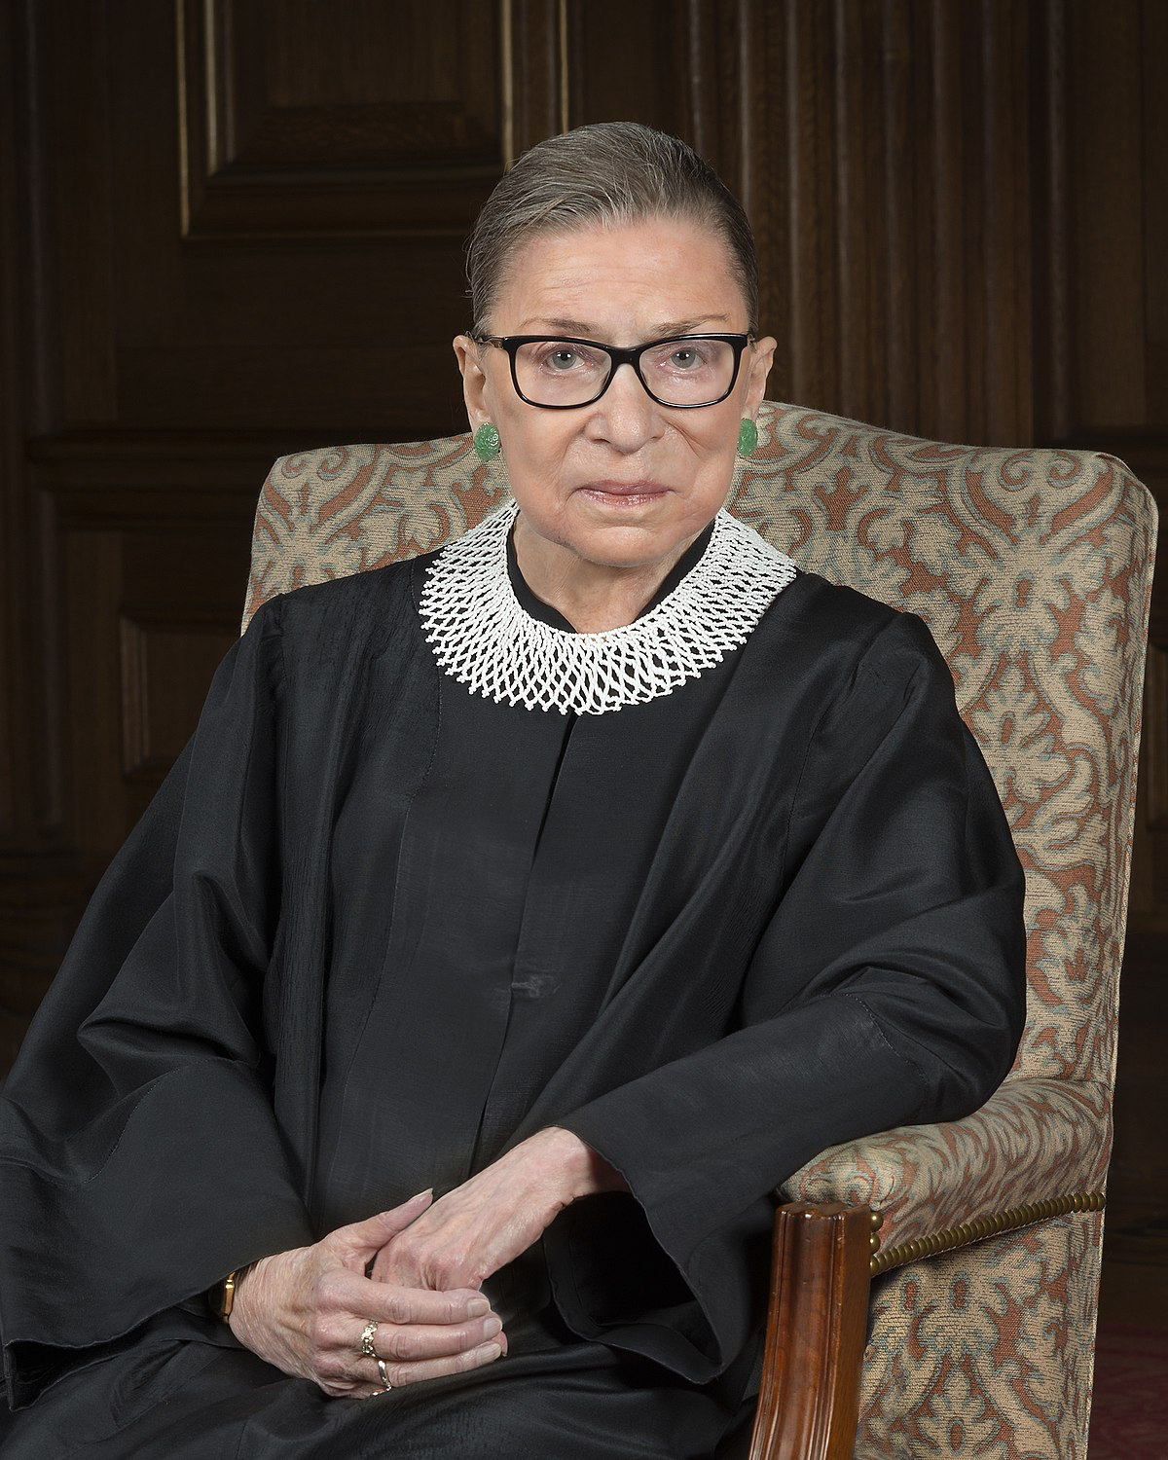
“Fight for the things you care about.
But do it in a way
that will lead others to join you.”
– Ruth Bader Ginsburg
“If not us, then who?
If not now, then when?”
– John E. Lewis

Slide 4
How closely, and how often, do we consider the impact of a word or action? And when a decision is made – whether for a family, neighborhood, city, county, state, country, of beyond – what is done to ensure that the needs, rights, concerns, priorities, and health and wellbeing of all people are understood and given fair voice and consideration?
Who gets to speak for a “community”, and for the interests of a community? What if there is a dispute?...How do people voice/enact their concerns?

Slide 5
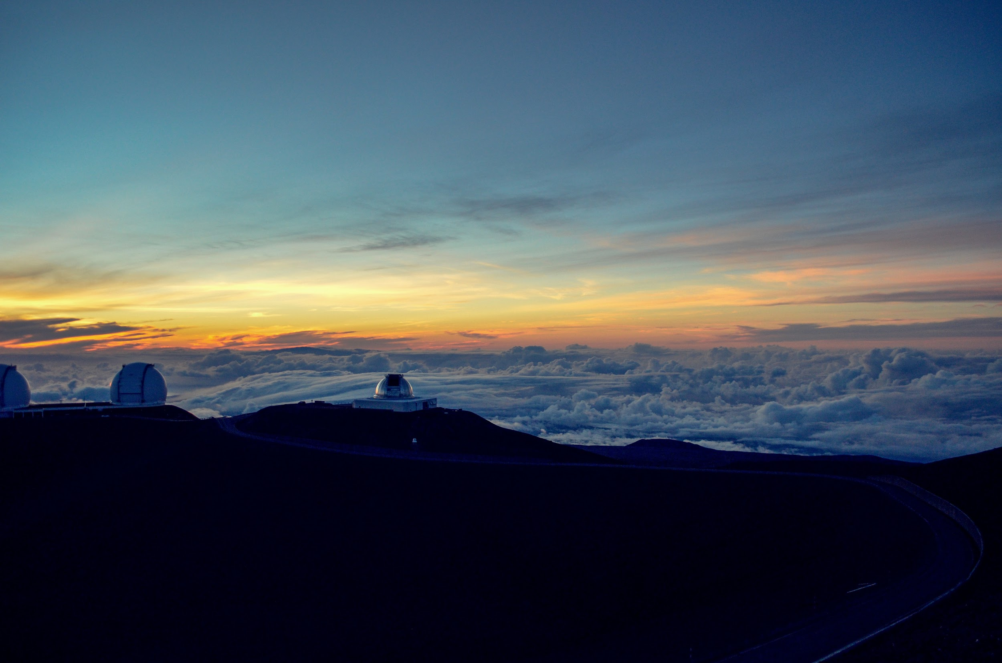
Telescope Observatory on top of Mauna Kea, Volcano on Hawaii
Notes:
Ask your students to research:
Why do scientists want to build a telescope on Mauna Kea?
What is special about this particular telescope? How could it expand scientific discovery?
Why do native Hawaiians object to the building of a telescope on Mauna Kea?
There are numerous telescopes on Mauna Kea – why are native Hawaiians protesting a new one?
How have native Hawaiians gone about expressing their point of view?
Who is listening, reporting on this story?
Whose voices are being considered, or not included?
What do those protesting hope to accomplish?
What has happened since July 2019? How has the pandemic impacted protests?
Are there similar stories/events that have arisen in other locations?
What connections can be made to this dispute?
Can you imagine a peaceful resolution and solution to this dispute?
What would need to be understood/change/happen for a resolution?
Some resources you might use:
New York Times: Why Are Native Hawaiians Protesting Against a Telescope?
New York Times: Under Hawaii’s Starriest Skies, a Fight Over Sacred Ground
NPR: Amid Protests In Hawaii Against Giant Telescope, Astronomers Look To 'Plan B'
Facing History: Indigenous Rights and Controversy Over Hawaii’s Mauna Kea Telescope
Smithsonian Magazine: The Heart of the Hawaiian Peoples’ Arguments Against the Telescope on Mauna Kea
Space.com: At Thirty Meter Telescope protest, native Hawaiian elders leave mountain over coronavirus threat

Slide 6
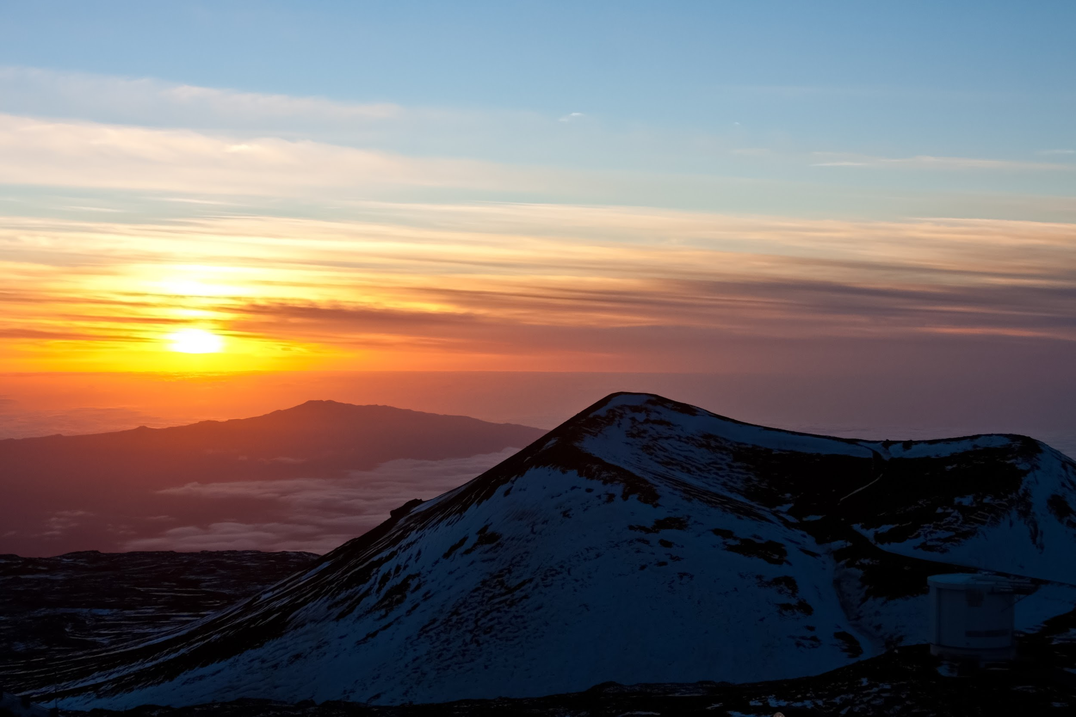
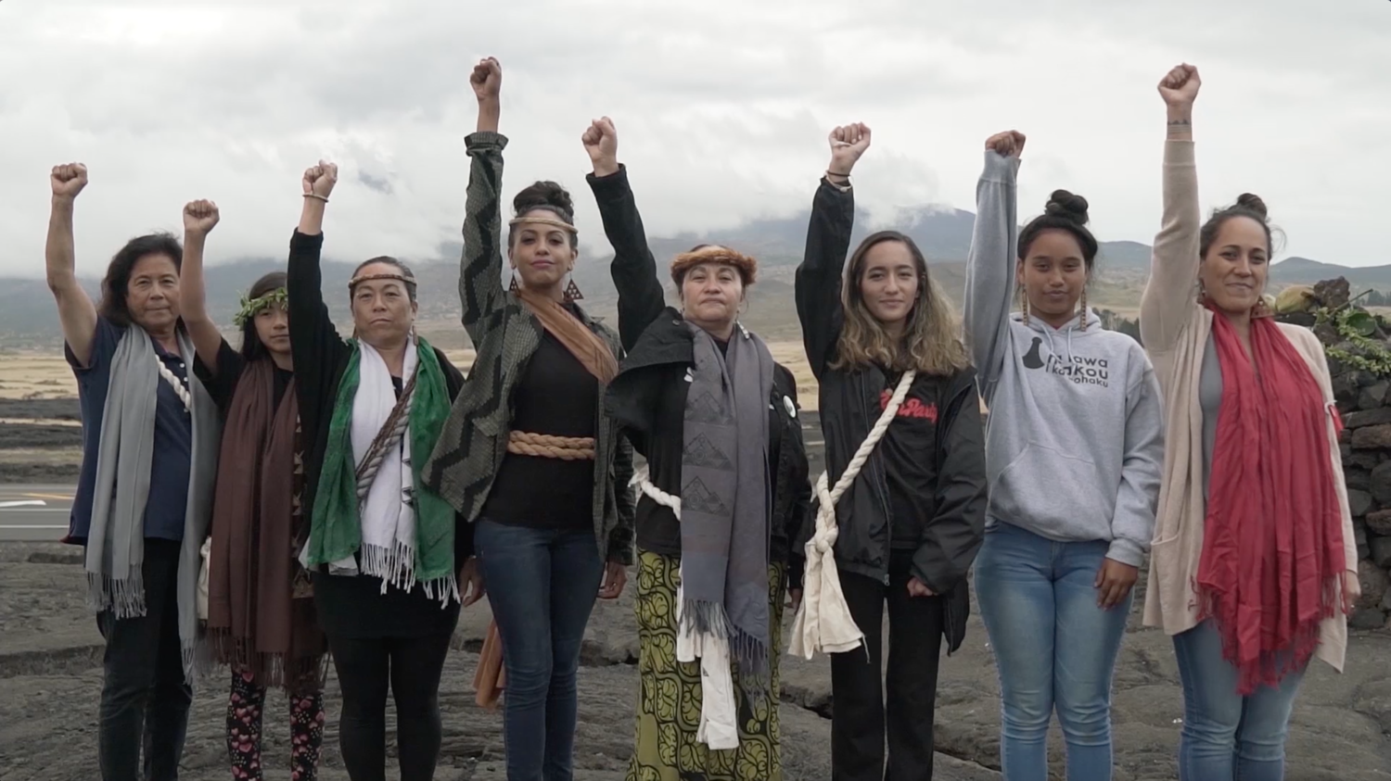

Standing Above the Clouds
Notes:
Standing Above the Clouds (15mins)
https://vimeo.com/363397315
PW: maunakea

Slide 7
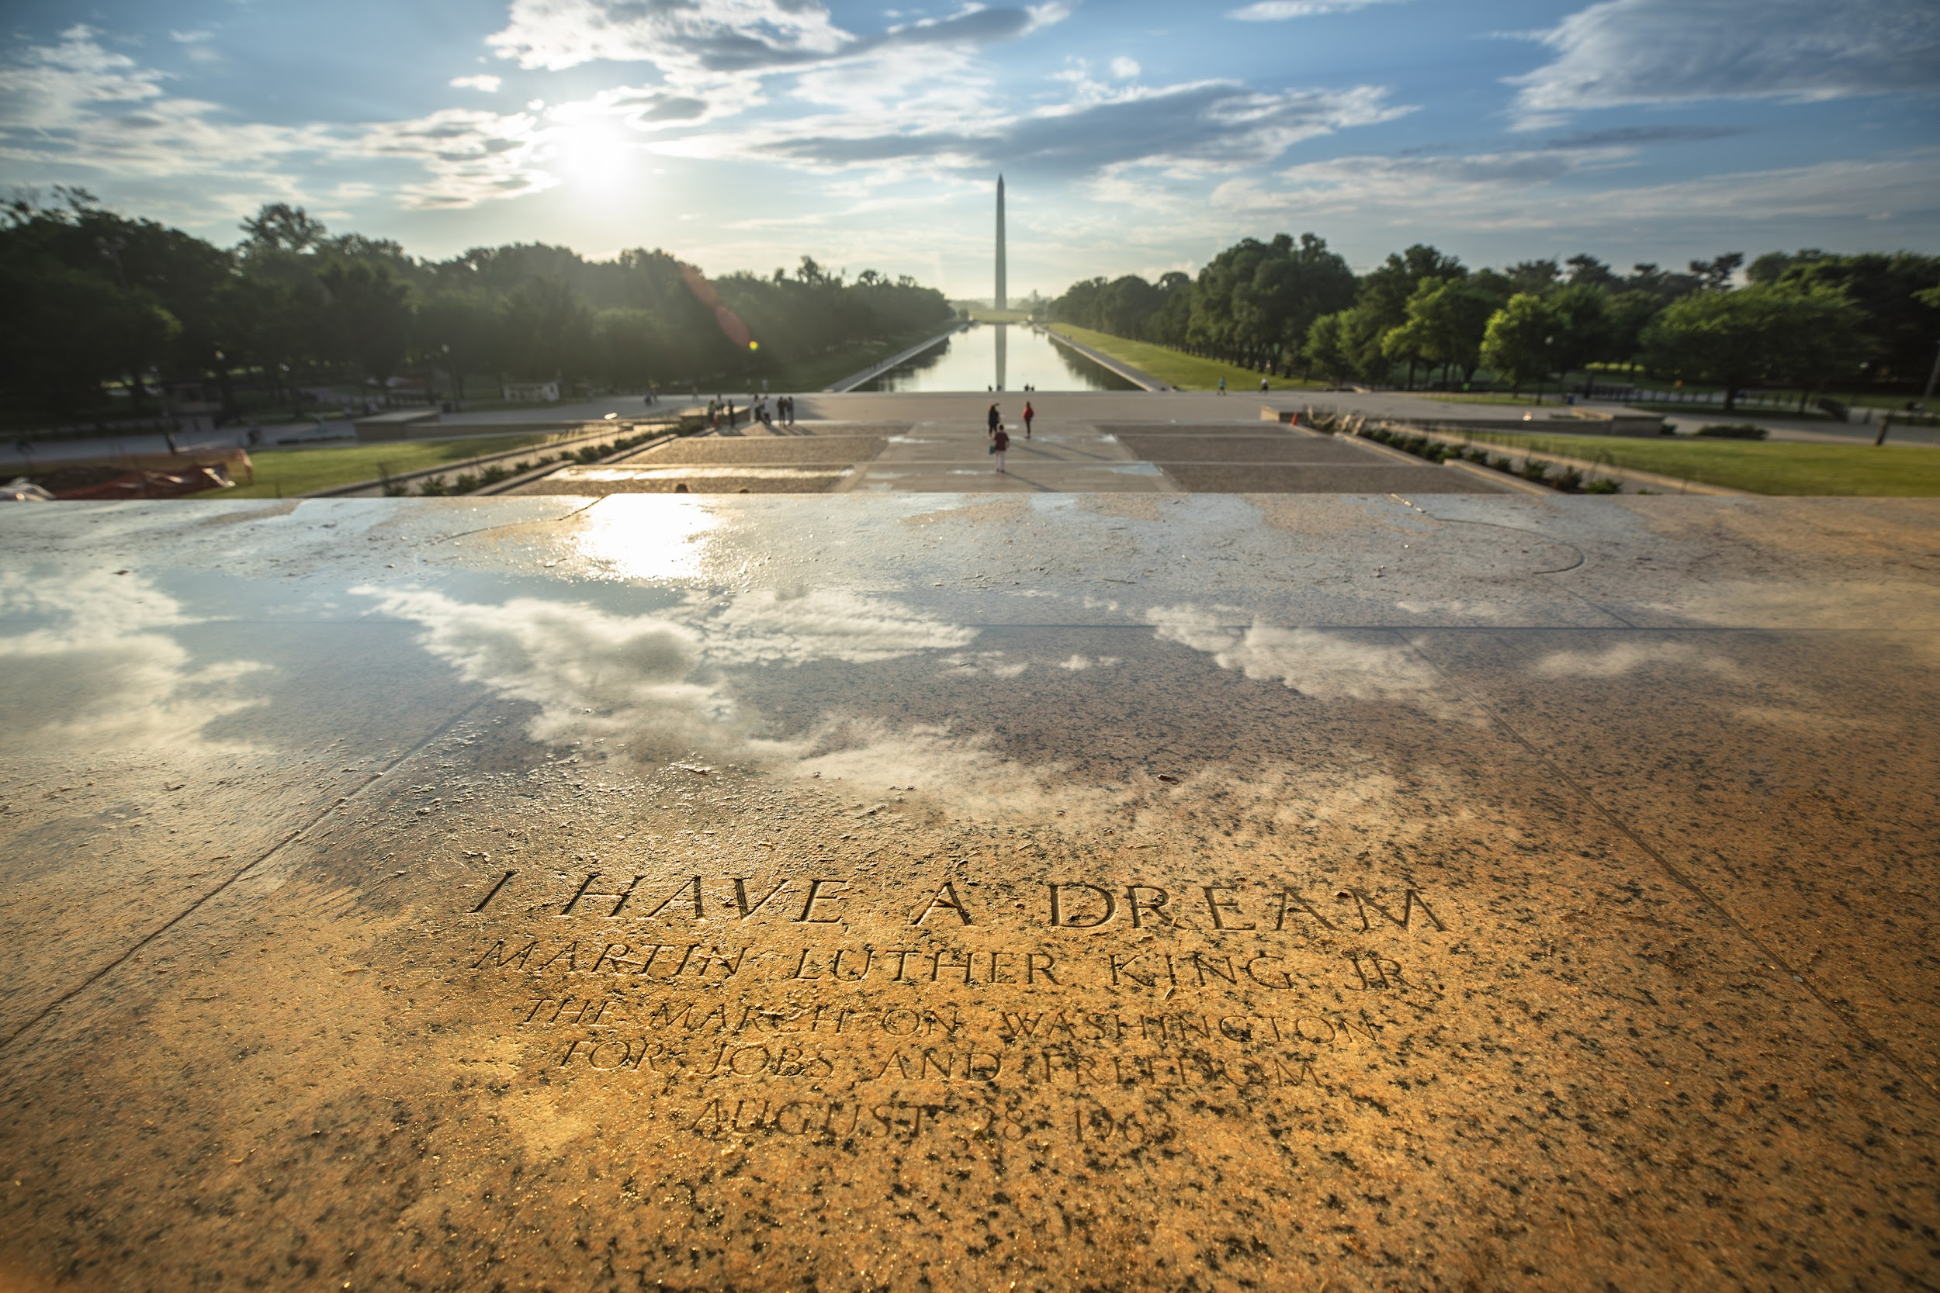
environmental justice: The fair treatment of people of all races, cultures, incomes and educational levels with respect to the development and enforcement of environmental laws, regulations and policies.
Razing Liberty Square

Slide 8
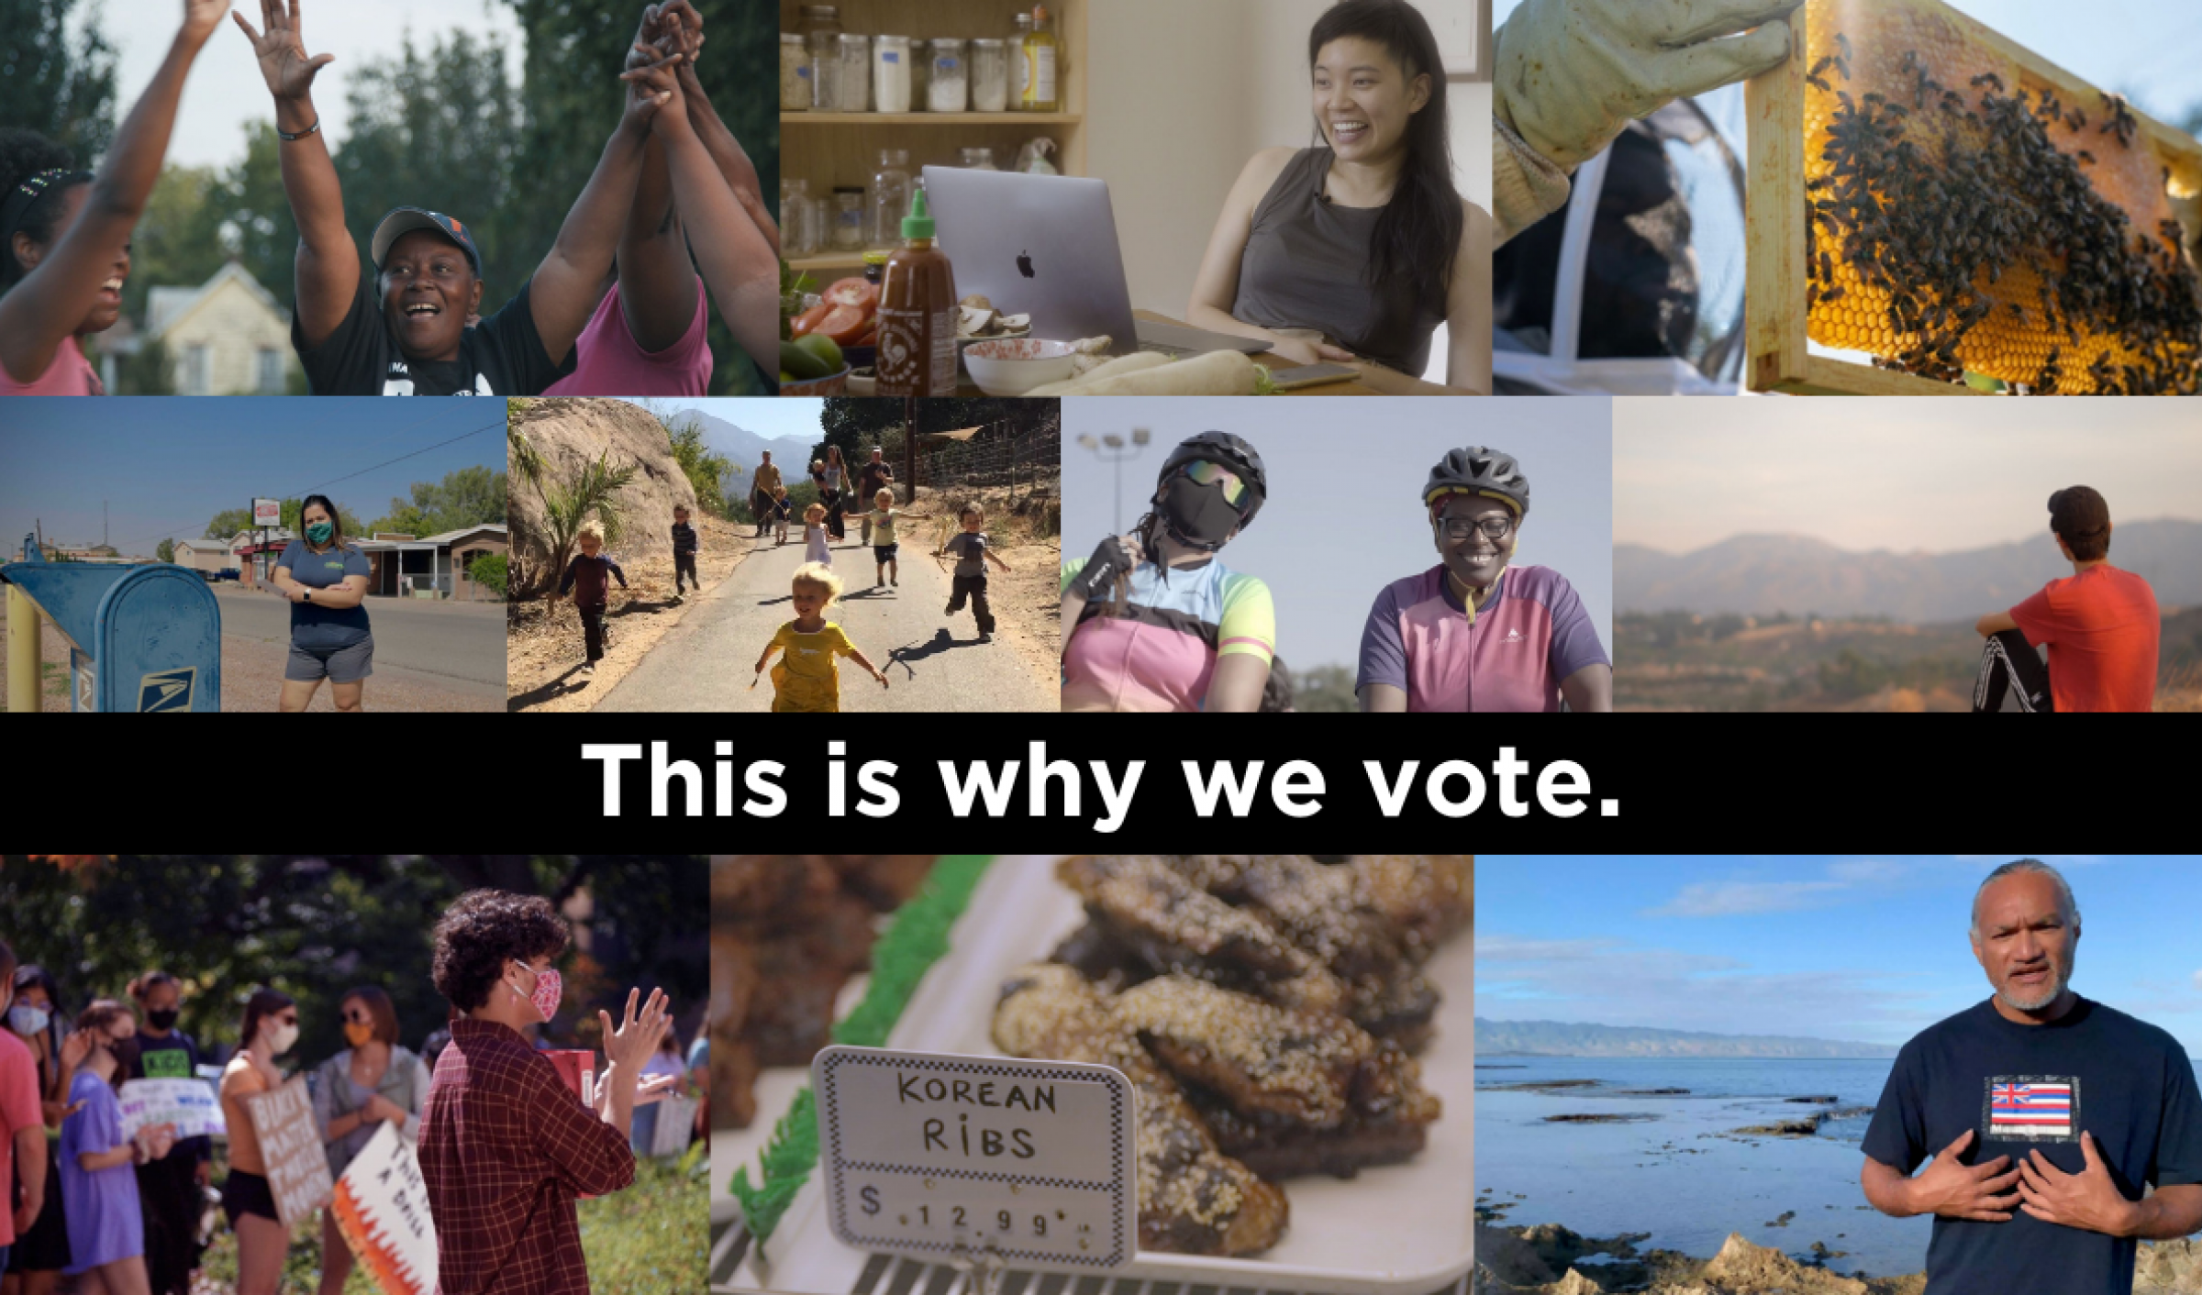
Notes:
https://redfordcenter.org/powerthevote/films

Slide 9
#Power the Vote
10 impactful filmmakers – 1:30-4:00 minute short films in a collective call for civic engagement.
Each film covers at least one or more of six inspirational storytelling threads drawn from Culture Surge’s recently launched Storyteller’s Guide to Changing the World:
1. “Together, we have power”: Stories of personal & collective power
2. “There is abundance”: Stories that show there's more than enough for everyone
3. “We lead by caring about each other”: Stories of people collaboratively leading the way to make change, that show people caring about each other and their communities
4. “We deserve joy”: Stories of joy and self-care
5. “We all belong”: Stories of our common mission, that show we all belong and have value
6. “Curiosity is the path to our best future”: Stories of curiosity about each other and society, stories of people asking bold questions about the future they want to build

Slide 10
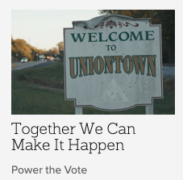
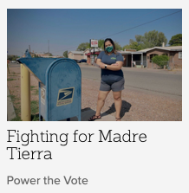
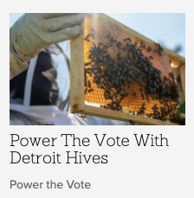
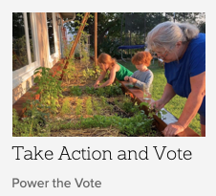
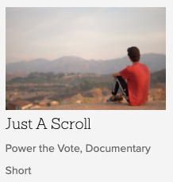
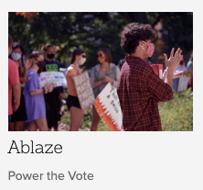
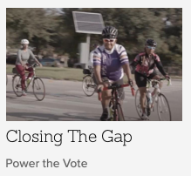
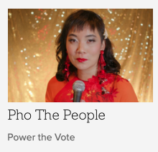
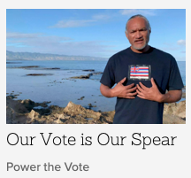
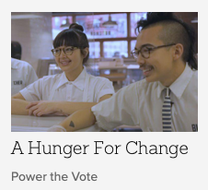
#Power the Vote
Notes:
https://redfordcenter.org/powerthevote/films

Slide 11
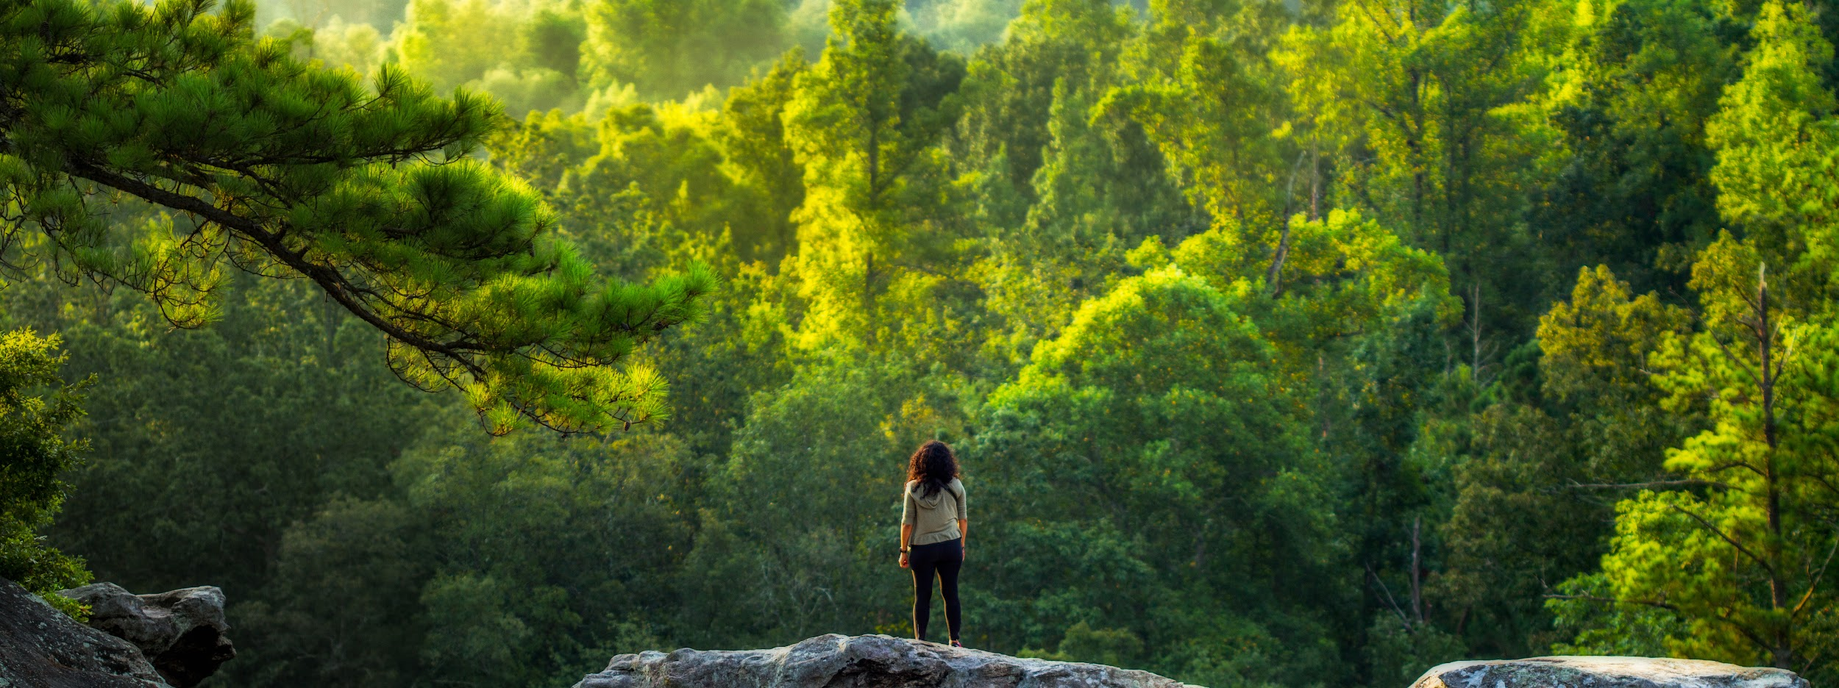
What do you/might you bring to your advocacy/activism?

Slide 12
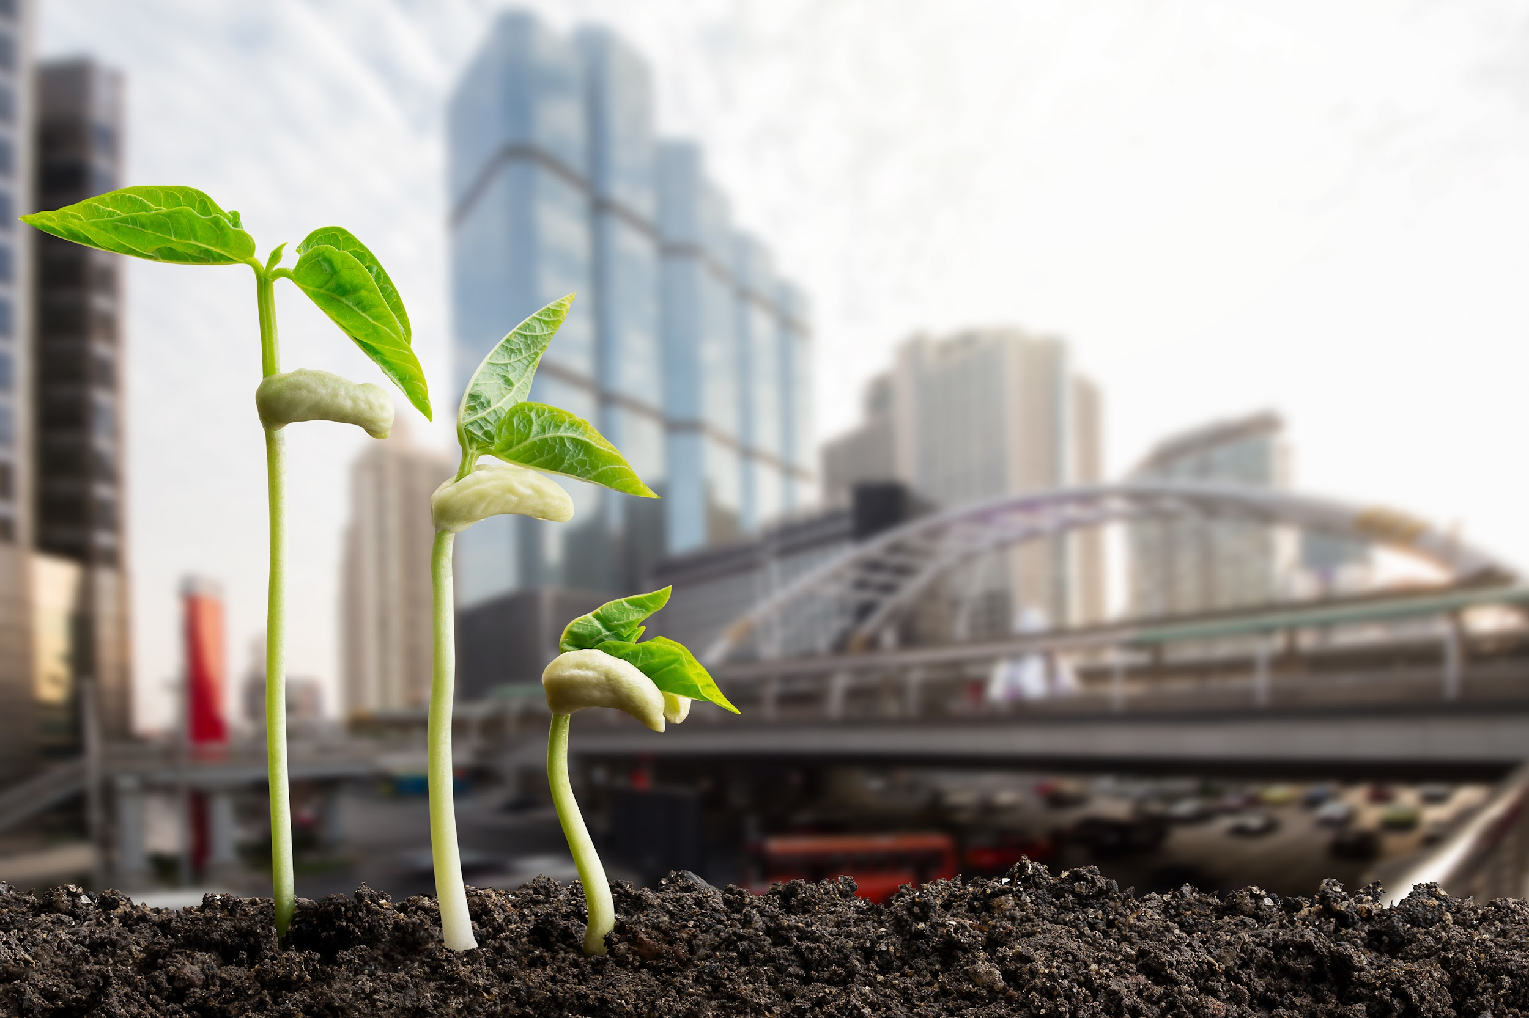


challenge:
Using video to share solutions
Notes:
Make a how-to video, sharing the steps to something you’ve learned how to do that benefits your family and might help someone else.
For example, you could walk people through how to cook something, how to use leftover food, how to plant a garden or a planter box, how to compost, how to make a reusable version of something, how to build something you’ve built before that’s been useful to you; how to write a story; how to create a game; how to connect with community in creative ways; how to; how to research local issues; how to write a letter to your local government; how to interview an elder…We’d love to see your videos! Feel free to send anything you’d like to stories@redfordcenter.org.

Slide 13
Bonus Slides

Slide 14
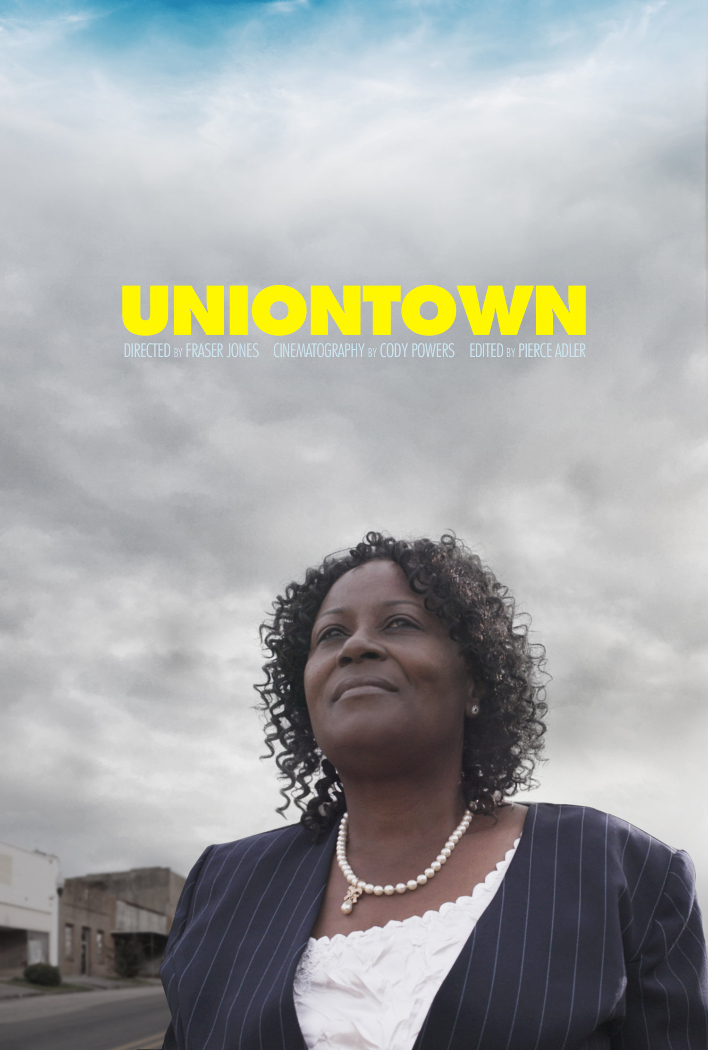
In the midst of a high-stakes local election, a group of grassroots activists in rural Alabama band together to take on industrial polluters and complacent politicians.
Notes:
Uniontown: https://vimeo.com/288640106
In the midst of a high-stakes local election, a group of grassroots activists in rural Alabama band together to take on industrial polluters and complacent politicians. Winner of Best Short Film at EarthX Film Festival and The Reel South Award at Indie Grits Film Festival. Official Selection at Big Sky Documenatry Film Festival and American Documentary Film Festival.

Slide 15
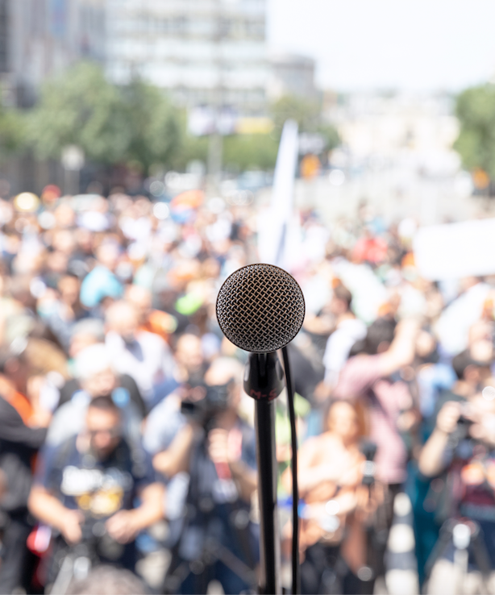
Actor and activist Robert Redford tells his personal story of what moves him to protect the environment, and his journey in doing so. "Art and nature combined, makes the world a better place.”
Notes:
https://vimeo.com/146947405

