Slide 1


Slide 2
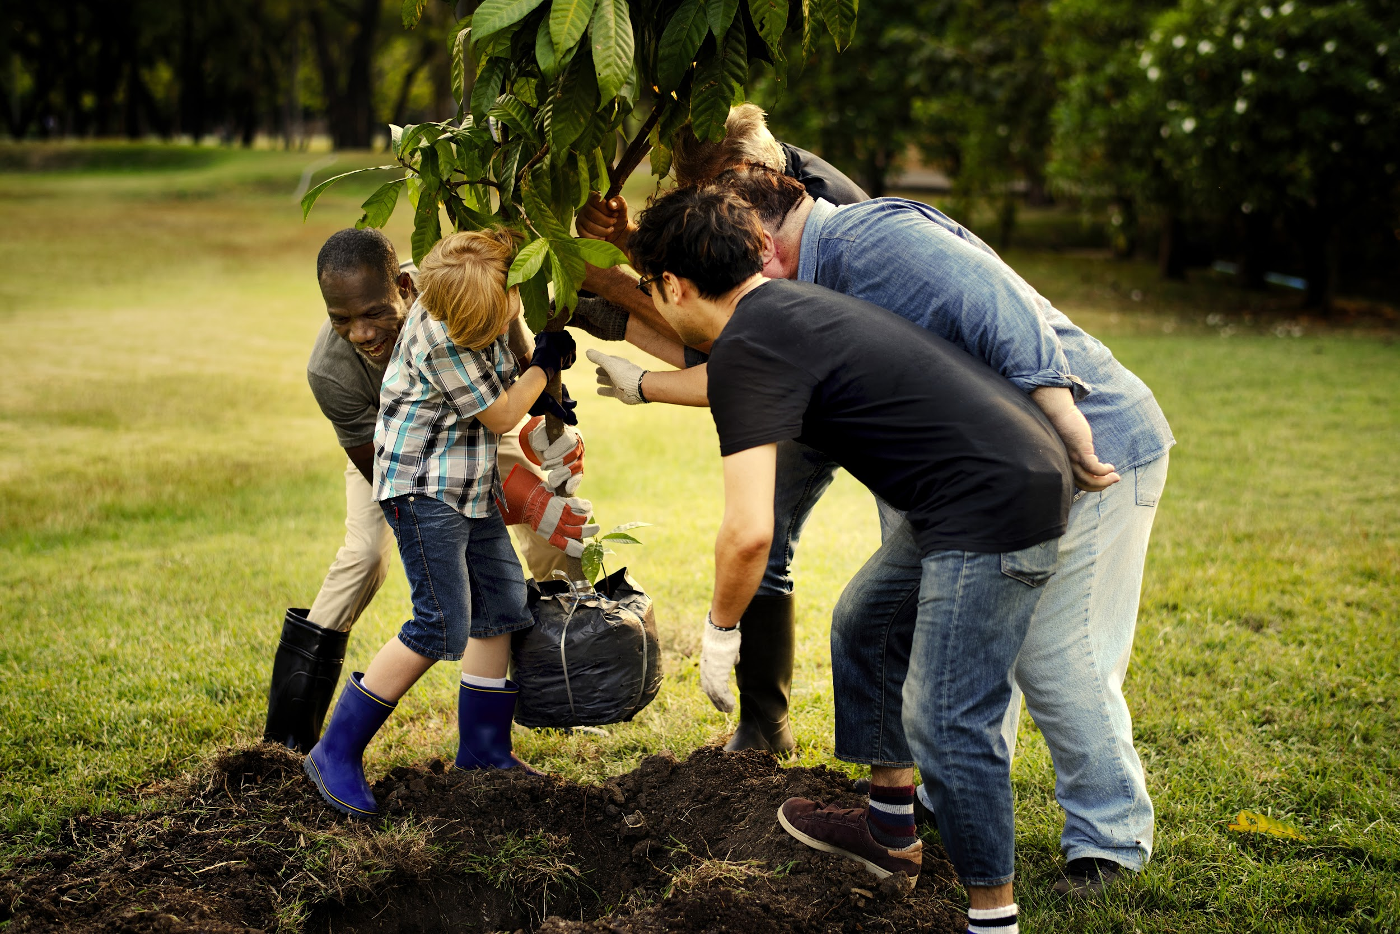
ch.8
Youth Activism

Slide 3
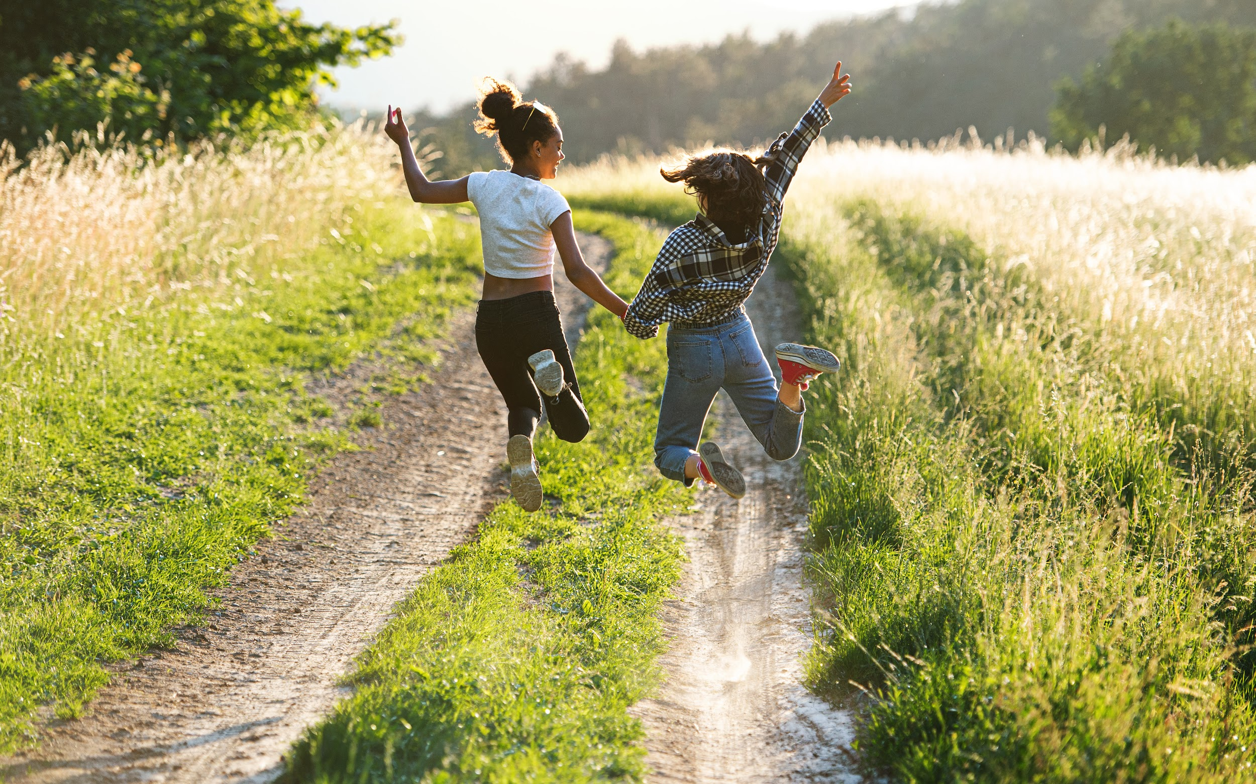
“When scrolling through your social media feed, share and amplify the messages you believe the world needs to hear. Who knows–maybe it’ll surge like a waterfall and change the hearts and minds of enough people to positively alter the future. That’s an incredible responsibility. I hope we use it wisely.”
– Leah Thomas
Notes:
Leah Thomas Bio: “Leah Thomas is an eco-communicator, aka an environmentalist with a love for writing + creativity, based in Ventura, CA. She’s passionate about advocating for and exploring the relationship between social justice and environmentalism.”
https://yaleclimateconnections.org/2020/09/leah-thomas-harnesses-instagram-to-promote-a-vision-of-anti-racist-environmentalism/
https://www.nationalgeographic.com/history/article/environmental-movement-very-white-these-leaders-want-change-that

Slide 4
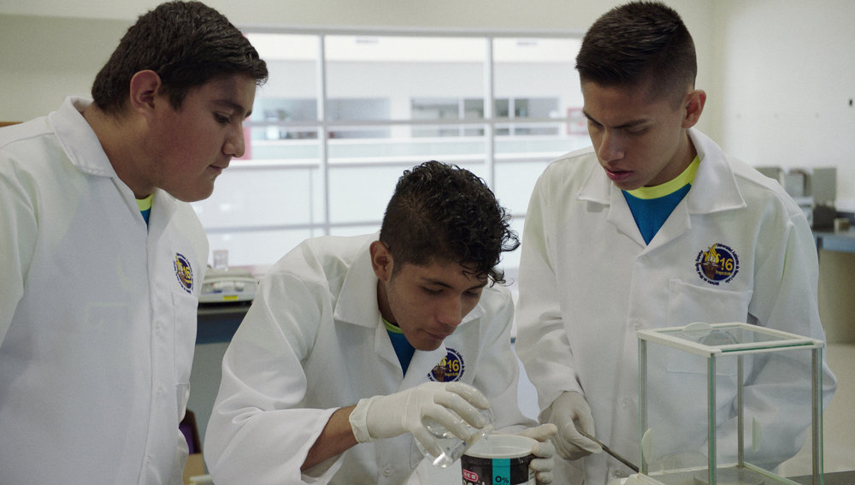
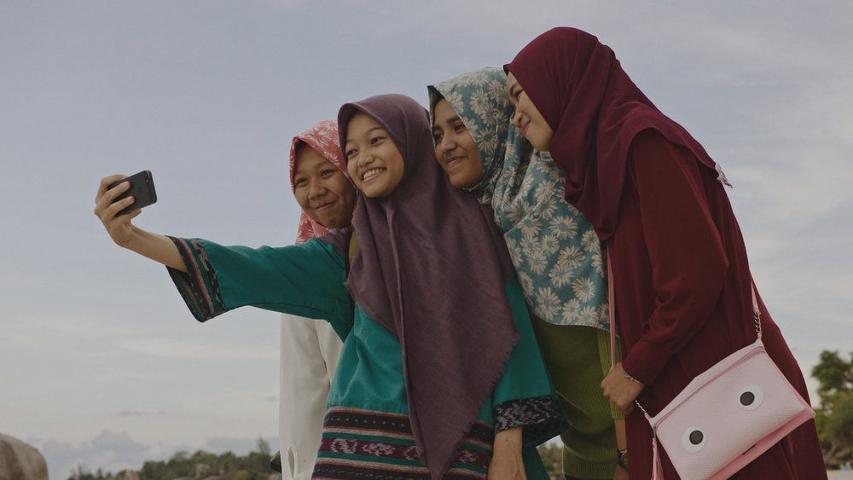
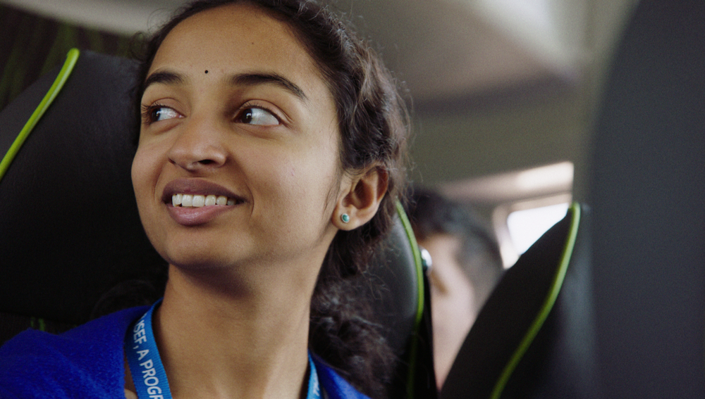


“Meet passionate teenage innovators from around the globe who are creating cutting-edge solutions to confront the world’s environmental threats – found right in their own backyards”.... What inspires their innovations? What solutions/stories await you?
Notes:
Inventing Tomorrow (clip): https://www.pbs.org/video/lesson-plan-clip-2-inventing-tomorrow/
Meet Fernando, Jesus, and José.
Inventing Tomorrow follows young scientists from Indonesia, Hawaii, India, and Mexico who propose innovative solutions to fix some of the most complex environmental issues facing humanity today – right in their own backyards. The students are preparing original scientific research projects they will defend at ISEF, the Intel International Science and Engineering Fair, a program of the Society for Science & the Public. The students travel to Los Angeles from all corners of the world to participate in ISEF 2017. The film follows them as they participate in social activities, field trips, and the gauntlet of judging. No matter who wins a prize, the students all make connections many call life changing. These young scientists invite a worldwide role reversal, where the youth show the way towards a more sustainable future.
Share the above clip from Inventing Tomorrow with students. Let students know that in this clip they will hear a small part of the story of Fernando, Jesus, and José, a team from Mexico preparing to attend ISEF. As they watch the clip, can they catch what it is that Fernando, Jesus and José are working on; and why?
Inventing Tomorrow website: https://www.inventingtomorrowmovie.com
Note from filmmaker Laura Nix: this full film can be made available to interested teachers/schools.
Some questions you might explore after watching the clip of Fernando, Jesus, and José.
Reflections on this clip? Things that stood out to you most in watching?
What it is that Fernando, Jesus, and José were working on?
What inspired their project? What’s their connection to their innovation?
What is the impact for you of seeing this film in Spanish with English subtitles?
Which images stayed with you after watching?
Did you notice contrasting images? (seeming opposites, things moving in different directions)
This is a small clip from a larger story that follows students from Indonesia, Hawaii, India, and Mexico to an international science and engineering fair. Even in this clip, how is the story narrated?
What do you learn/feel about Fernando, Jesus, and José?
Why do you think this film was made? Just based on this clip, what are some of the impacts you can imagine that director Laura Nix was/is interested to inspire?
How does she present that people in this clip?

Slide 5
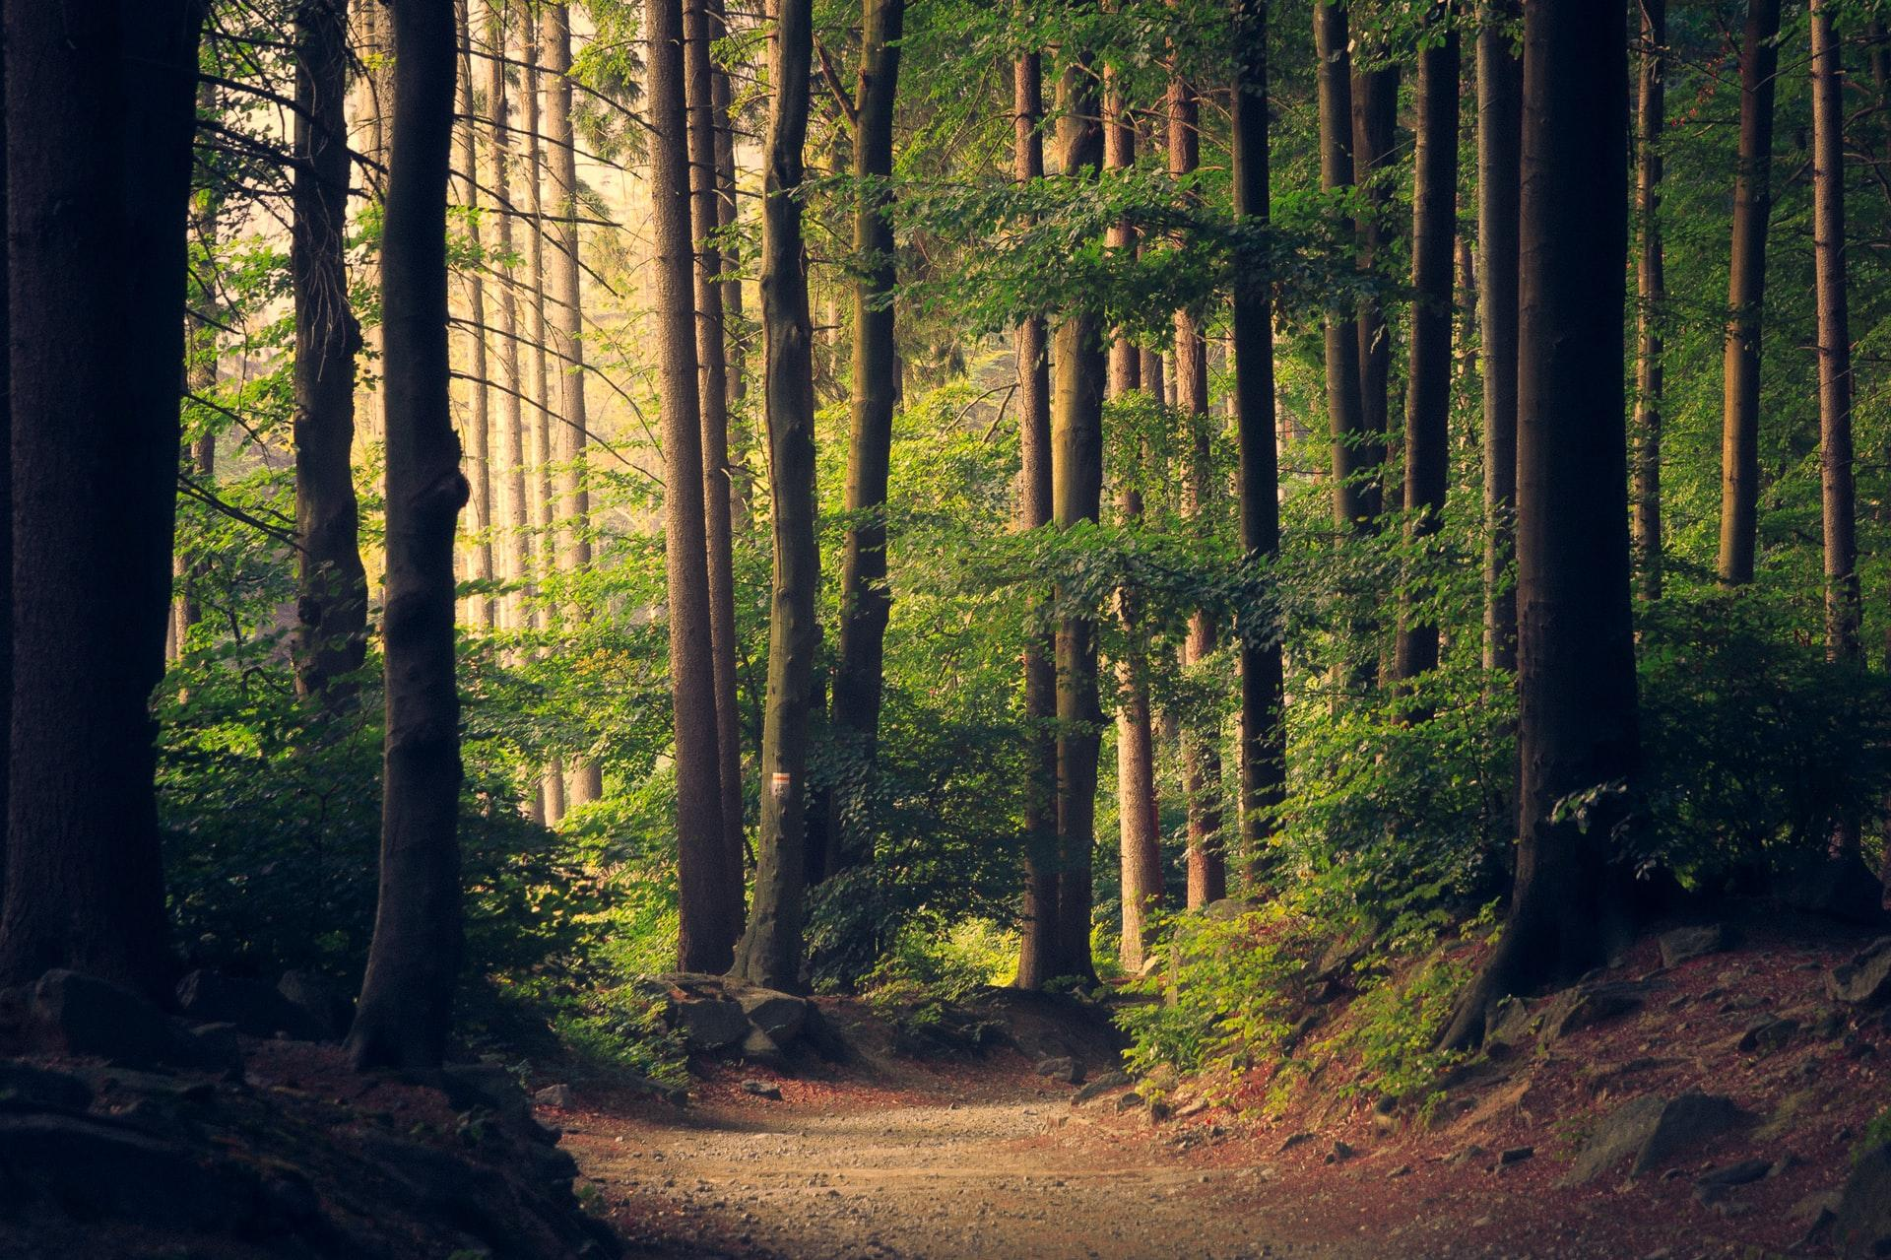
INVENTING TOMORROW | DIRECTOR’S STATEMENT | LAURA NIX
Laura Nix, the director of Inventing Tomorrow, recalls: “When we were casting for the film...we discovered that in developing countries, approximately 60-70% of student projects we reviewed were intended to have an environmental impact in their own communities.
But when we dug into the projects in the United States, that number fell to around 10%.”
Why do you think there are these differences?
What do you think could change to engage
students more fully in your country?
Notes:
Laura Nix, the director of Inventing Tomorrow, recalls: “When we were casting for the film...we discovered that in developing countries,approximately 60-70% of student projects we reviewed were intended to have an environmental impact in their own communities. But when we dug into the projects in the United States, that number fell to around 10%.” Why do you think this is?
She goes on to say: “We interviewed over 100 ISEF finalists around the world, and learned that most of the students who were focusing their research on environmental solutions were motivated by an issue that was facing their local community. Over time, we realized young people who live in American frontline communities, mostly urban and rural students who are directly impacted by environmental injustice, don’t have access to the type of advanced STEM education that trains students to qualify for the top science fairs....Our [film] and program is designed to inspire young people to create solutions that lead to cleaner air, potable water, reducing industrial contamination, renewable energy, and improved quality of life for their families and communities.”
How can more frontline communities speak up for their own needs, and also feel empowered to share their knowledge, ideas, innovations, and creative solutions?

Slide 6
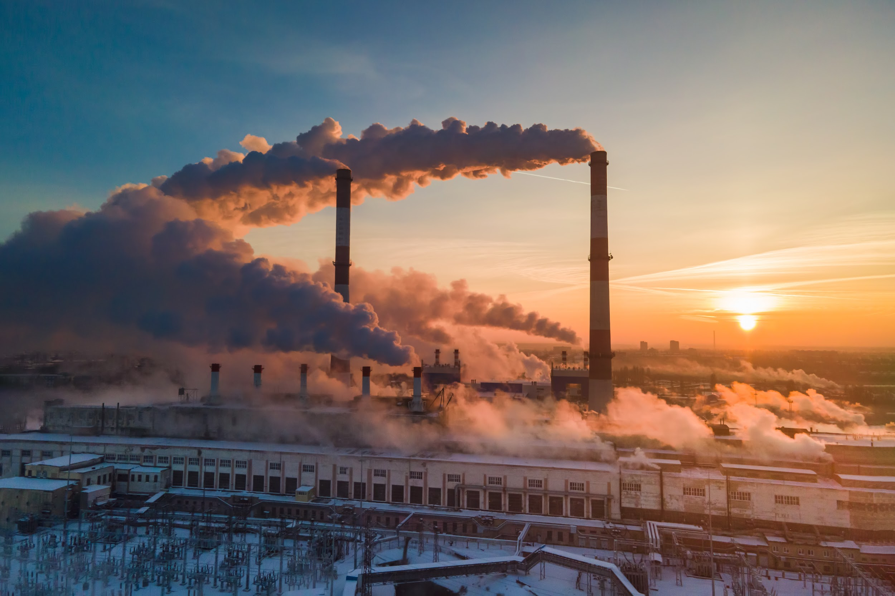
Frontline Youth:
Fighting for Climate Justice
Notes:
https://vimeo.com/387928607
You might consider some of the following questions:
Reflections on this video? What feeling(s) did you experience watching it?
What does it mean to be in a “frontline community”?
How do you think the pandemic continues to impact communities disproportionately facing challenges like fossil-fuel pollution, poor access to clean air/clean water?
Did you recognize issues of concern in this video that are also impacting your local community?
How do you think about the notion of “your community”?
What do you think is meant by the phrase “just recovery”? [*also see film included in Slide 7]
Recovery from what?
What could have recovery be “just”?
Community gardens and food growing were mentioned multiple times in this video, why?
What are some possible connections between community organizing, food systems and environmental justice?
How were young people portrayed in this video?
Were they talked about? Speaking for themselves?
What priorities did the young people in this video express?
How are youth and older adults/elders shown working together in this video?
Why do young people in this video reference “climate justice” as being part of “a movement”?
What makes something “a movement”?
Additional perspectives you might explore:
Zero Hour on principles and practices of a “Just Transition”
YES Magazine and “The Just Transition Issue”
YES Magazine and “The Power of Inclusive, Intergenerational Climate Activism”

Slide 7


Xiuhtezcatl Martinez
Notes:
https://youtu.be/KvIq3NXs04E

Slide 8
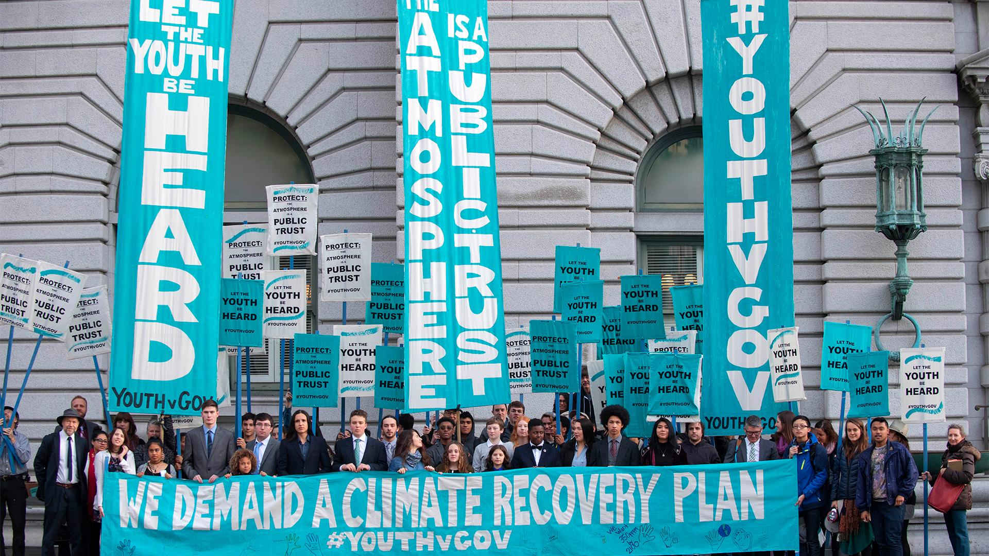

Slide 9
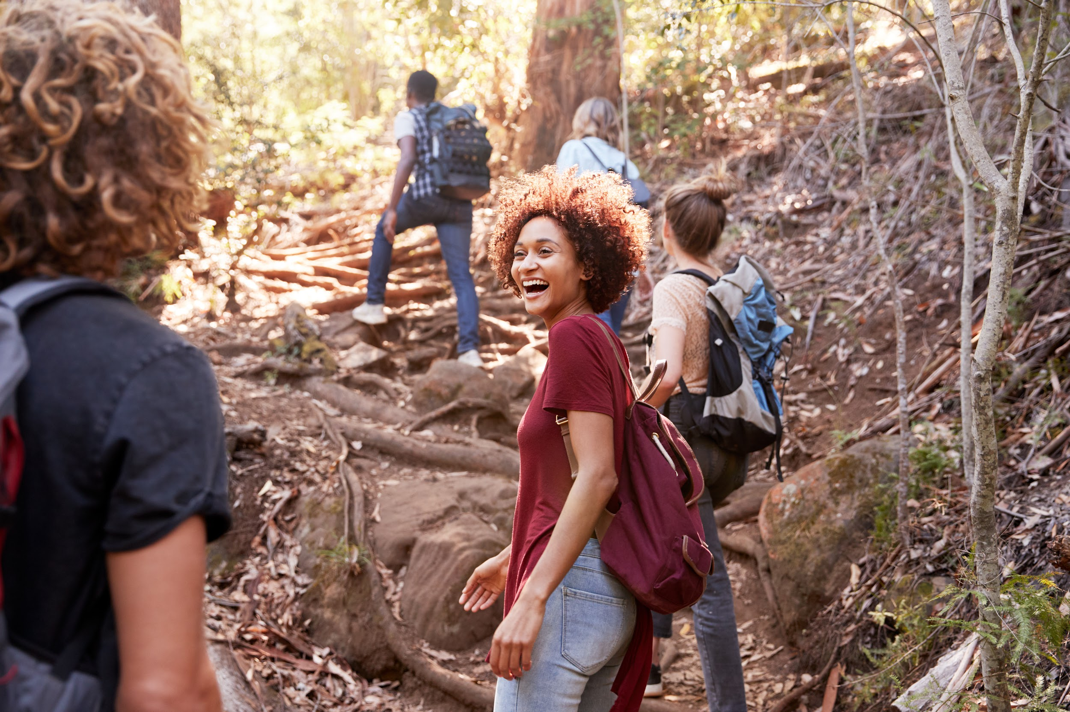


challenge:
Using film for impact

Slide 10
Bonus Slides

Slide 11
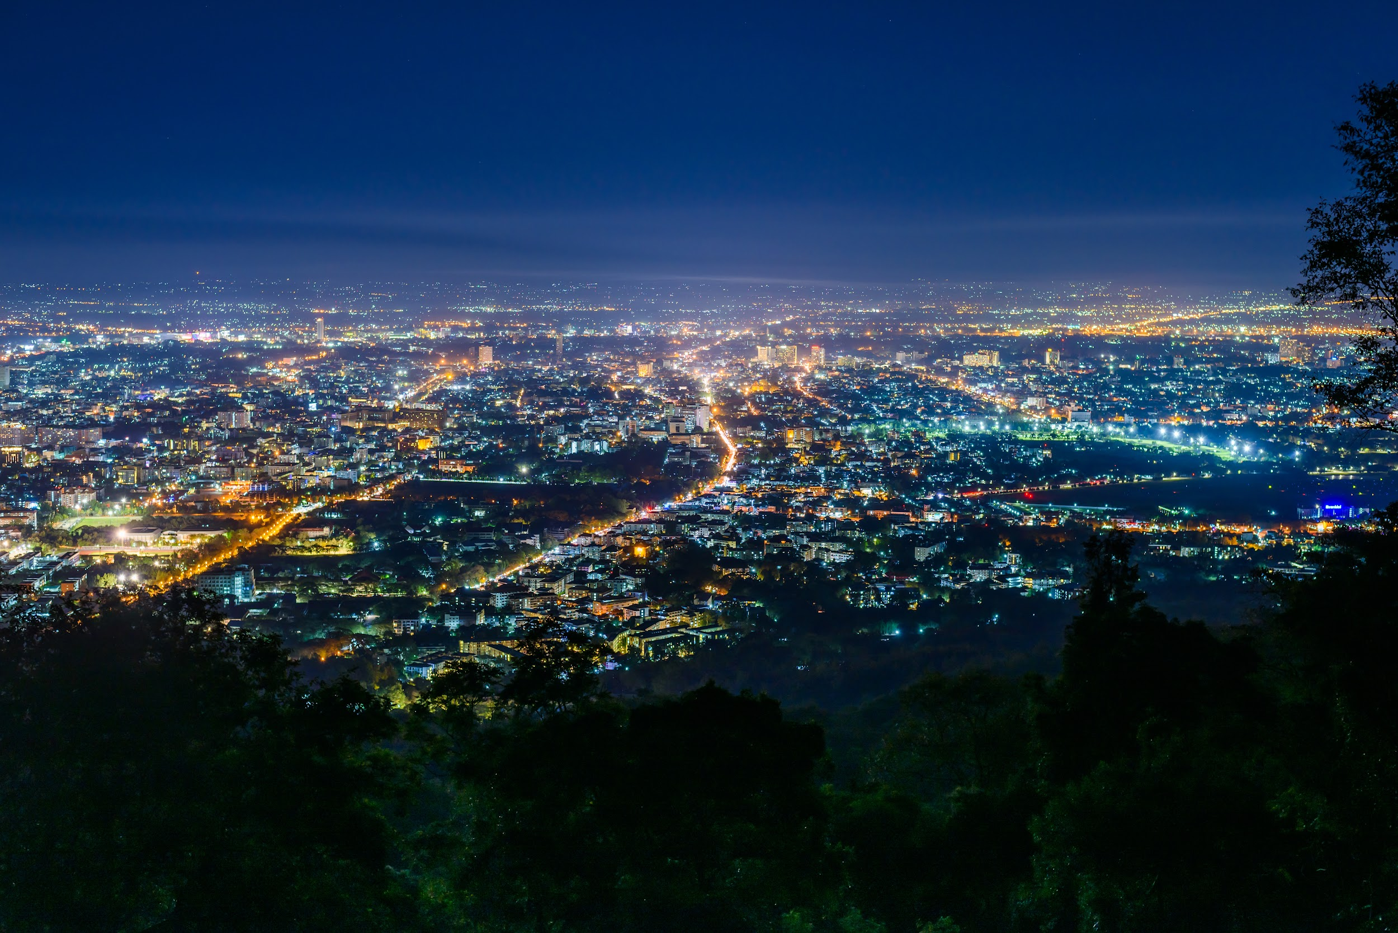
Light Pollution 101

Slide 12
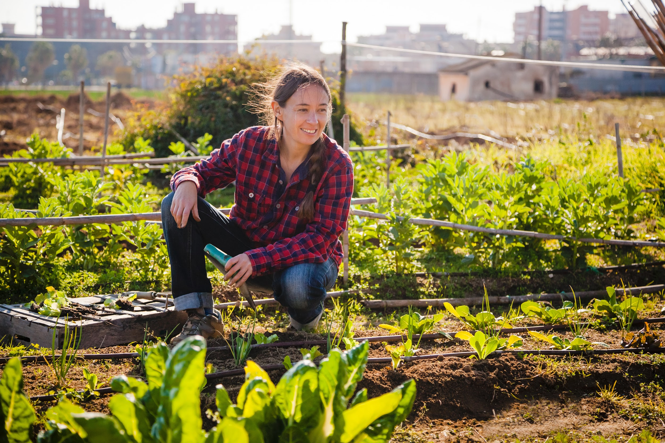
Rising Community:
Vic Barrett
Notes:
https://youtu.be/U6FU1PXqMGY

