Slide 1


Slide 2

ch.7
Advocacy & Food Justice

Slide 3
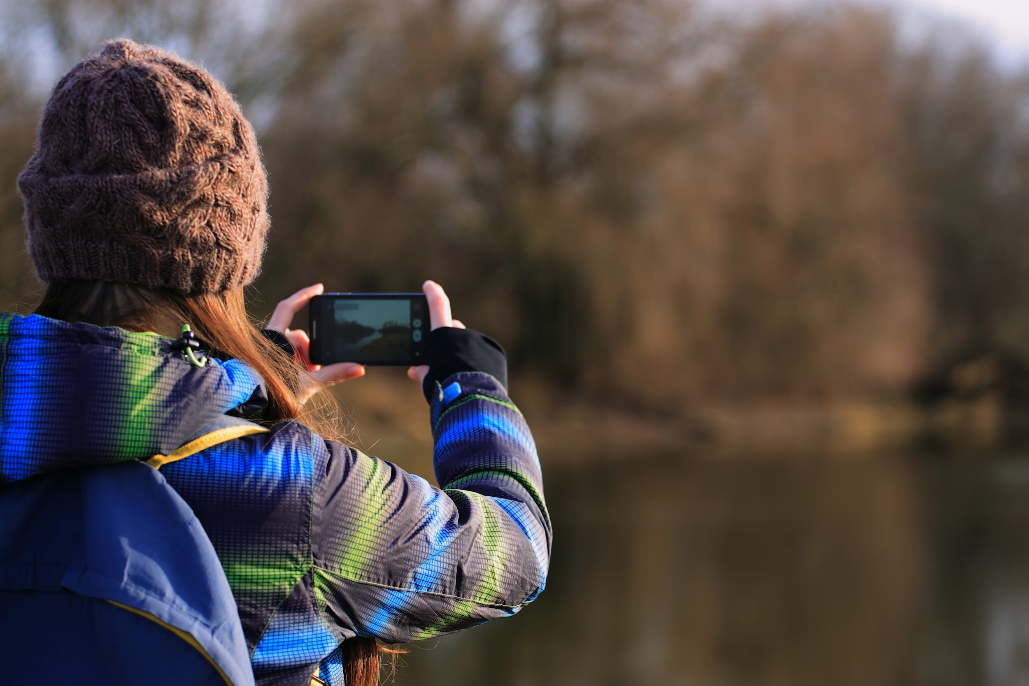

What is “advocacy”?
How is it done?
What does story /narrative have to do with it?
Greenswell & Divest
Notes:
(Merriam-Webster Dictionary: the act or process of supporting a cause or proposal; the act or process of advocating for something)

Slide 4
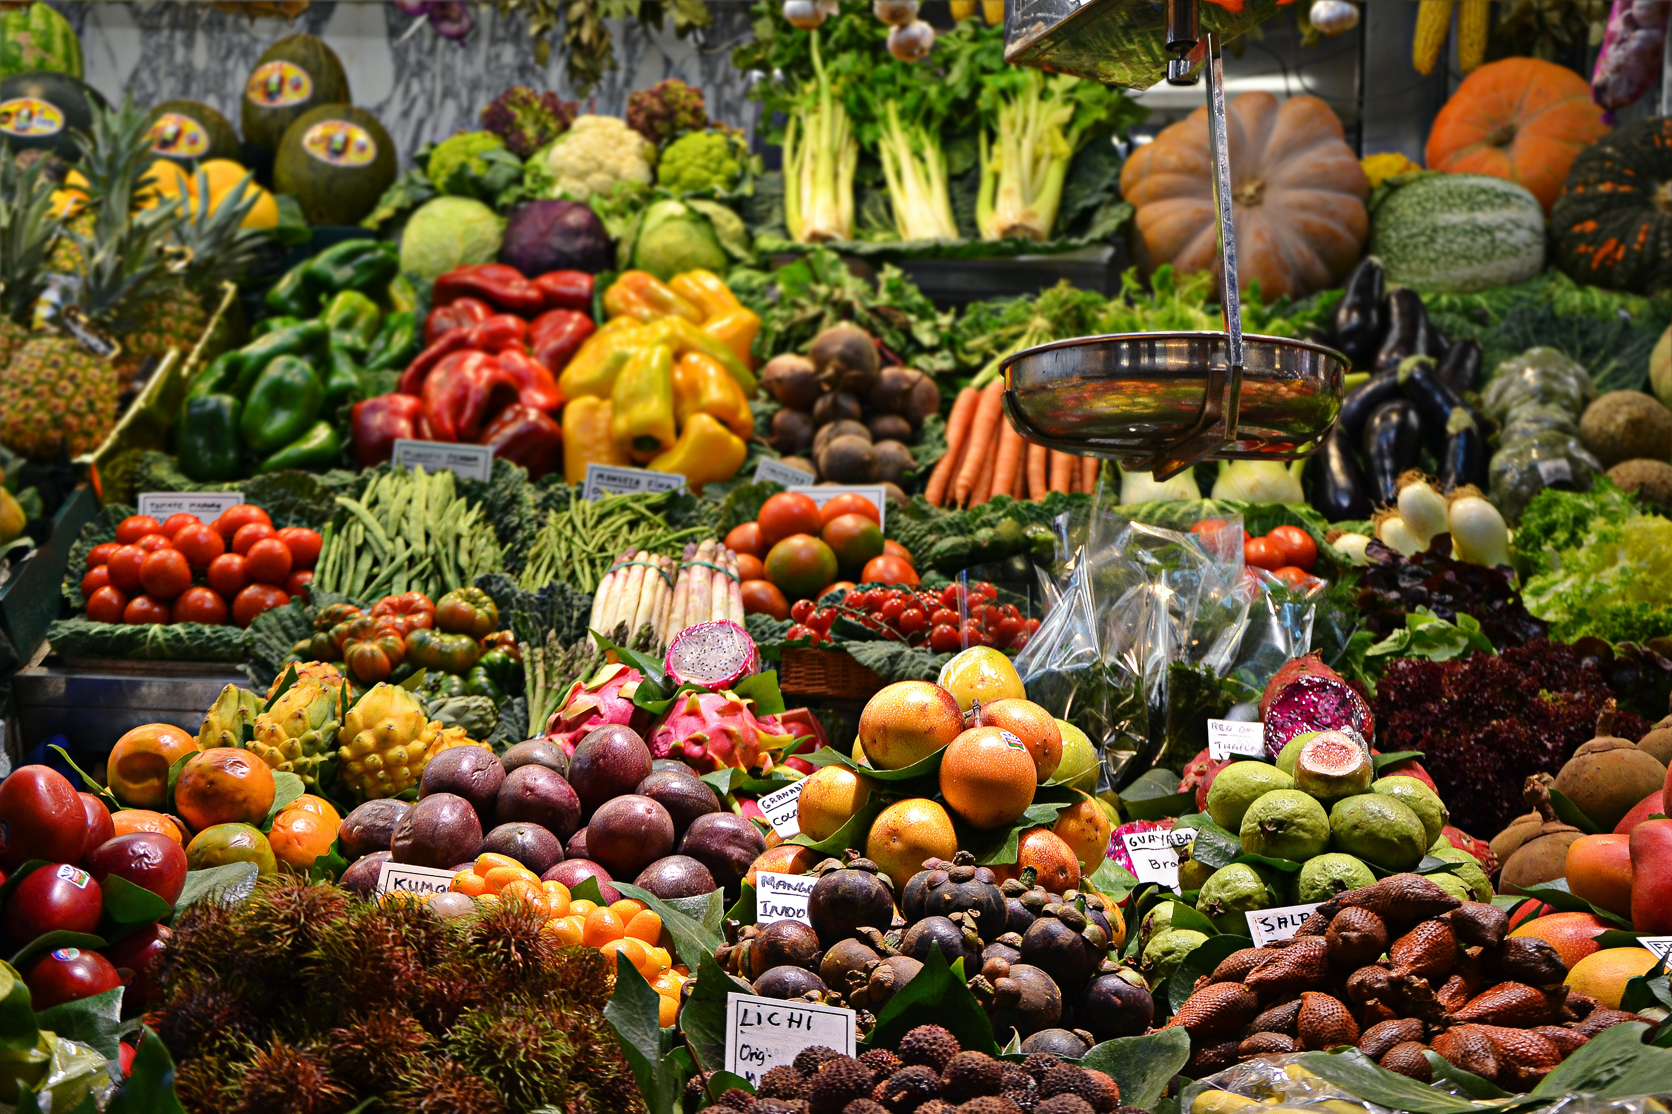
Food Justice Advocacy
What is Food Justice?
Food for the Rest of Us

Slide 5
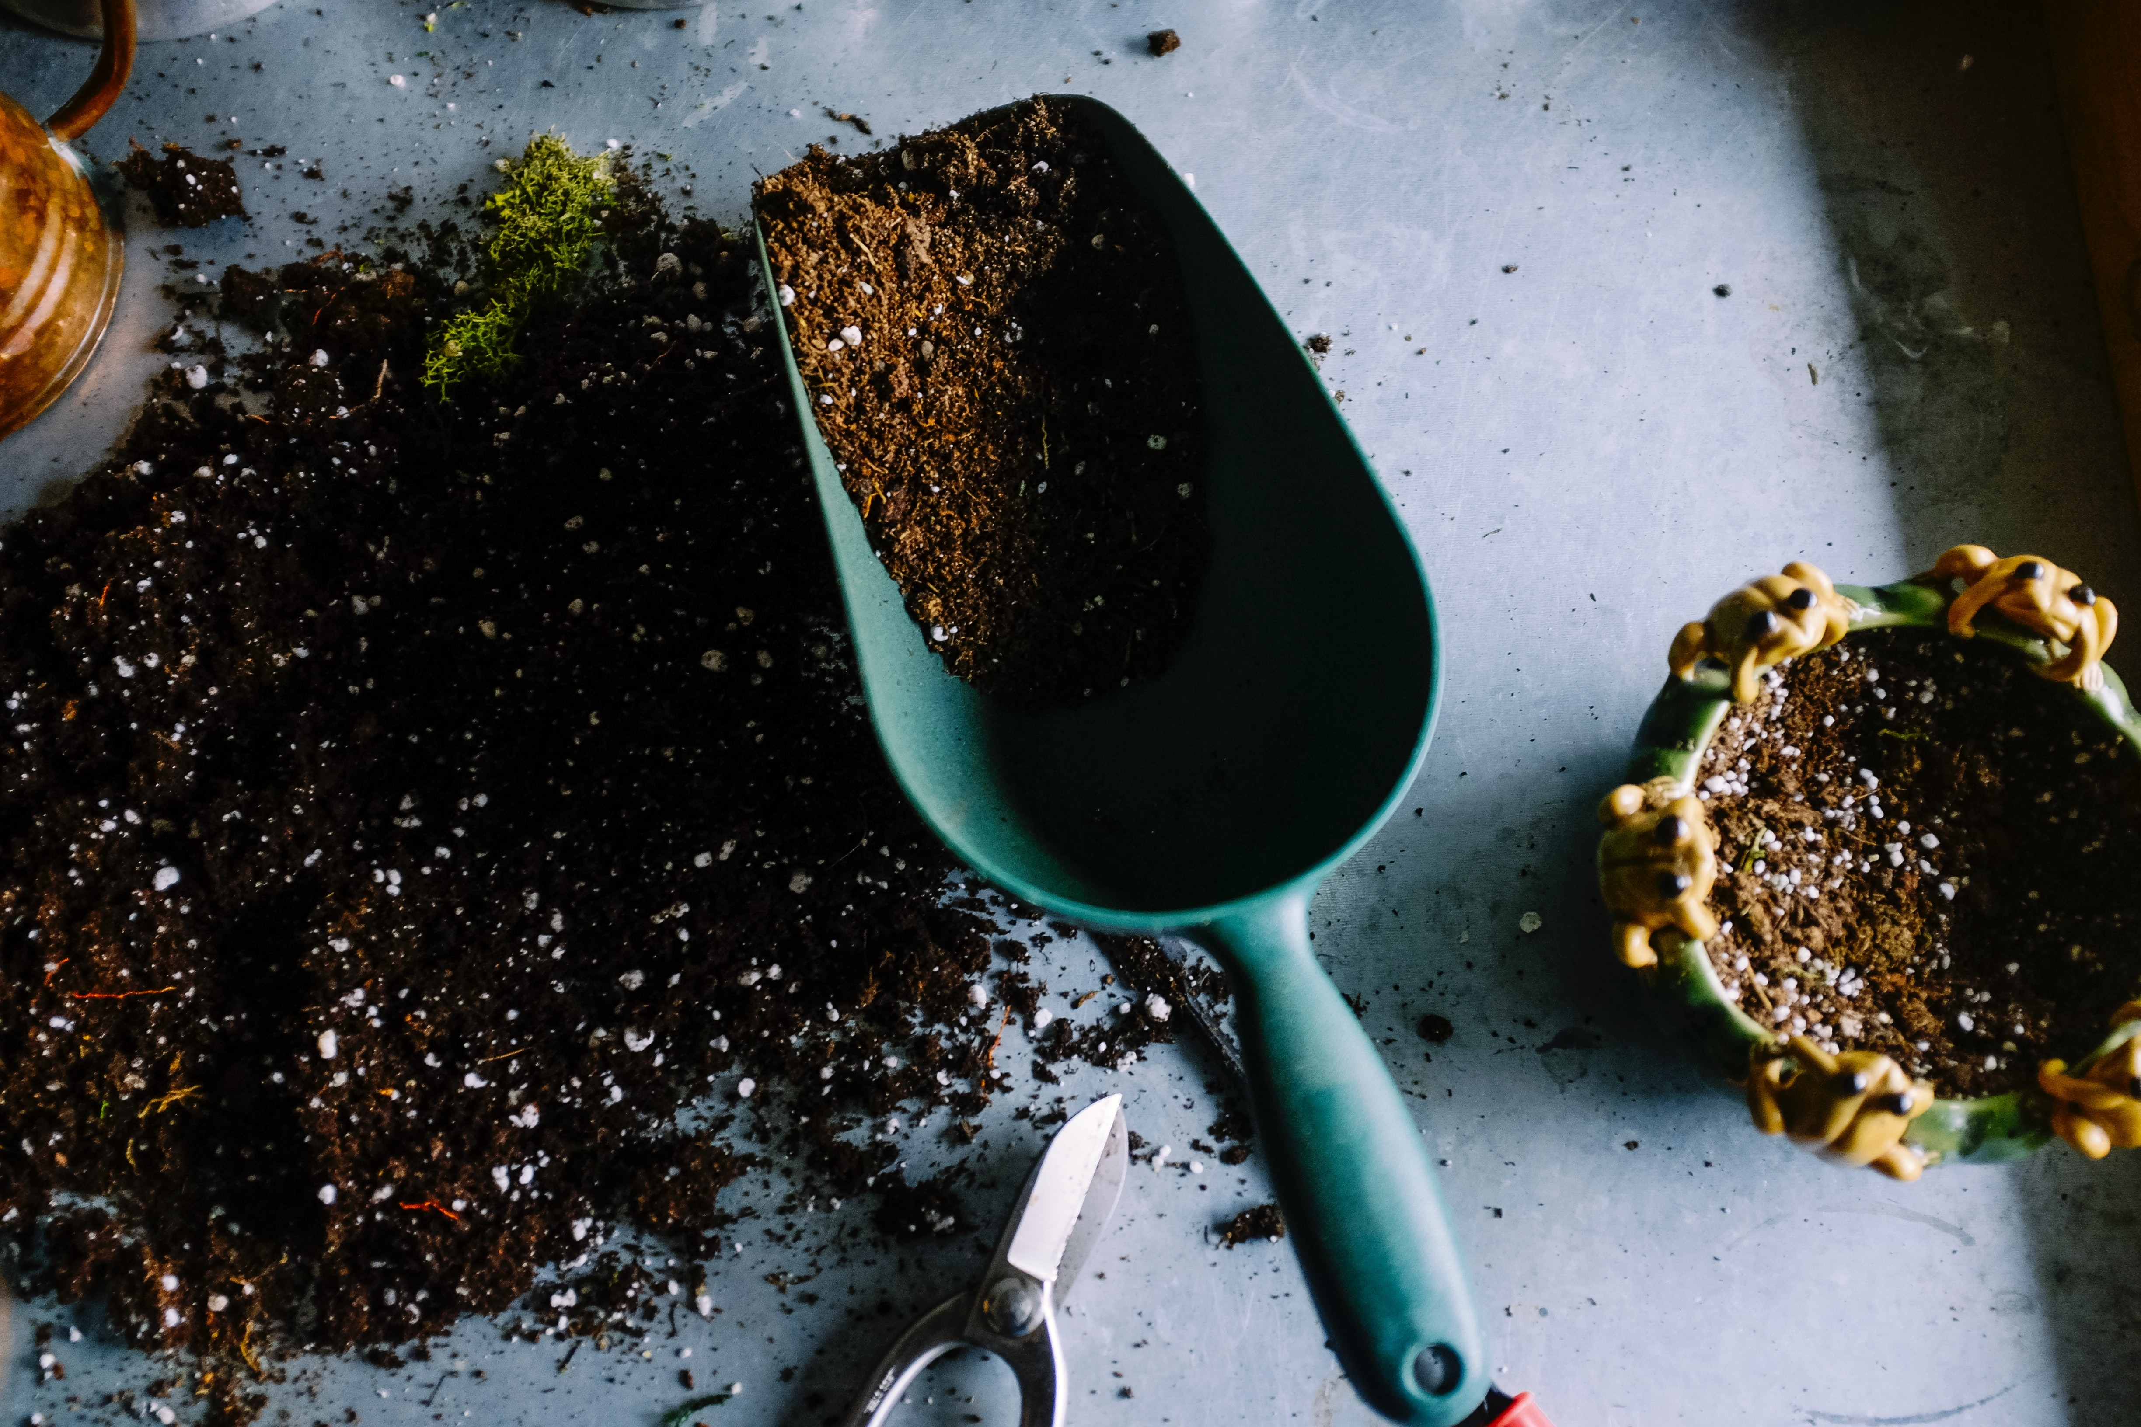
The Compost Story
Soil Solutions

Slide 6
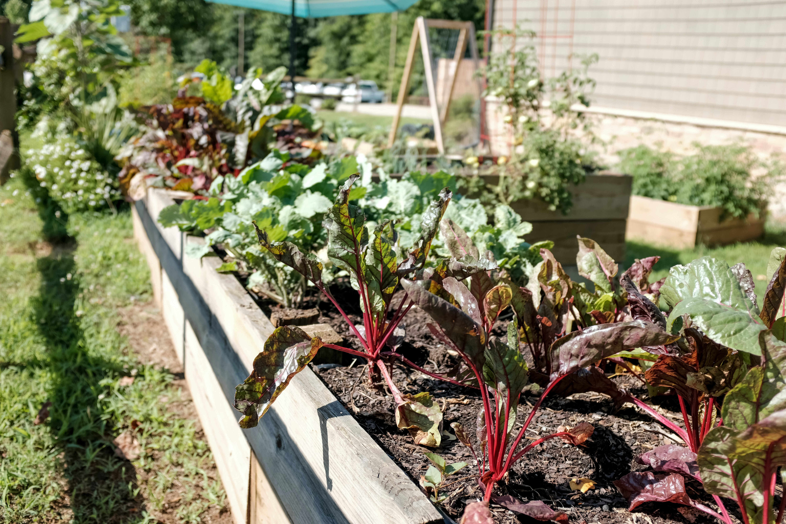
Environmentalism in my Garden

Slide 7
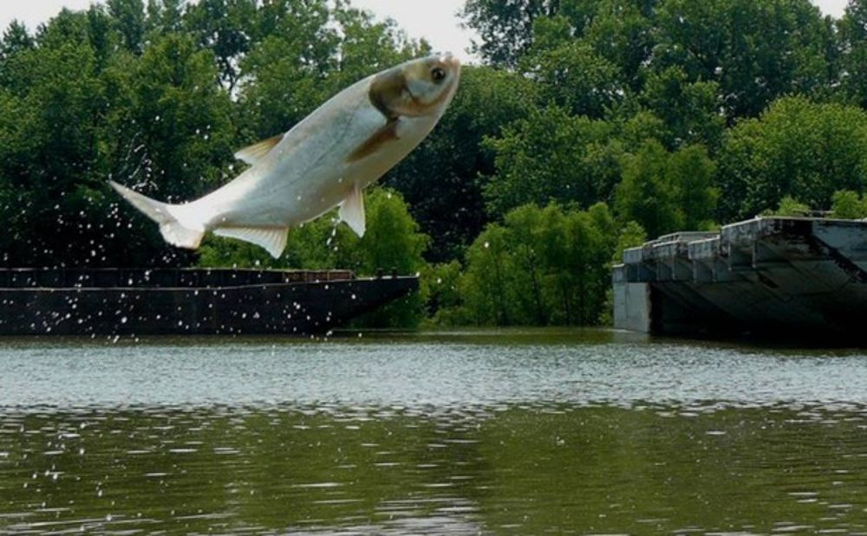
Invasive Carp of Kentucky

Slide 8



challenge:
Using sound to tell a story
Notes:
Challenge: After conducting some initial research, create a short one-page outline of the film you would make, and include the following:
What is the issue at the heart of your story?
Who is involved – Who is impacted? Who are the decision-makers? Who is actively participating?
Whose point of view/voices would you include in this story? How (interview, submit a quote, narrator)?
What shots/images would you want to collect to help you tell this story?
Who would your intended audience be for this film?
What action(s) would you want your audience to take after viewing your film?

