Slide 1


Slide 2
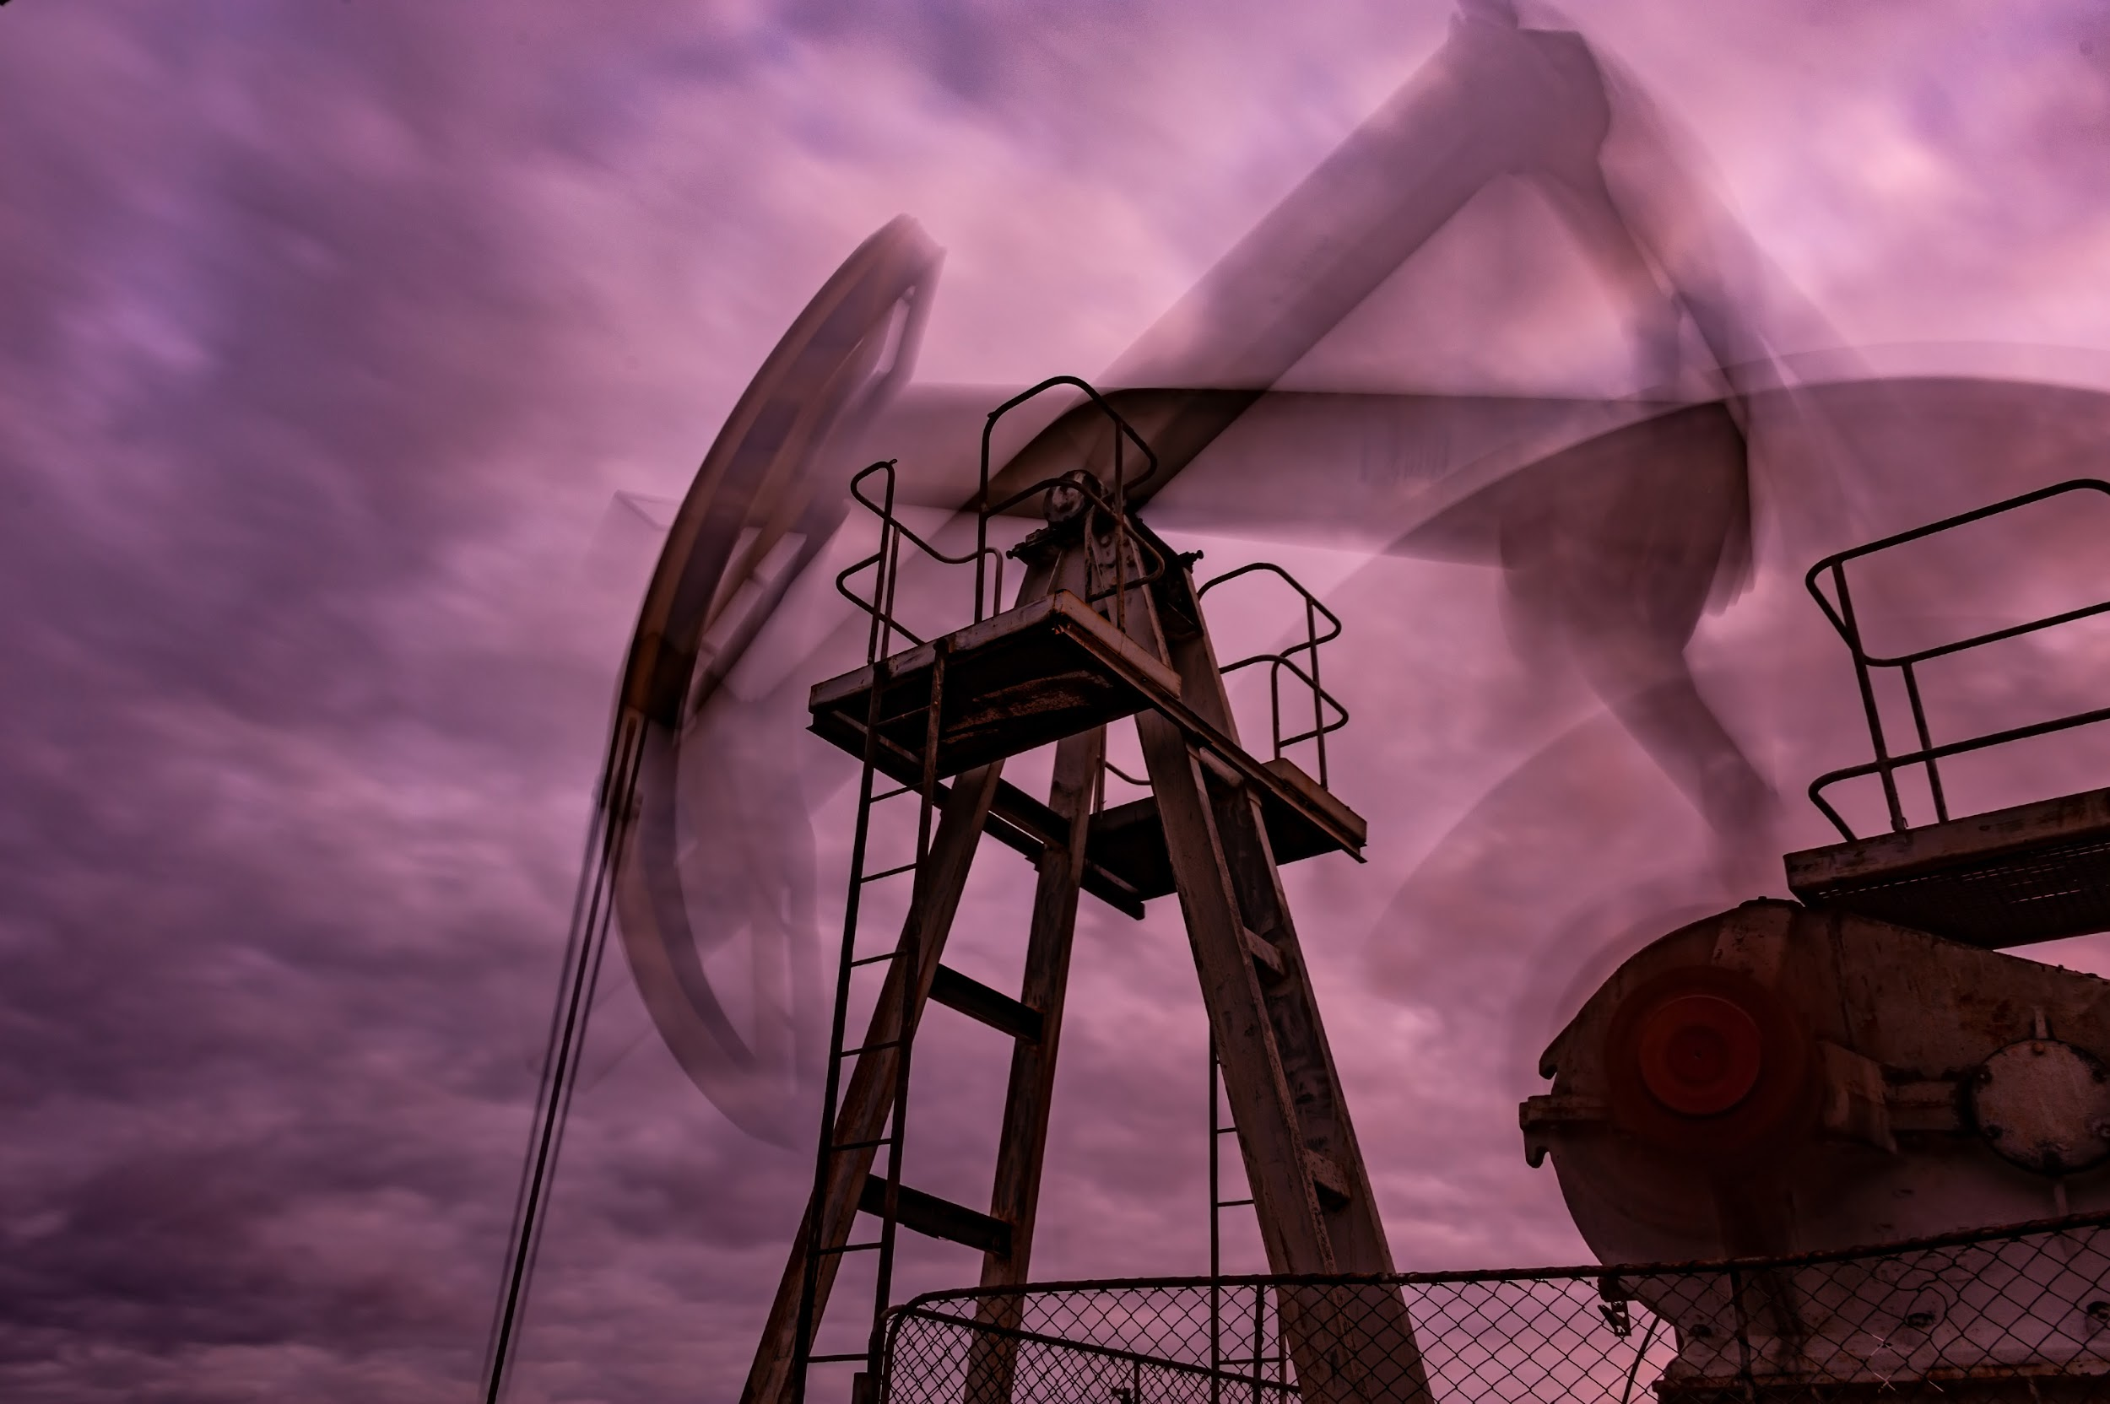
ch.6
Energy

Slide 3

What is “energy”?
Notes:
Scientists describe energy as the ability of a body or system to do work. Energy is all around us and is constantly changing. When you feel the warmth of the sun on your back, you’re enjoying the heat energy from the sun. When you cook over a campfire, you’re using heat energy converted from the stored energy in the wood you’re burning. There is energy in the food that we eat. This energy comes from plants that absorbed, converted and used the energy from the sun. And there is the energy we use making electricity...

Slide 4

Where does electricity come from?
Why does it matter?

Slide 5
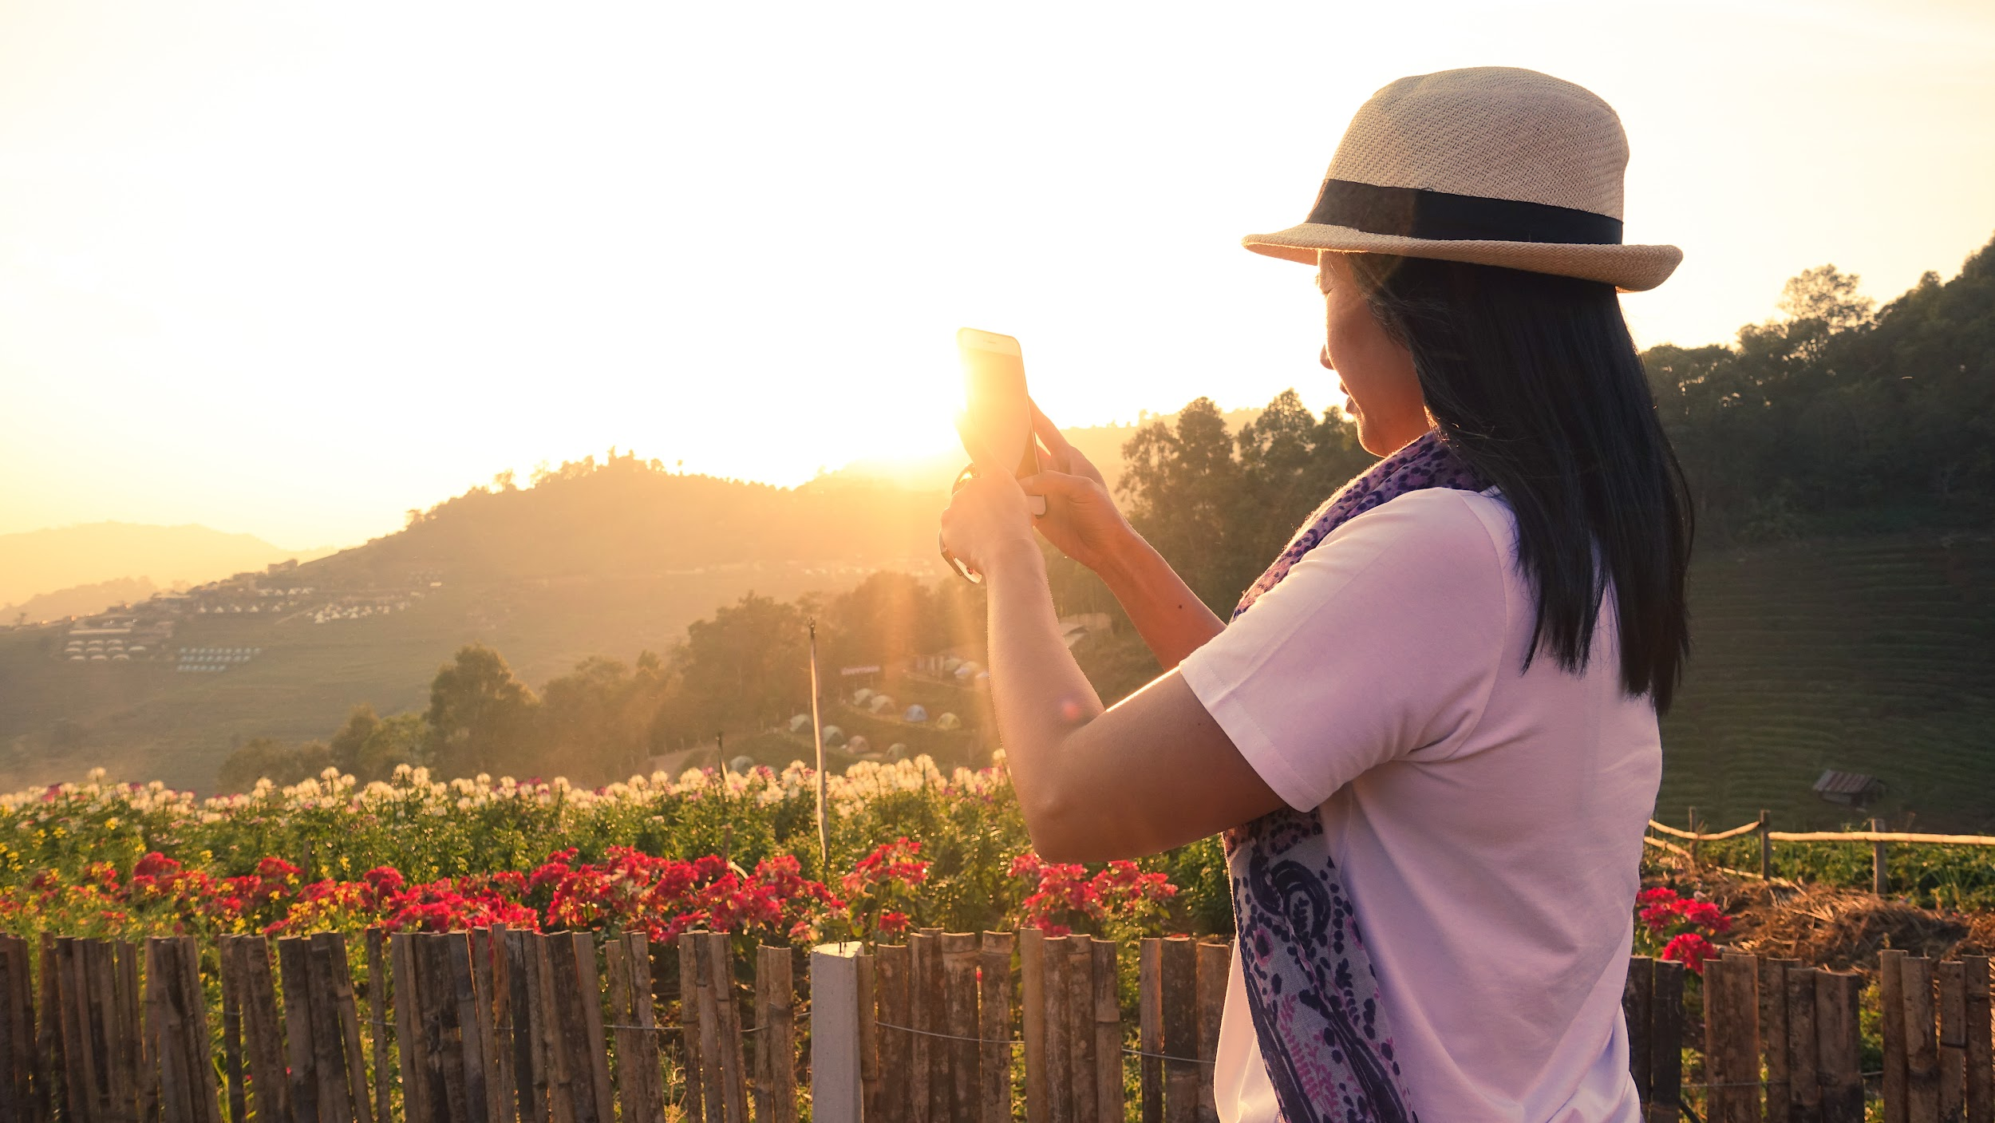

A Guide to the
Energy of the Earth

Slide 6
What About Energy Use?
Energy consumption in the U.S. is ______ every 20 years!
The U.S. uses around _____ of the world’s energy, yet only holds about 5% of the world’s population.
K-12 schools in the U.S. spend more than 6 ____ dollars on energy use.
It’s estimated that the U.S. spends more than $300 billion a year on energy that goes to drafty doors and windows, inefficient appliances or other energy _______ that could be easily remedied.
Currently, non-renewable fuels (which include coal, oil, and natural gas) supply about ______ percent of the world’s energy.
Decomposing plants and other organisms, buried beneath layers of sediment and rock, have taken millennia to become the carbon-rich deposits we now call ________.
Notes:
Doubling
25%
Billion
Wasters
80%
Fossil fuels

Slide 7

Fossil fuels and plastic?
Fossil fuels not only power our lives, producing electricity and heat, and powering engines, over 99% of plastic is made of chemicals from fossil fuels, found in the Earth–the fossil fuel and plastic industries are connected.
Bottle, Bottle
Notes:
What stood out to you in this video?
How was the story of the spoon told (where did it begin/end)? Was it effective?
What about the story of a plastic bottle (where would it begin/end)?
Who would/could tell this story?
What about the story of a plastic bag (where would it begin/end)?
How could this story be told without words?
For whom is it easy to find and purchase a metal spoon? For whom is it not?
Why might you have to rely more on “single-use” plastics?
* Additional extension: What Really Happens to the Plastic You Throw Away
* Additional extension: Where Your Recycled Plastic Ends Up (from the film, The Story of Plastic)

Slide 8

“I was more than a decade into being an environmental activist when I saw it: energy. It was everywhere. In the fuel for our cars, in the fertilizer in our food, in the plastics at the grocery store, in the electricity lighting our homes. We were relying on fossil fuels for everything.
Once I learned to see them, I could find fossil fuels wherever I looked. And it wasn’t hard to see their harms either: coal, oil, and gas make people pick, pump pollution into our air and water, and push up carbon concentrations in our atmosphere, driving dangerous weather.” ….. And the impact on communities is not the same.”
– Dr. Leah Cardamore Stokes

Slide 9
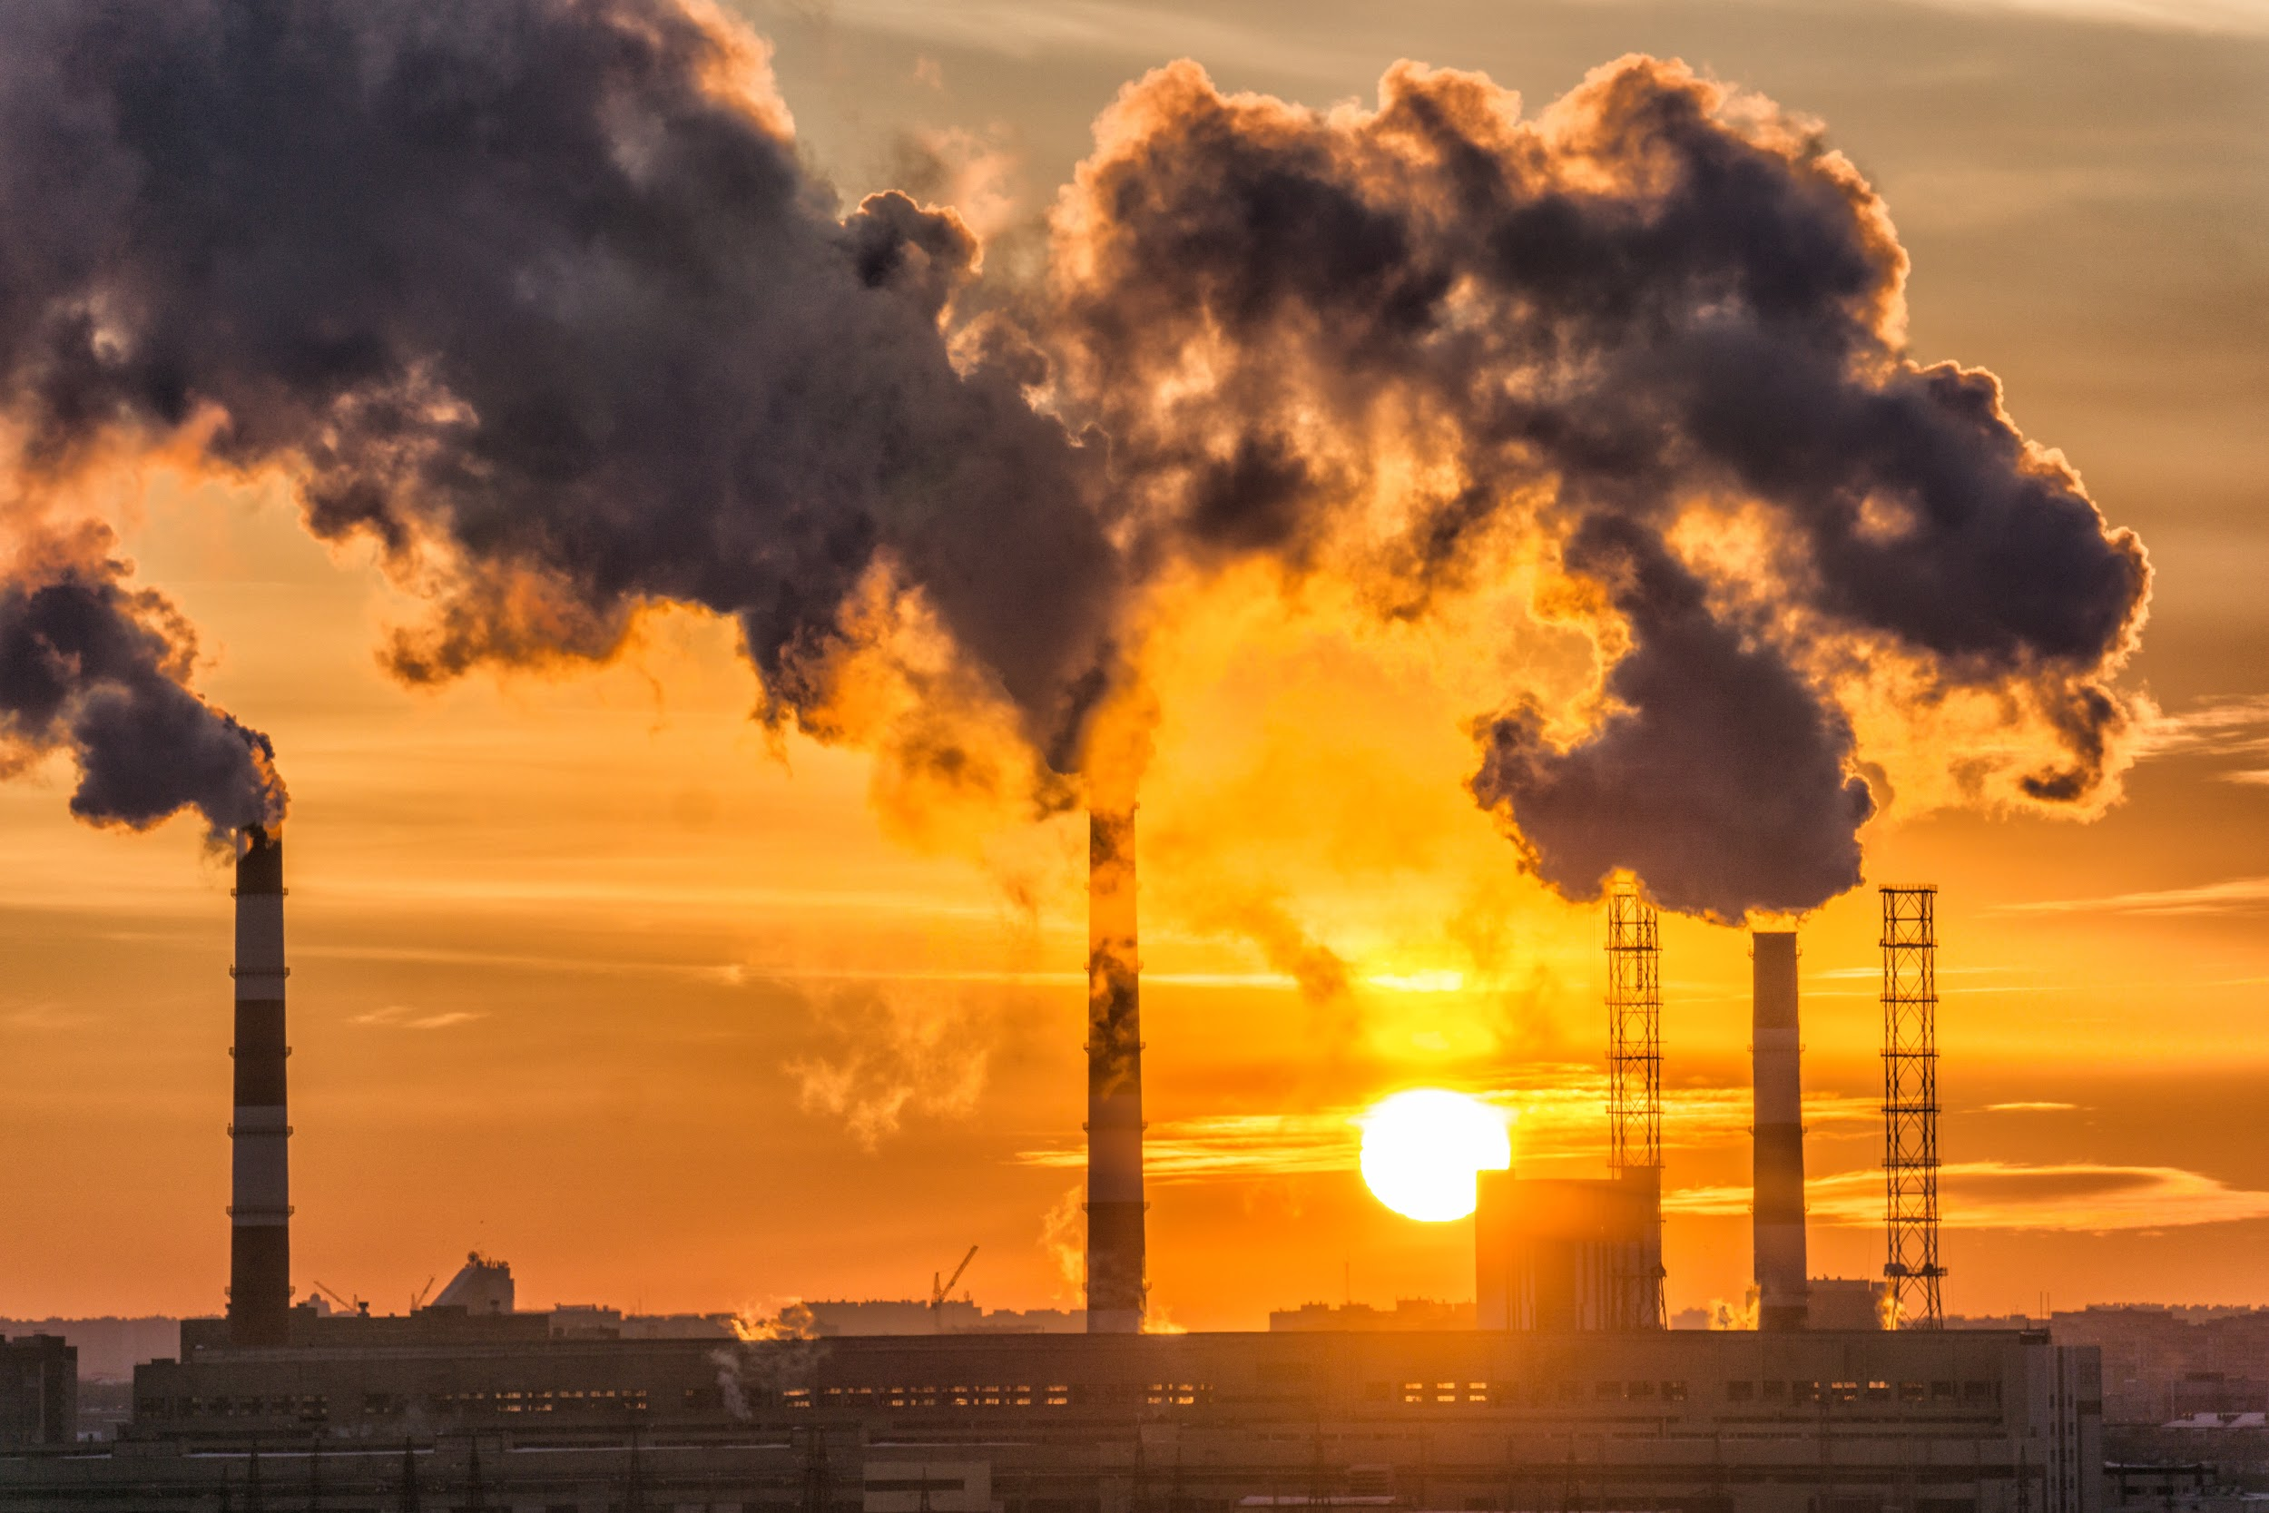
Environmental Justice, explained
Notes:
It is increasingly understood and recognized that pollution and climate change negatively affect people’s health and quality of life around the world. But what is not as frequently talked about or made clear is which people and communities are most exposed and impacted, and why.
How did this video make you feel?
What information stayed with you, if anything? Or was it something different that most affected you?
What questions are you left with?
Have you heard the term “differential impact”?
What do you think are some of the underlying reasons for the differences in impact?
How might/can thinking about “differential impact” change how we talk about, research, create solutions?

Slide 10

What solutions exist?
That protect + support all people and communities?
Notes:
As a possible extension, student might conduct their own research on energy use (past, present, future) and the role and history of government policy with respect to energy.
They also and might try this game in envisioning solutions: HERE.

Slide 11


Community Power Arizona
Notes:
https://happeningthemovie.com

Slide 12
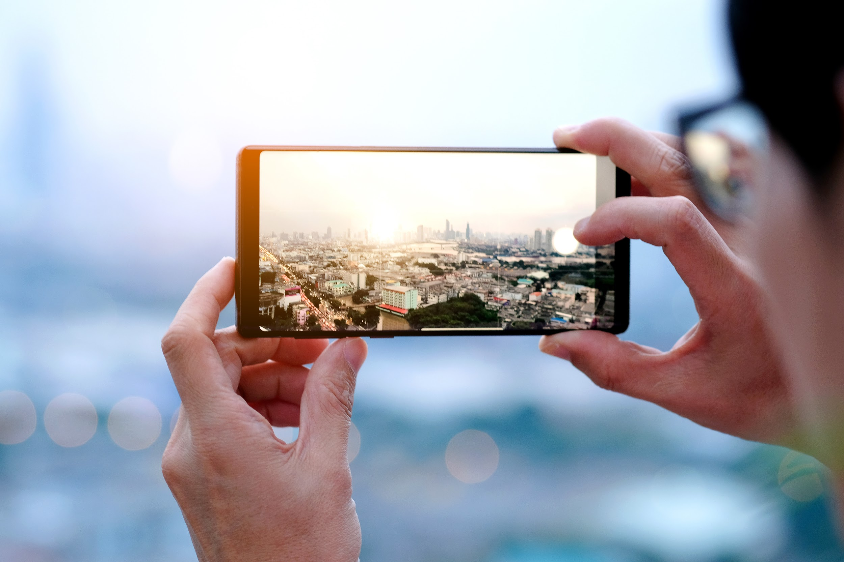


challenge:
Visual Communication

