Slide 1


Slide 2
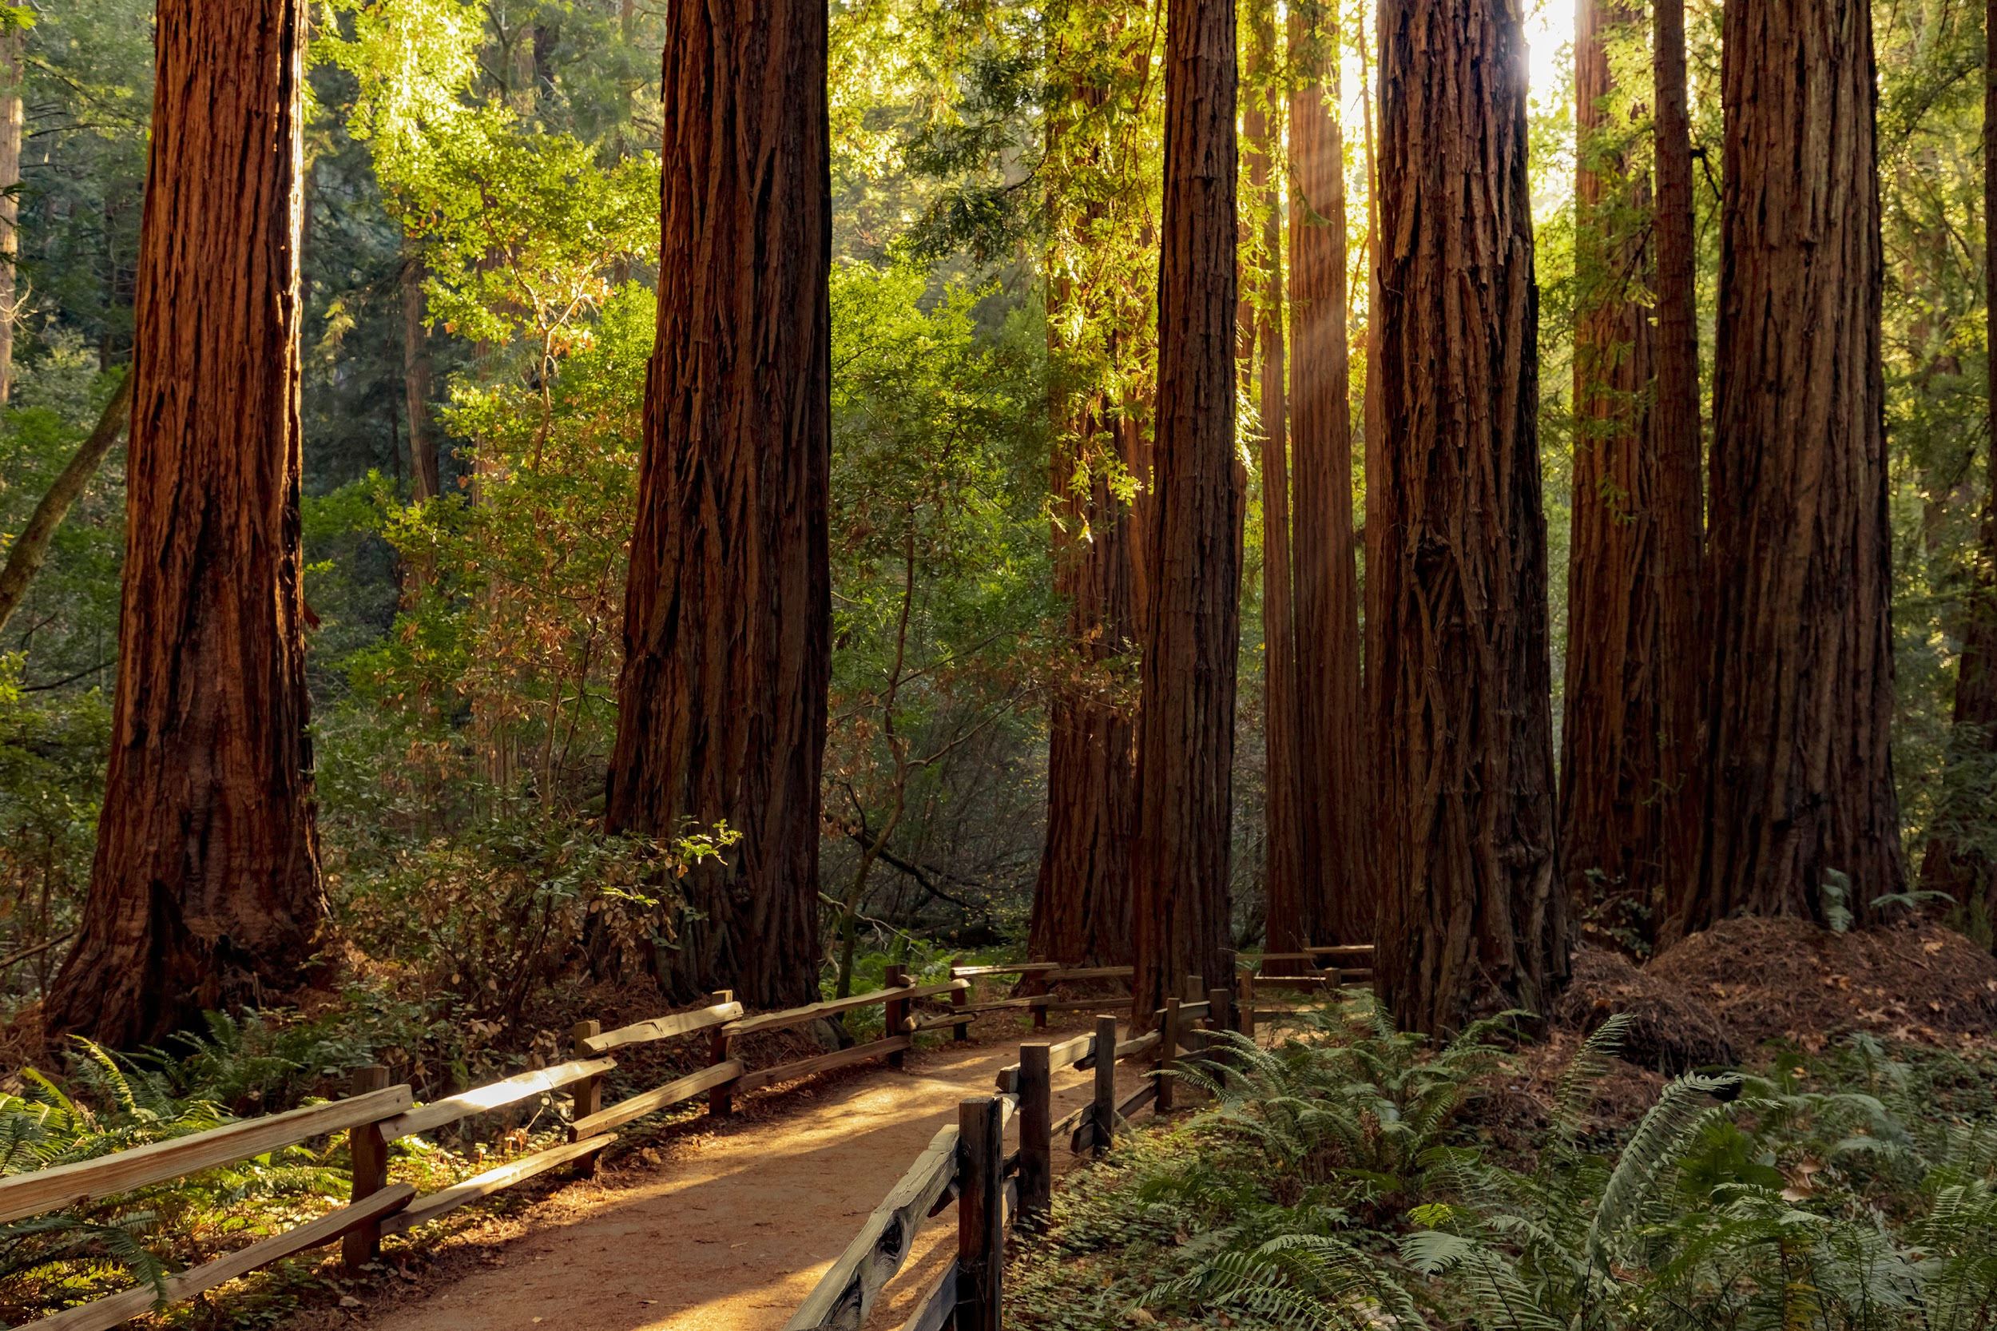
ch.5
shared lands & tuning to the trees
life and reciprocity: part 3

Slide 3
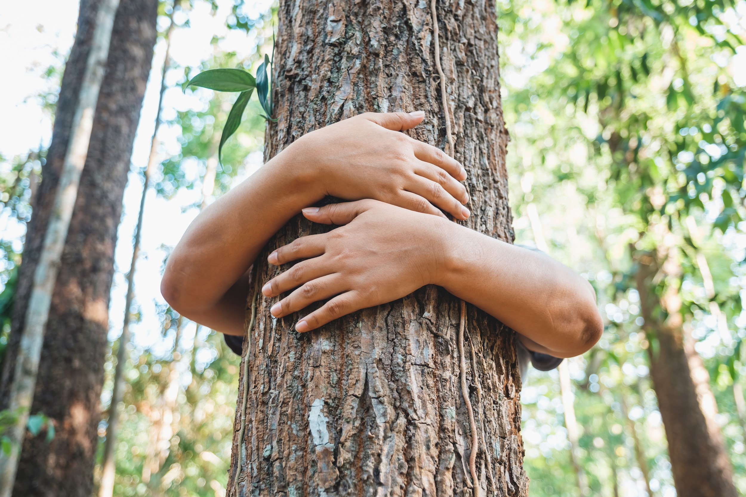
Tell a story about a tree
Notes:
Where you live, is it easy to spend time near the trees?
Is it something you notice or think about very often?
What species of tree are “native” to your neighborhood, city, county, state?
What does “native” mean referring to a tree, plant, or animal?
How can you find out what species are native to your area, and why does it matter?
What is it, or would it be like, to live in a community with very few trees or plants?
Why might there be few trees or plants growing in a community?

Slide 4
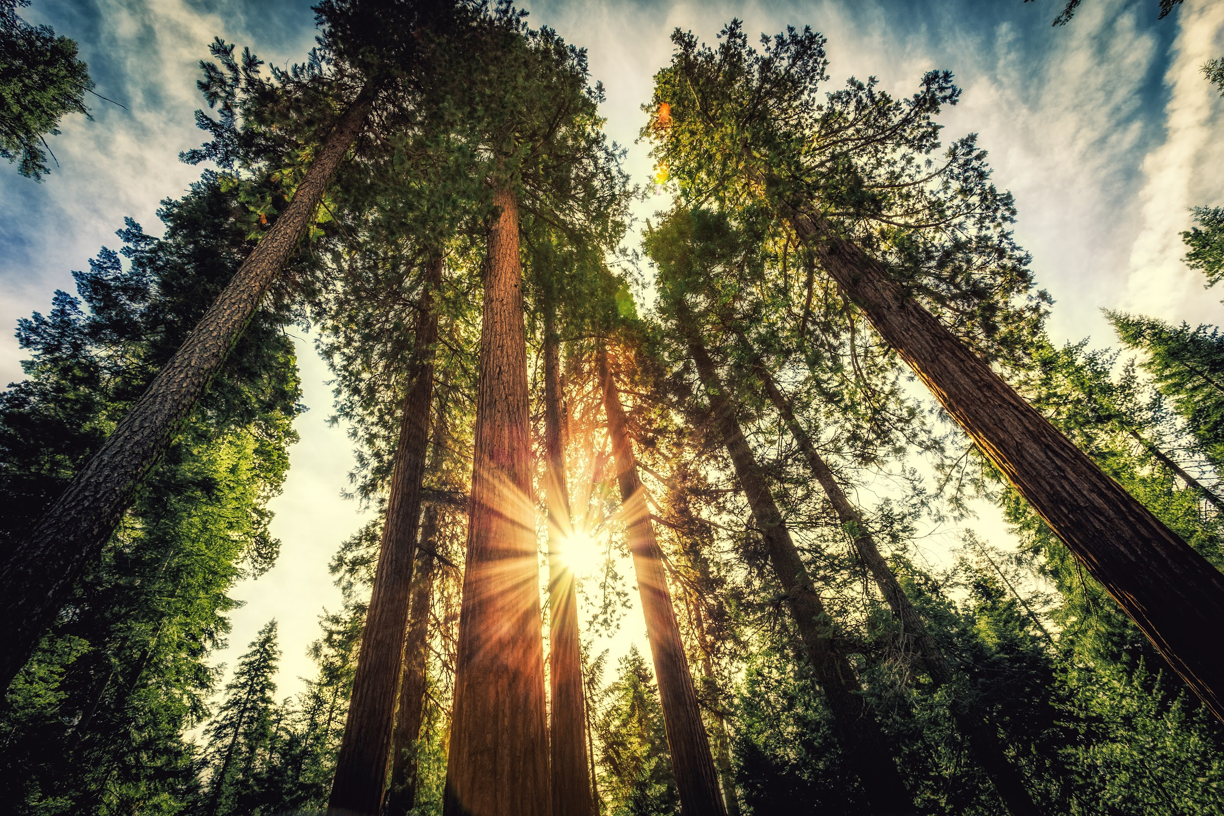

Giants Rising
Notes:
https://vimeo.com/452766180

Slide 5
What’s happening with trees….?
In the last few decades, _______ have become more severe and drawn out, snapping even sturdy trees under water stress.
Forest ______ are burning hotter and more erratically, jumping canyons and lines faster than they can be contained.
Bark _______ infestations in the Sierra Nevada have claimed the lives of millions of ponderosa, lodgepole, Jeffrey, and sugar pines, turning mountains into ghostlands.
Urban forests in such iconic tree cities as Portland, Oregon, are losing ground to rapid development, creating heat islands from reduced _______.
Today’s levels of greenhouse gases are the highest in forest _______.
As forest cover shrinks due to agriculture, timber cutting, and urban development, forest species are _________ all over the world.
Notes:
This can also be done as a Kahoot HERE
From Stephanie Kaza, Conversations with Trees, x-xii.
Answers:
droughts
fires
beetle
Shade
history
Disappearing

Slide 6
At the same time, scientists are newly coming to understand the ________ life of trees.
The reports of tree communication via symbiotic fungi and complex root networks has given scientific support to something many people have long sensed: Trees _______ to each other!
Trees function as ________ more than as individuals.
Often identified as elders of the Earth, some trees live for thousands of years. One of the oldest trees on Earth, a spruce in Sweden, is more than _______ years old.
As logging threatened Northern California in the 1960s, the discovery of the world’s tallest tree sped up the call for federal protection, and ______ National Park was officially established on October 2, 1968. (*Bonus: How tall is the world’s tallest tree?)
Notes:
This can also be done as a Kahoot HERE
From Stephanie Kaza, Conversations with Trees, x-xii.
hidden
talk
communities
9,500
Redwood National Park (379.7 feet)
* You might also watch TED-Ed: What if there were 1 trillion more trees?

Slide 7
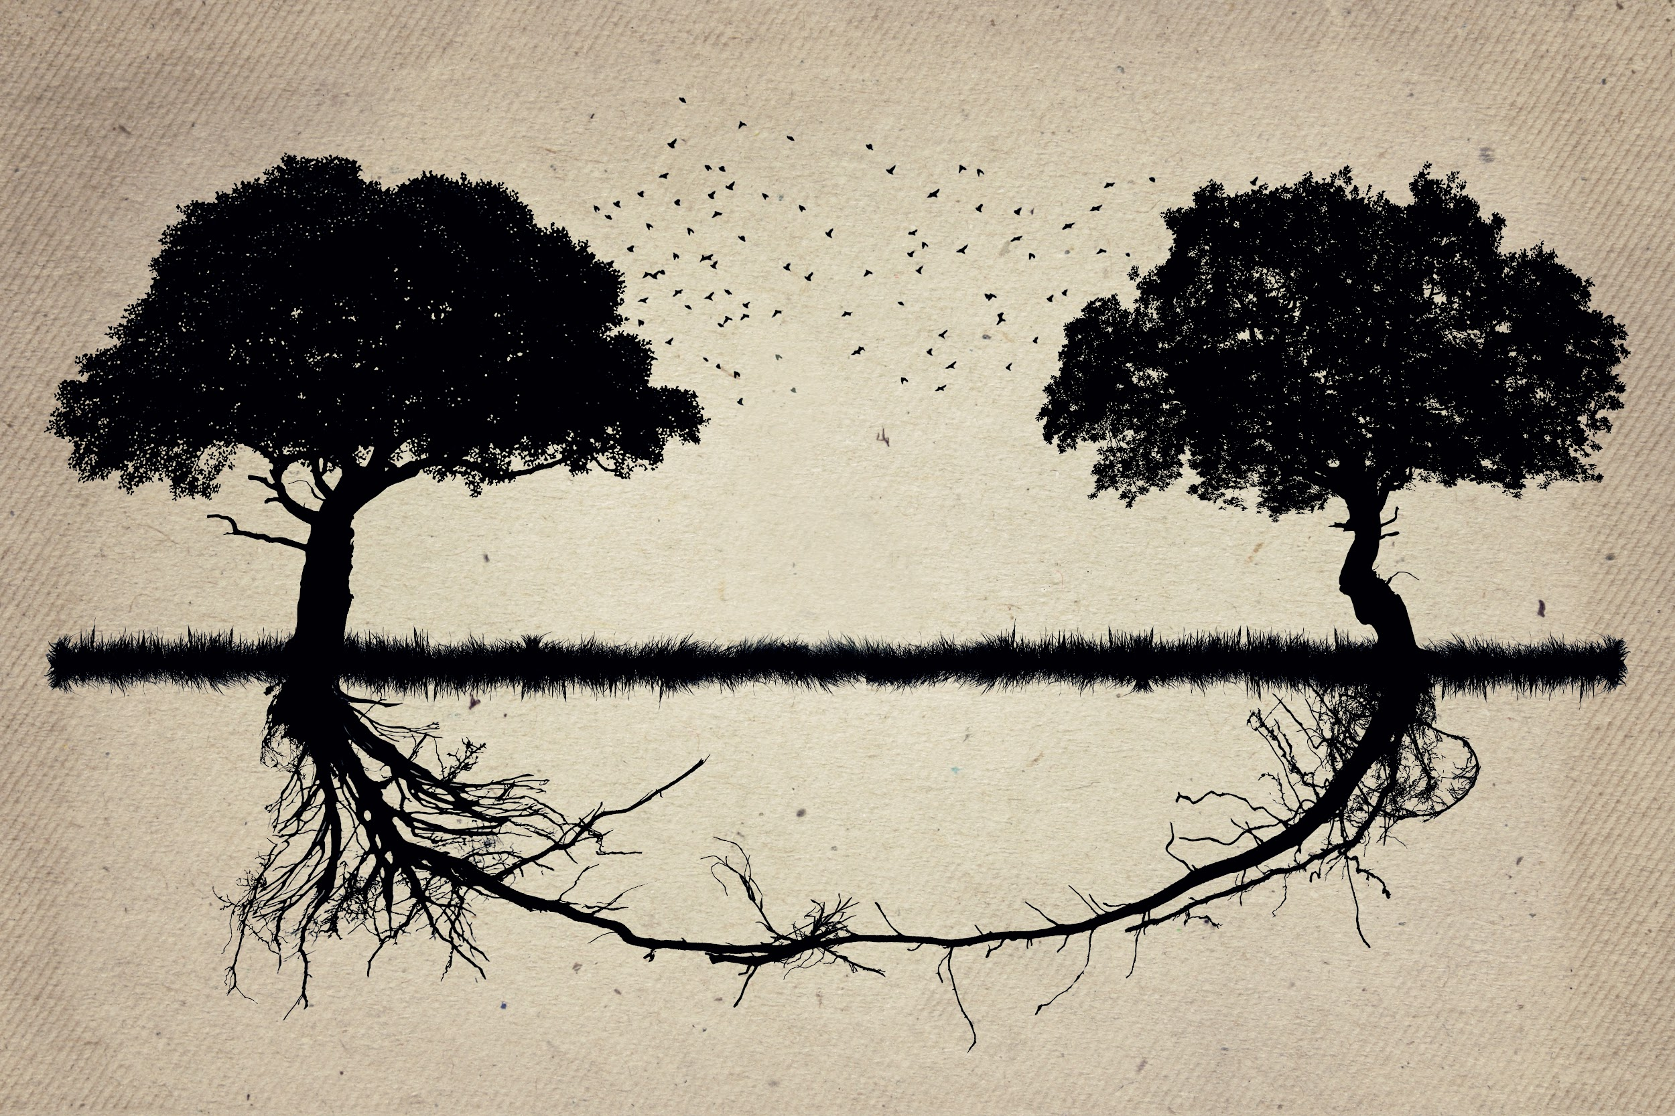
Intelligent Trees
What can we learn from the trees?
Notes:
https://youtu.be/3HPgqqdcQXA

Slide 8
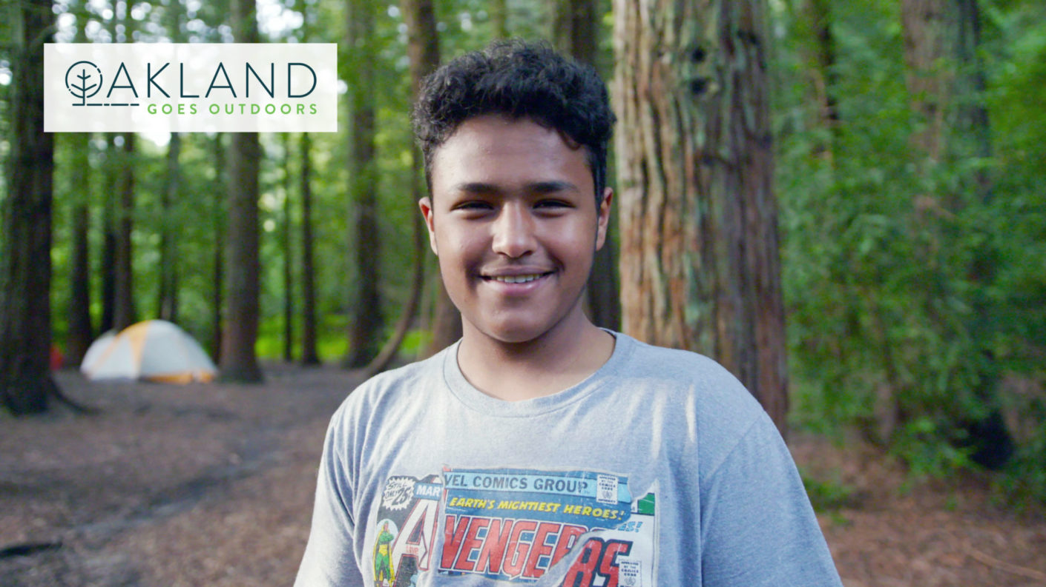
Notes:
Oakland Goes Outdoors - 4 minute cut (linked on slide): https://vimeo.com/489031570
Oakland Goes Outdoors - 15 minute cut: https://vimeo.com/488686732

Slide 9
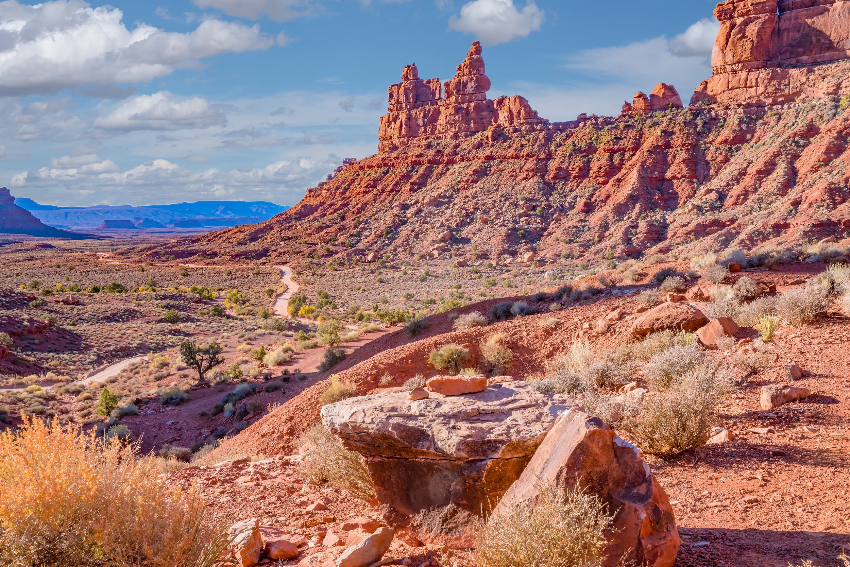
“I appreciate that during this time - a pandemic - that people are posting that ‘nature is still open’. That includes an implicit invitation that certain areas are for everyone, but when you come from communities that were historically not allowed, it’s not that simple.”
– Faith E. Briggs, This Land

Slide 10
This Land
Notes:
https://drive.google.com/file/d/1AgzR8lcTOoziSQBuUW2QgnR5ooGuLb0n/view?usp=sharing
(Alternative way to access the clean edit of This Land: HERE)
What feeling are you left with in watching this film?
What most surprised you in the story told here, or the journey Faith Briggs takes?
How does Faith Briggs say she experiences her connection to the Earth most of her life?
What actions does she take to change/deepen her experience? Why?
How does Faith Briggs take action around something she cares about?
What would you say is the relationship between felt connection, care and “conservation”?
How does the story Faith Briggs tells help to draw out the connections between human beings and nature, between caring for the environment and caring for people?

Slide 11
Backyard Birds
“I think for me, calling myself a ‘conservationist’ is definitely an act of reclamation. This is sort of a funny question, because I’ve never really looked up the textbook definition of the word! What it comes down to is that what I’m doing is also about protecting the environment - one way of many ways.”
– Faith E. Briggs, This Land
Notes:
(Frequent definition of conservationist: “a person who advocates or acts for the protection and preservation of the environment and wildlife.”)
How do you understand what it is to be a “conservationist”?
Why might Faith Briggs say that for her, ‘calling myself a ‘conservationist’ is definitely an act of redemption”?
Also see: “Five Ways to Make the Outdoors More Inclusive”

Slide 12



challenge:
Interview an elder
Notes:
Storycrafting, and creating change, is often about more deeply discovering your own values and voice. But it is also about listening and receiving a message. Choose an elder – a parent, grandparent, aunt/uncle, neighbor, or other–and invite them to speak with you, seeking to understand their experience and point of view. Decide on a time and way for connecting (phone, online, an email, a letter, etc.), and identify how you will record or take notes on the conversation (with the permission of the person you invite to speak with you). A few questions you might explore (and make your own):
What feeling do you get when you imagine a human community respectful of each individual, and also of the Earth? Have you seen example of this kind of respect in your life?
What in nature do you enjoy? Have you been able to access nature easily in your life? Has this changed in any way across your lifetime?
How might we create a world more characterized by ease of community, and by a spirit of welcoming, honoring and shared belonging?
* How does listening build community? (Maybe a question for yourself and/or for your interviewee)
* This interview could then be edited into a short film or film clip, used in the final film challenge, or turned into a written story, poem or journal reflection. You can also share them with The Stories Project anytime!

Slide 13
Bonus Slides

Slide 14
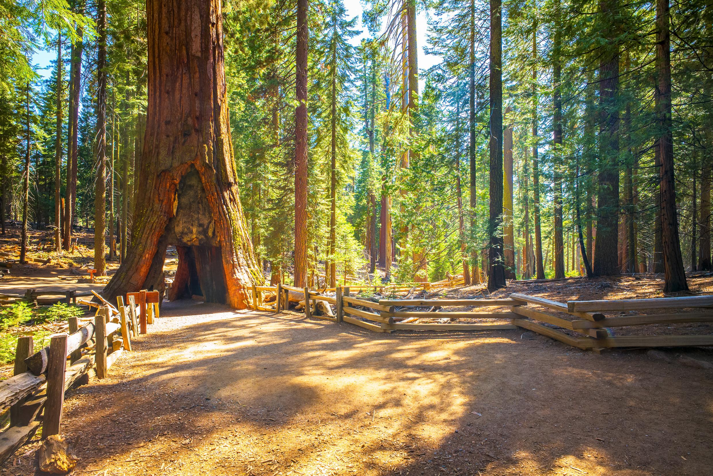
What is the story of National Parks?
Who can access them?

Slide 15
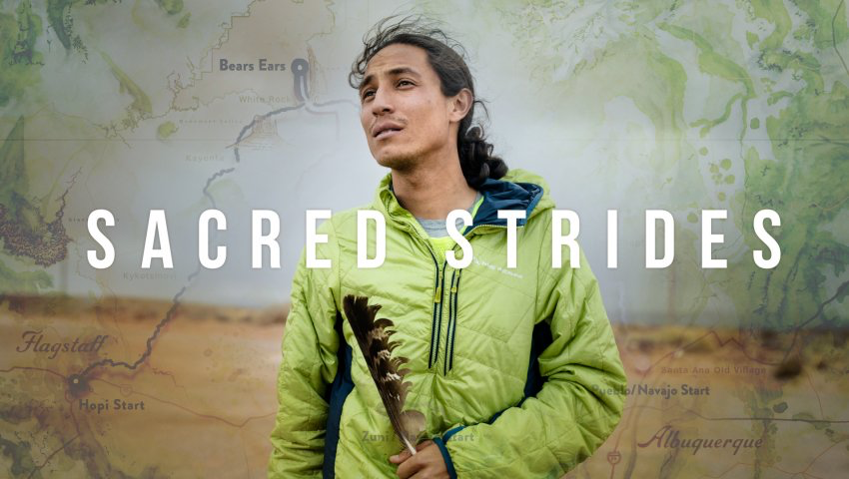
800 Miles with Bears Ears Prayer Runners

