Slide 1


Slide 2
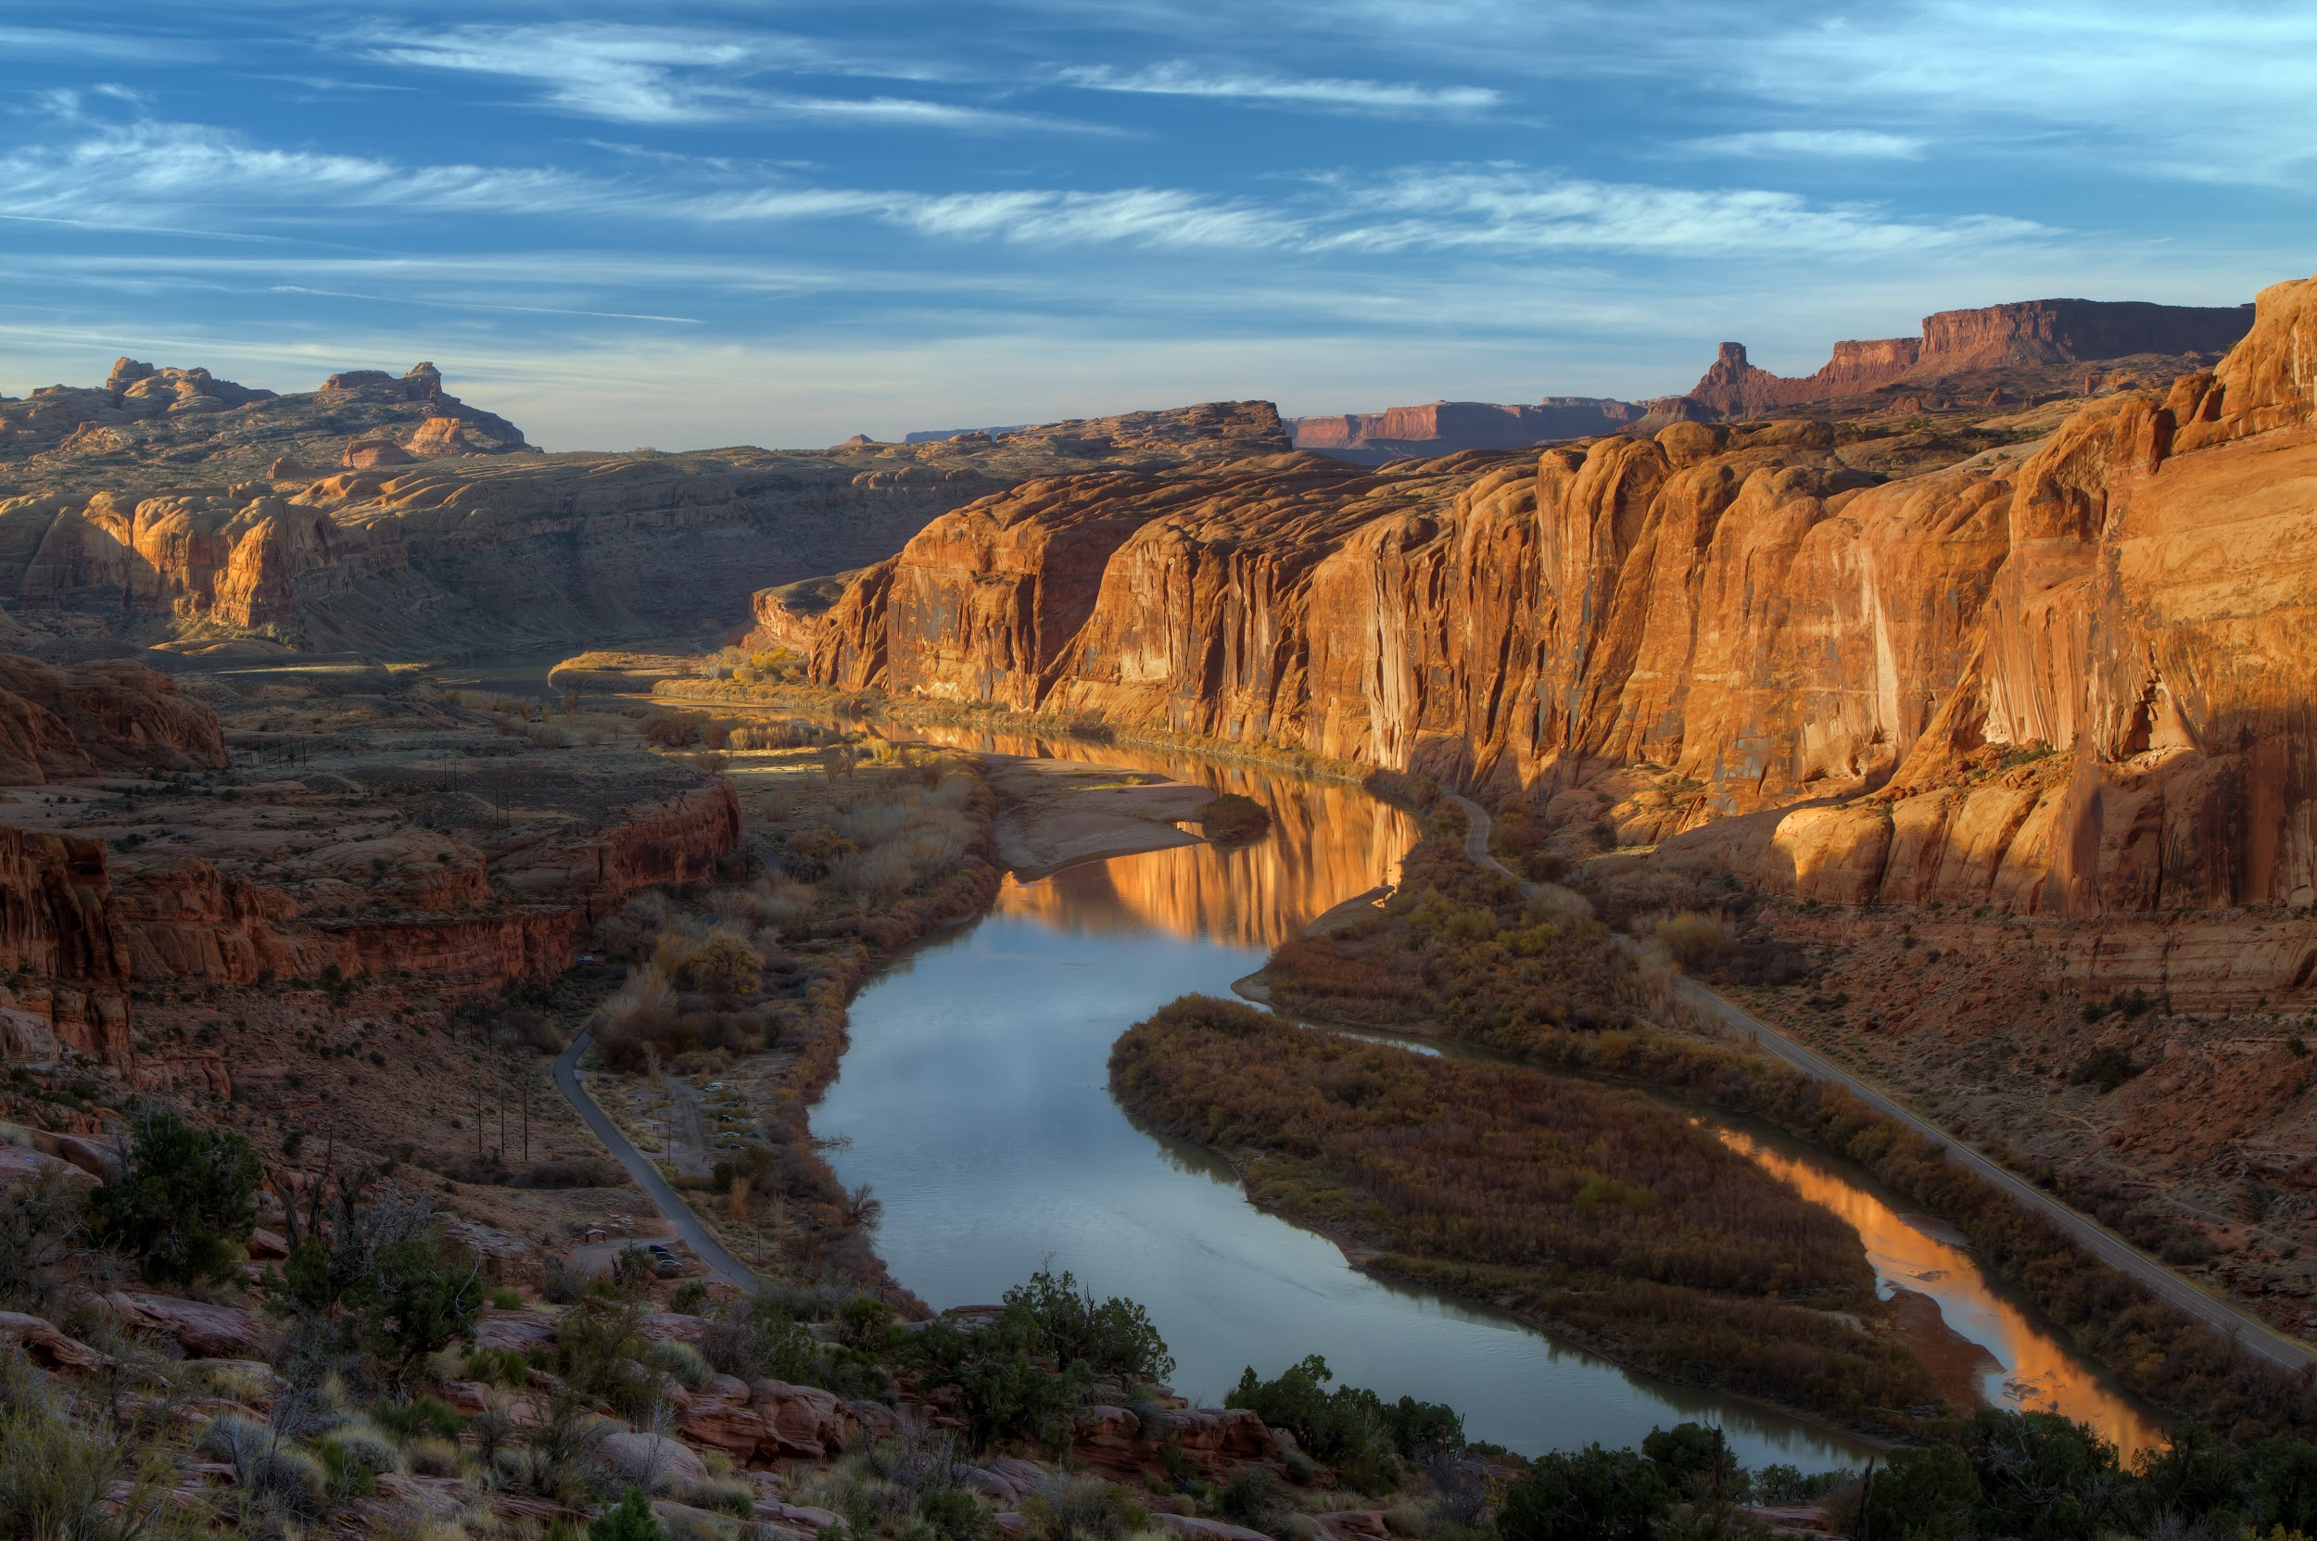
ch.4
the design of the earth
life and reciprocity: part 2

Slide 3
I’m writing my story so that others might see fragments of themselves.
– Lena Waithe

Slide 4
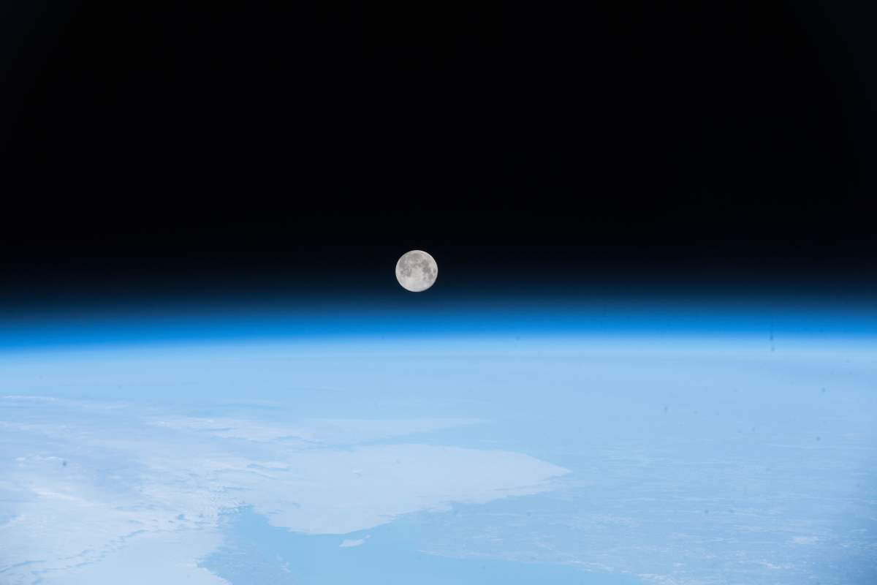

Amanda Gorman
First Youth Poet Laureate of the United States
Notes:
https://youtu.be/xwOvBv8RLmo

Slide 5
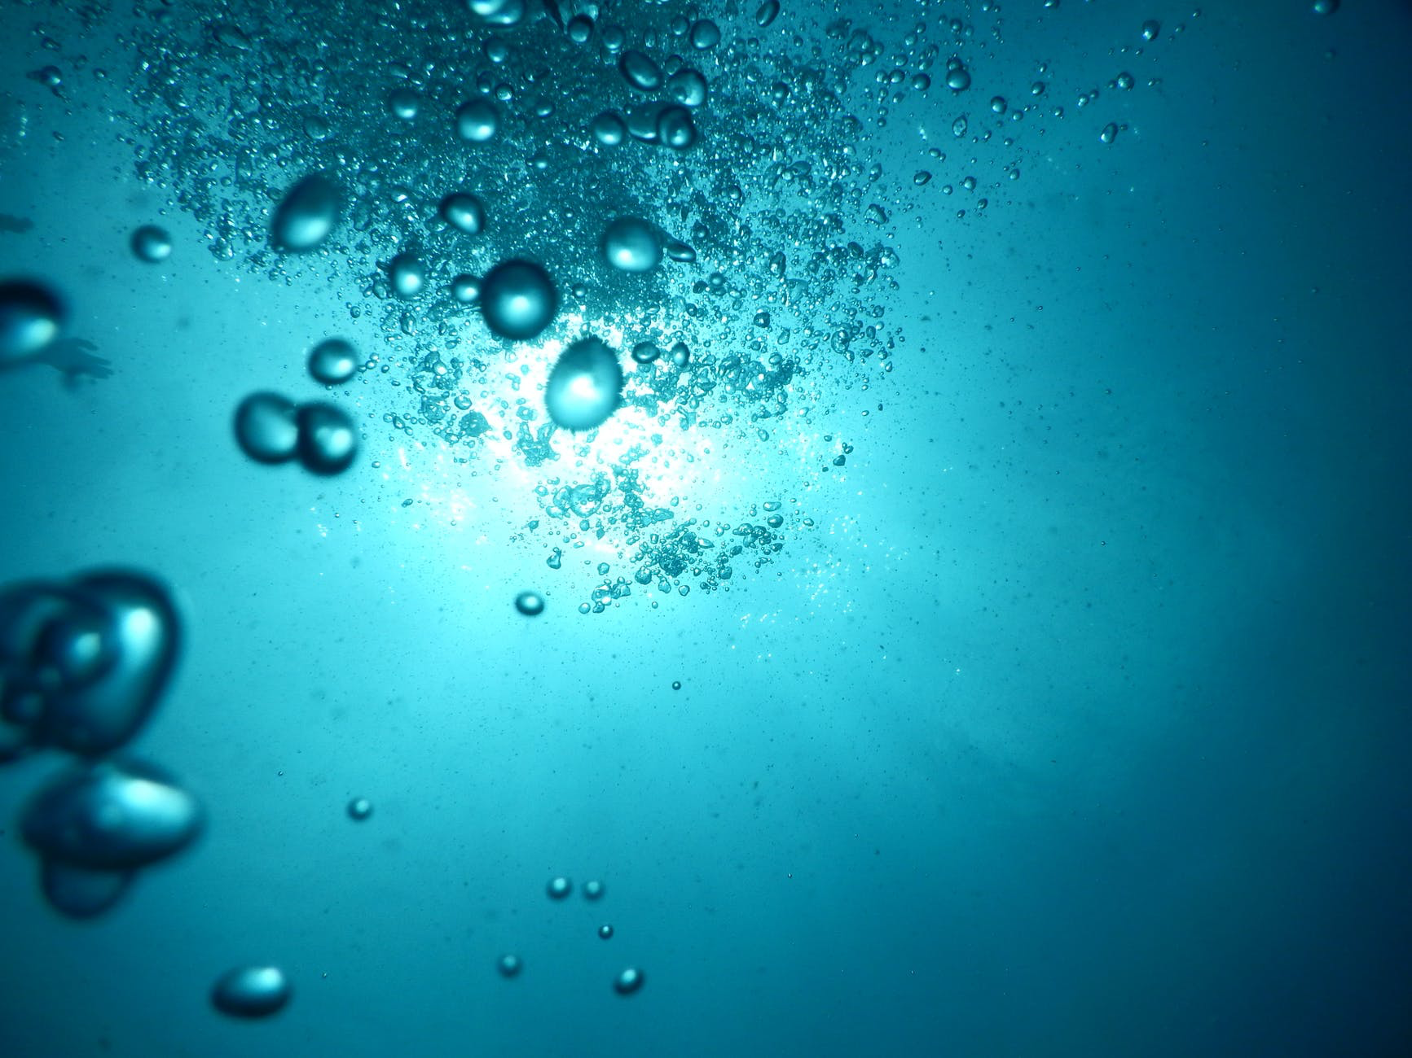
“I firmly believe that our human story over the next several decades will be to no small degree a water story. But the conclusion of that water story is not a foregone one; we’re still creating that narrative, and we’re making that narrative every day by the choices we make about how we use, manage, value, and even think about, fresh water.”
– Sandra Postel, National Geographic Fellow, Global Water Policy Project

Slide 6
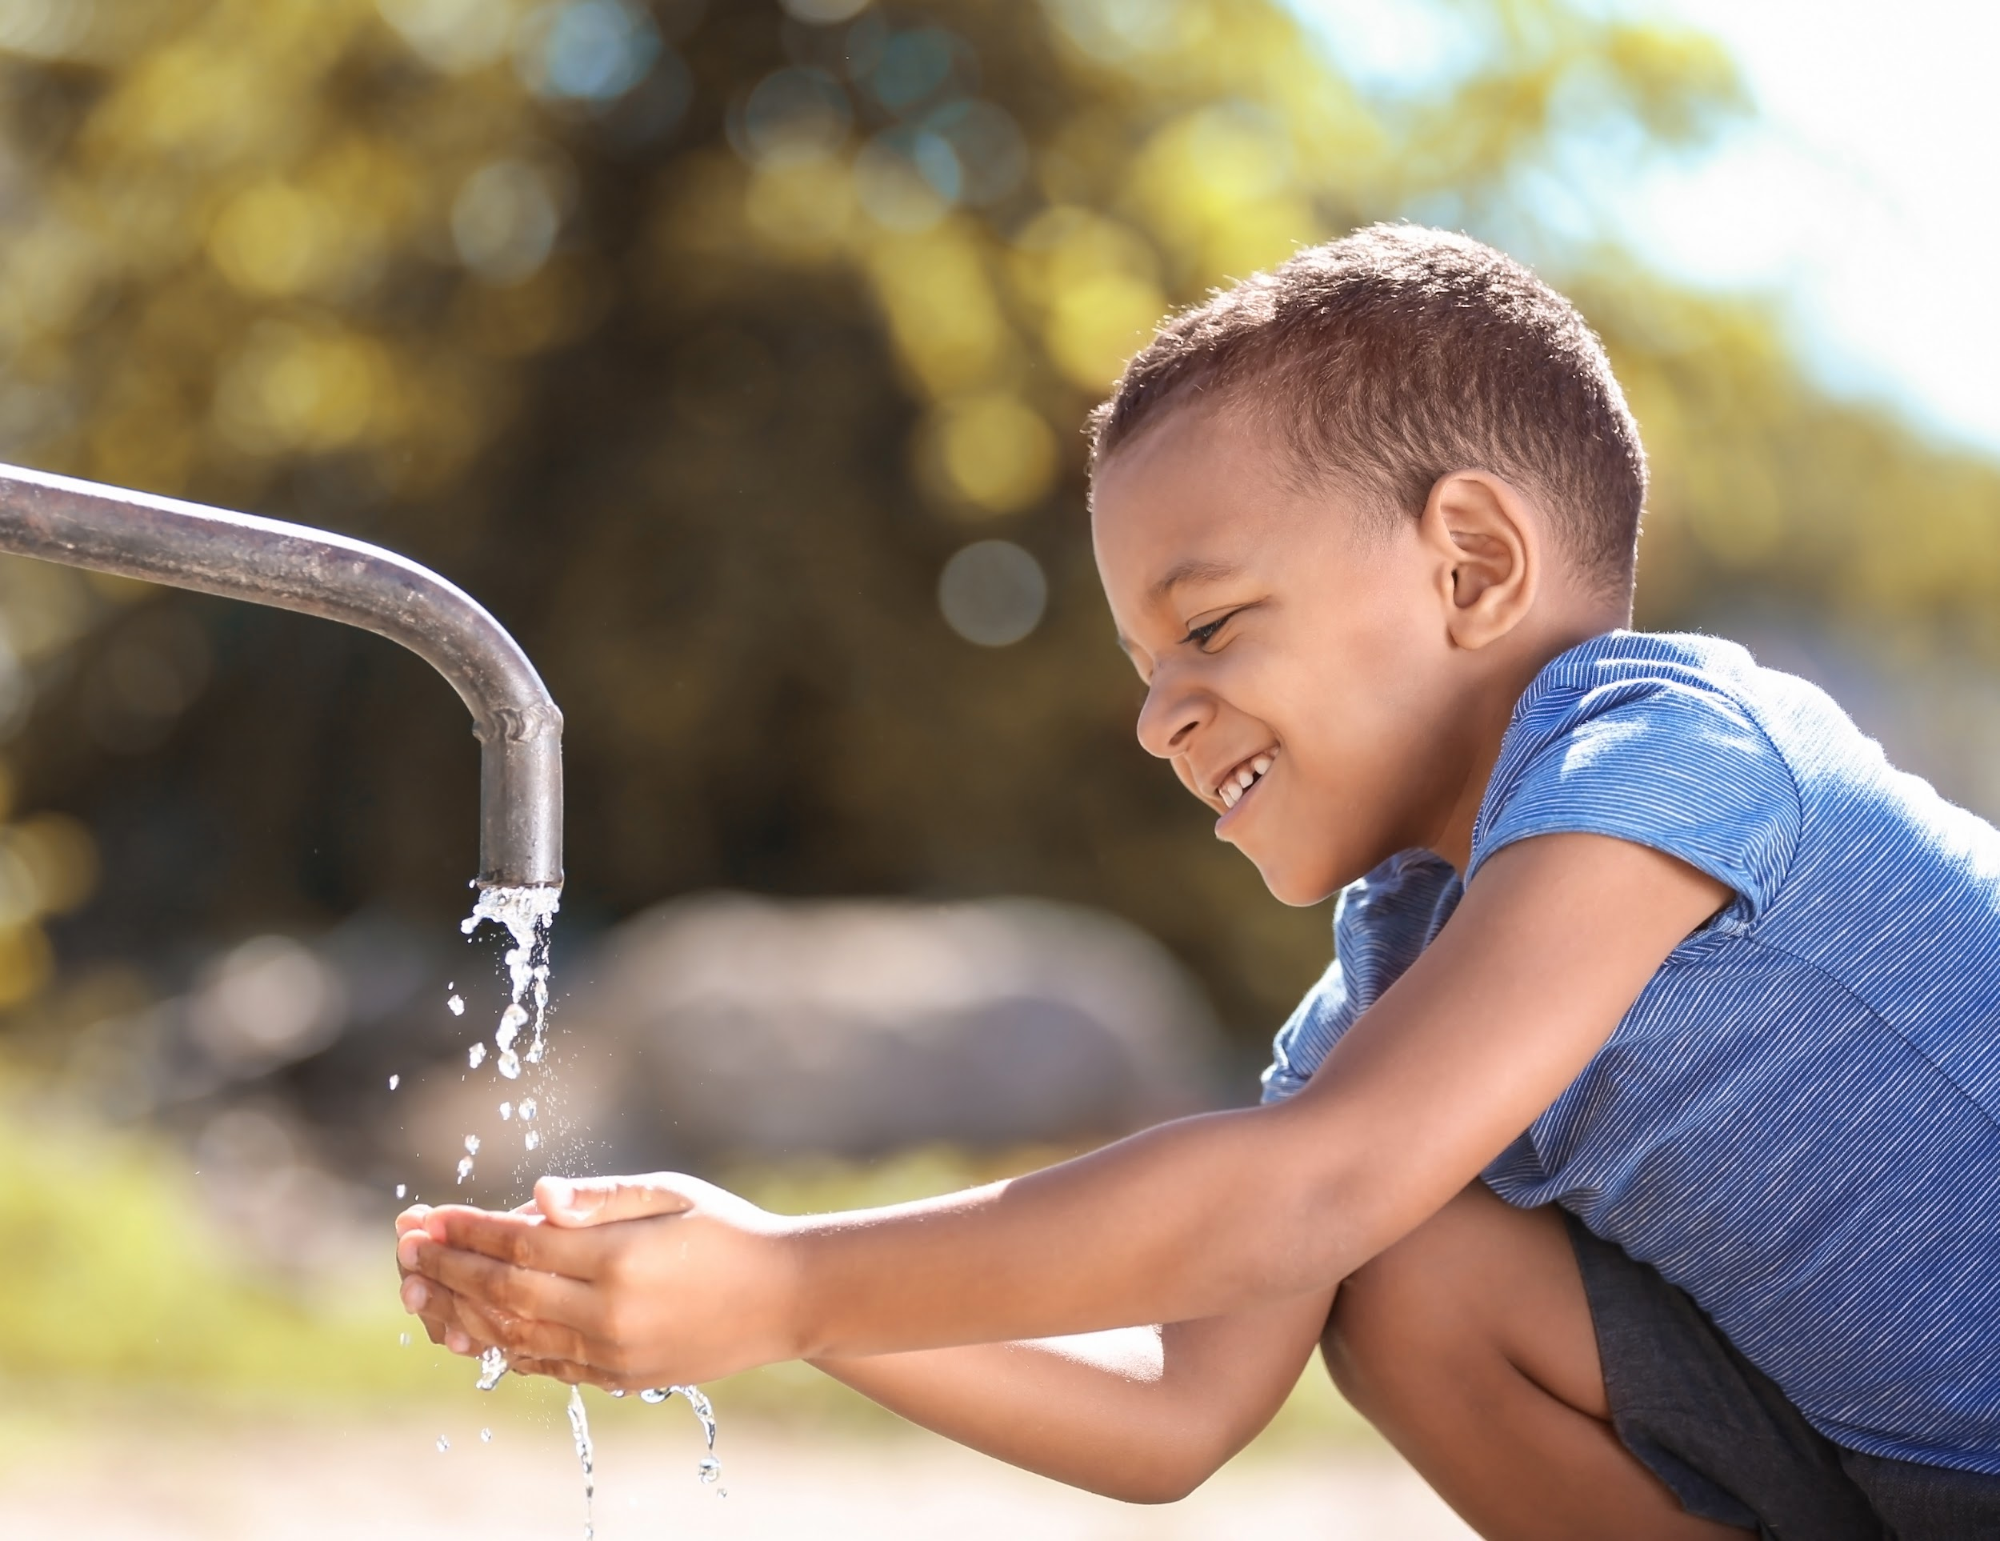
What human activities require
clean water?

Slide 7
What human activities require
clean water?
food production
cooking
bathing
sanitation
power generation manufacturing
watering lawns
washing dishes
brushing teeth

Slide 8
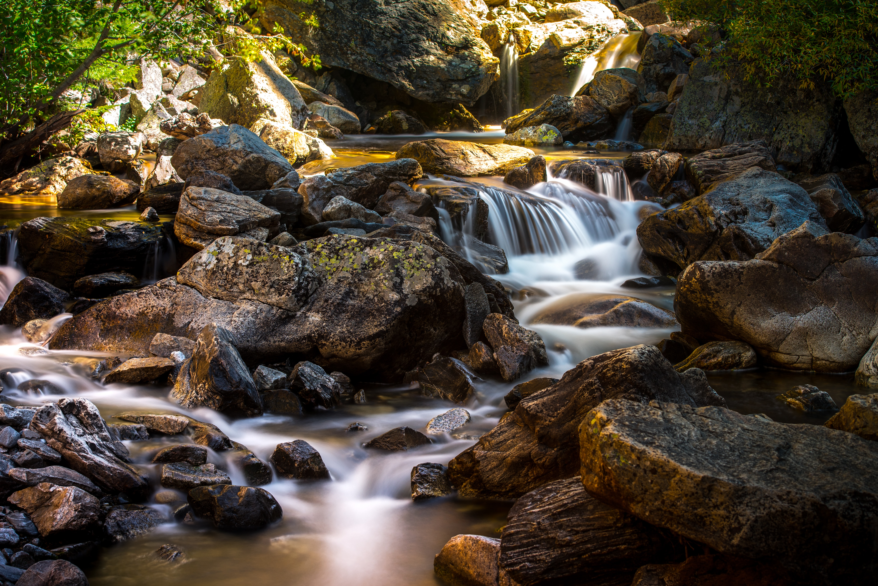
“The human right to water is indispensable for leading a life of human dignity….It is a prerequisite for the realization of other human rights.”
– United Nations Committee on Economic, Social and Cultural Rights
Home is Where the Water Runs Clean
Notes:
https://youtu.be/4V-KoJGGJ4s

Slide 9
Did you know….
There is the same amount of water on Earth today as there was when _________ roamed.
Just less than _____ percent of the planet's water is available to meet daily drinking water, sanitation and food needs of 7.8 billion people and millions of other species.
More than 97% of the world’s water is too _______ to drink.
Another 2% is not available to drink because it is locked up in ____ caps and ________.
Access to clean water is a local issue and a ________ issue.
All of us live in the _______sphere.
To support the average American lifestyle today requires ____ times the global average for water use.
Notes:
This can also be done as a Kahoot quiz HERE.
the dinosaurs
one percent
salty
ice caps and glaciers
global
Hydrosphere
2 times
Source: National Geographic
Optional Video: National Geographic: Why Care About Water

Slide 10
Agriculture (farming) accounts for ______ percent of global water withdrawal.
As the human population continues to rise, so does the number of people experiencing water _______ (meaning a water shortage).
It is estimated that 2.2 ______ people in the world lack access to safely managed drinking water services.
The United Nations estimates that 3 billion people worldwide lack basic _________ facilities at home.
_______ and ______ are most often responsible for collecting water in countries around the world.
Notes:
70 percent
scarcity
billion
handwashing
women and girls
https://www.un.org/en/sections/issues-depth/water/

Slide 11
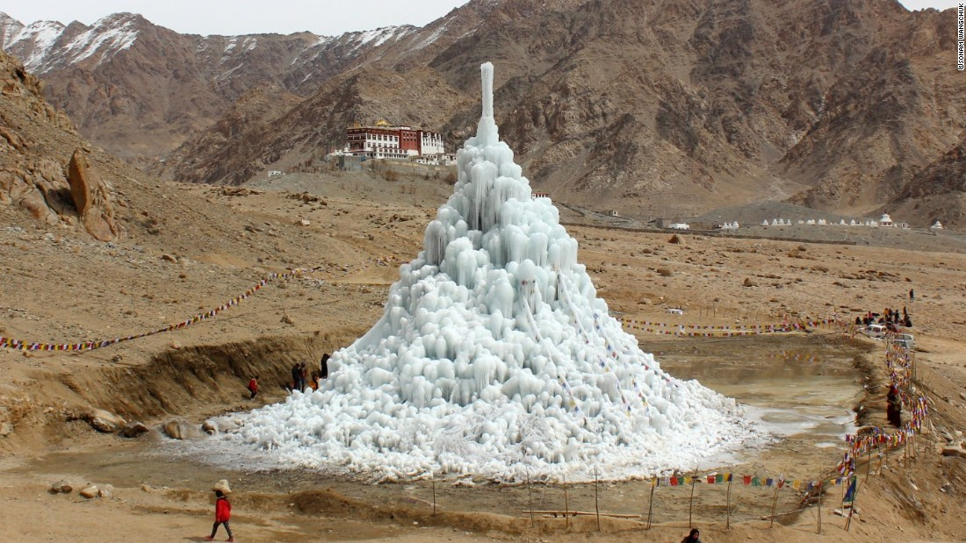
Ice Stupas of Ladakh

Slide 12
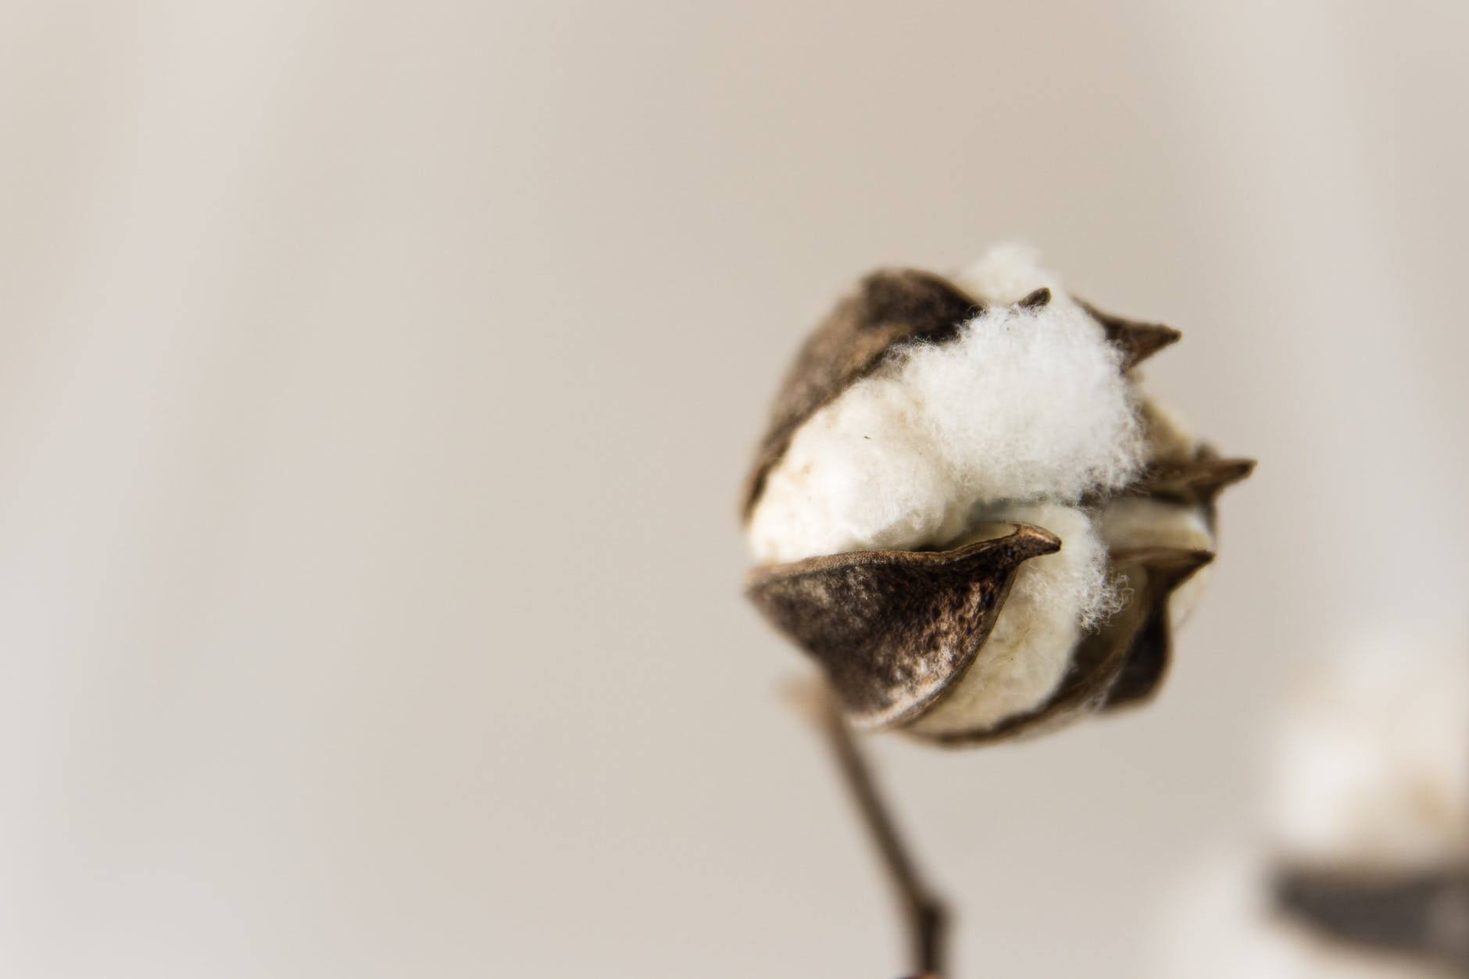

On average, how many gallons of water does it take to make a cotton t-shirt?
What about a hamburger?
Or a cup of coffee?
Notes:
How much do we know about water use, and what it takes to create things we may not associate with water at all? For example, on average, how many gallons of water does it take to make a cotton t-shirt? (Around 700 gallons of water; most is consumed growing the cotton in the field). Sandra Postel invites, “Think about all of the water we’re wearing.”
And what about a hamburger (634 gallons of water); or a cup of coffee (34 gallons of water).
Source: Sandra Postel, https://youtu.be/1vmxvsx_D9Q

Slide 13
As many as 63 million Americans (nearly ⅕ of the United States) were exposed to unsafe drinking water between 2007 and 2017.
Unclean water can cause serious health issues, yet in many communities polluted waters are not being addressed. Many local water plants, especially in small, low income and minority communities, cannot afford or access equipment needed to filter contaminants out of water, or to replace old pipes that leave people susceptible to lead contamination, leaks and broken water lines.
In addition, water is being polluted by industrial dumping, farm pollution, and oil spills as oil pipelines are built through communities. What more can we learn about water supplies, and what can do to increase knowledge, awareness and action?

Slide 14
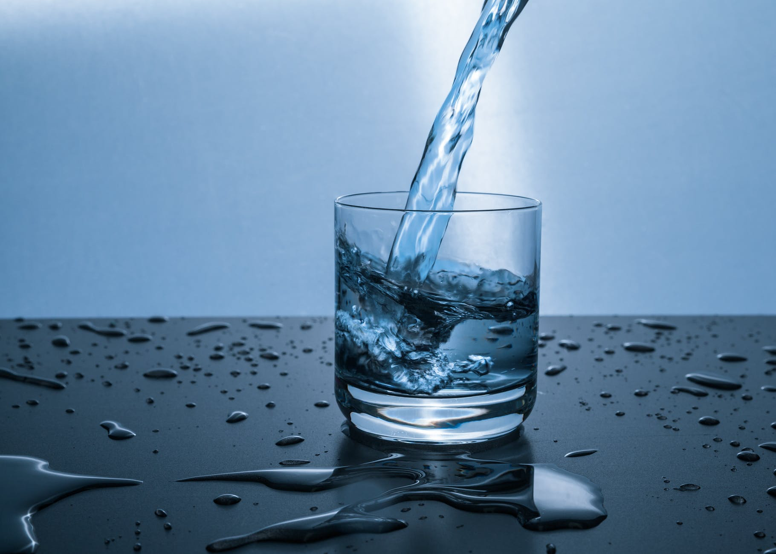


challenge:
Your Water Story

Slide 15
Bonus Slides

Slide 16
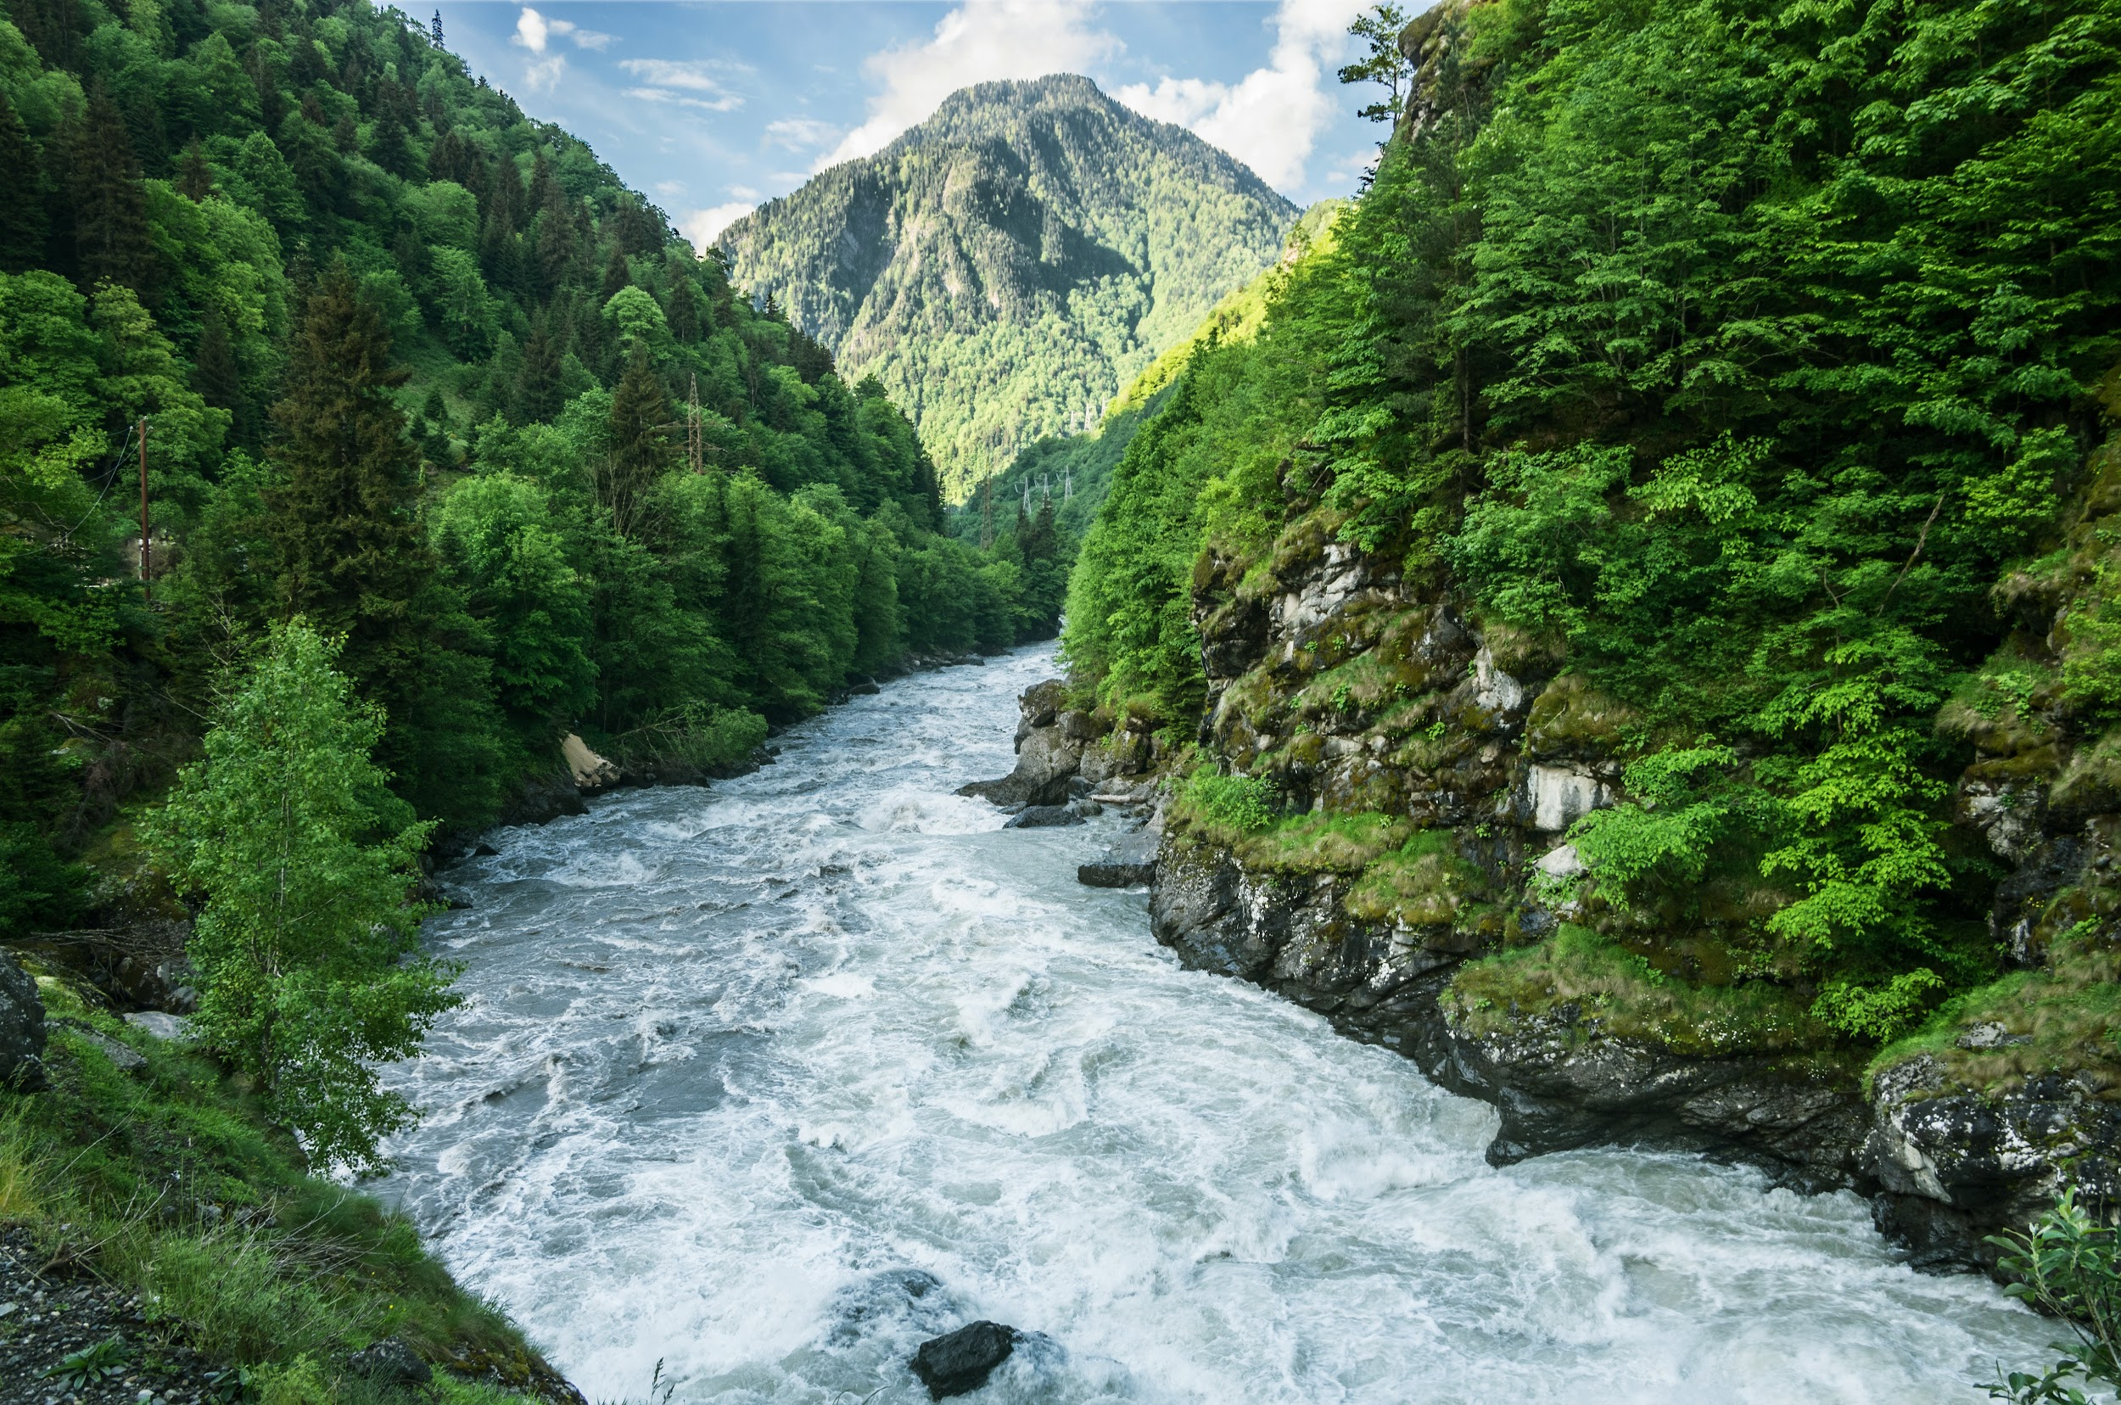
How has human development
changed the natural flow of water?
Notes:
Pollution in the world’s rivers, streams, and lakes renders water undrinkable and harms local wildlife. Overuse, triggered in part by population growth, causes water shortages and dries up lakes, rivers, or streams before they reach the sea or downstream neighbors, sometimes causing conflict.

Slide 17
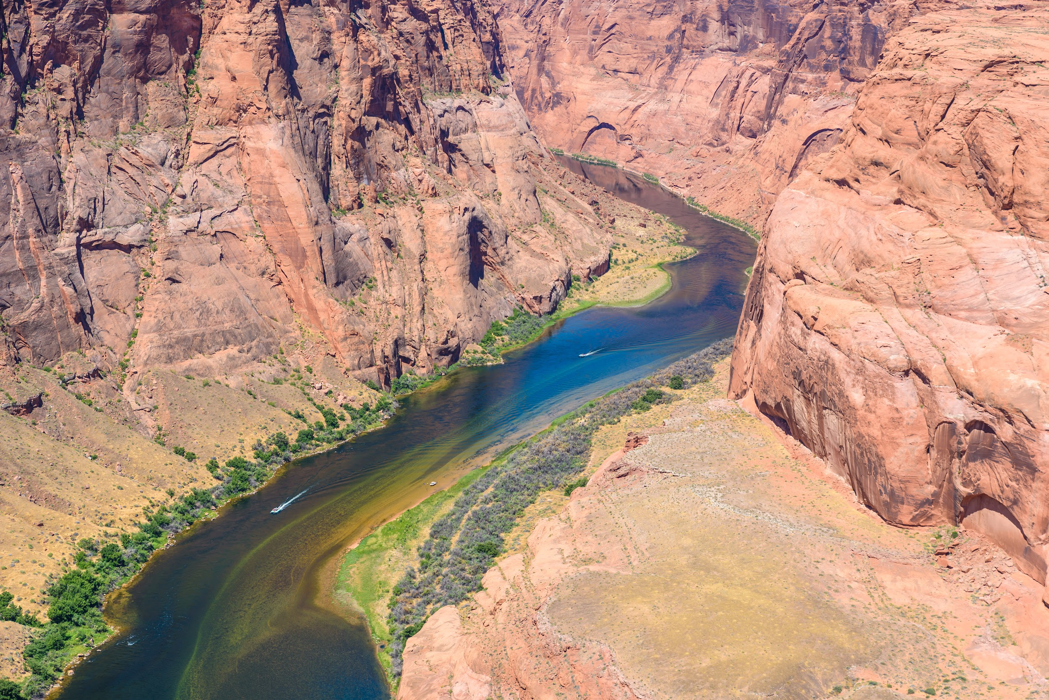
Watershed
Notes:
https://youtu.be/5s6ne766cZI

