Slide 1


Slide 2
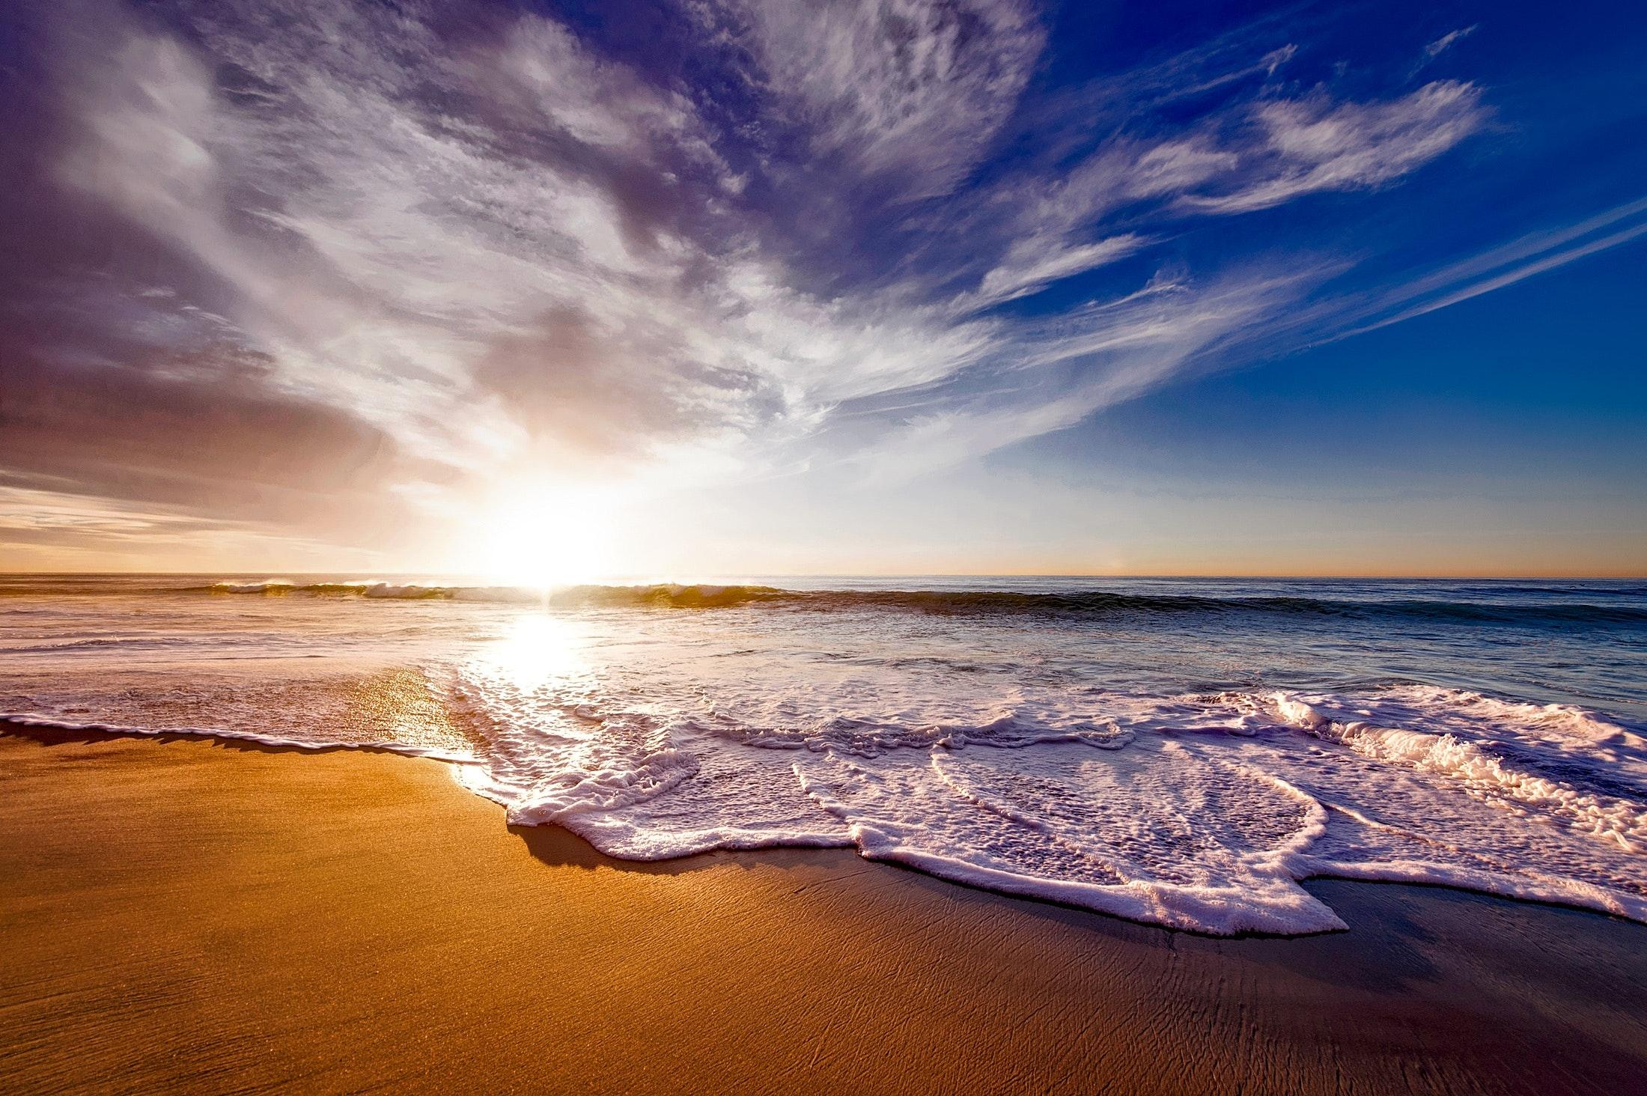
ch.3
life and reciprocity: part 1
the sea around us

Slide 3

When I think of the ocean, I think of, feel, remember…
(or imagine…)
Notes:
Extending the conversation:
You might also think with students about your geographical relationship to the ocean. Is your local community near an ocean? How does the proximity to or distance from the ocean impact life in your local area? Does proximity to an ocean impact the sense of relationship one feels to the world’s oceans?
You could also invite students to consider what questions they have about oceans? What’s curious to them about the ocean, or the life within ocean waters?

Slide 4
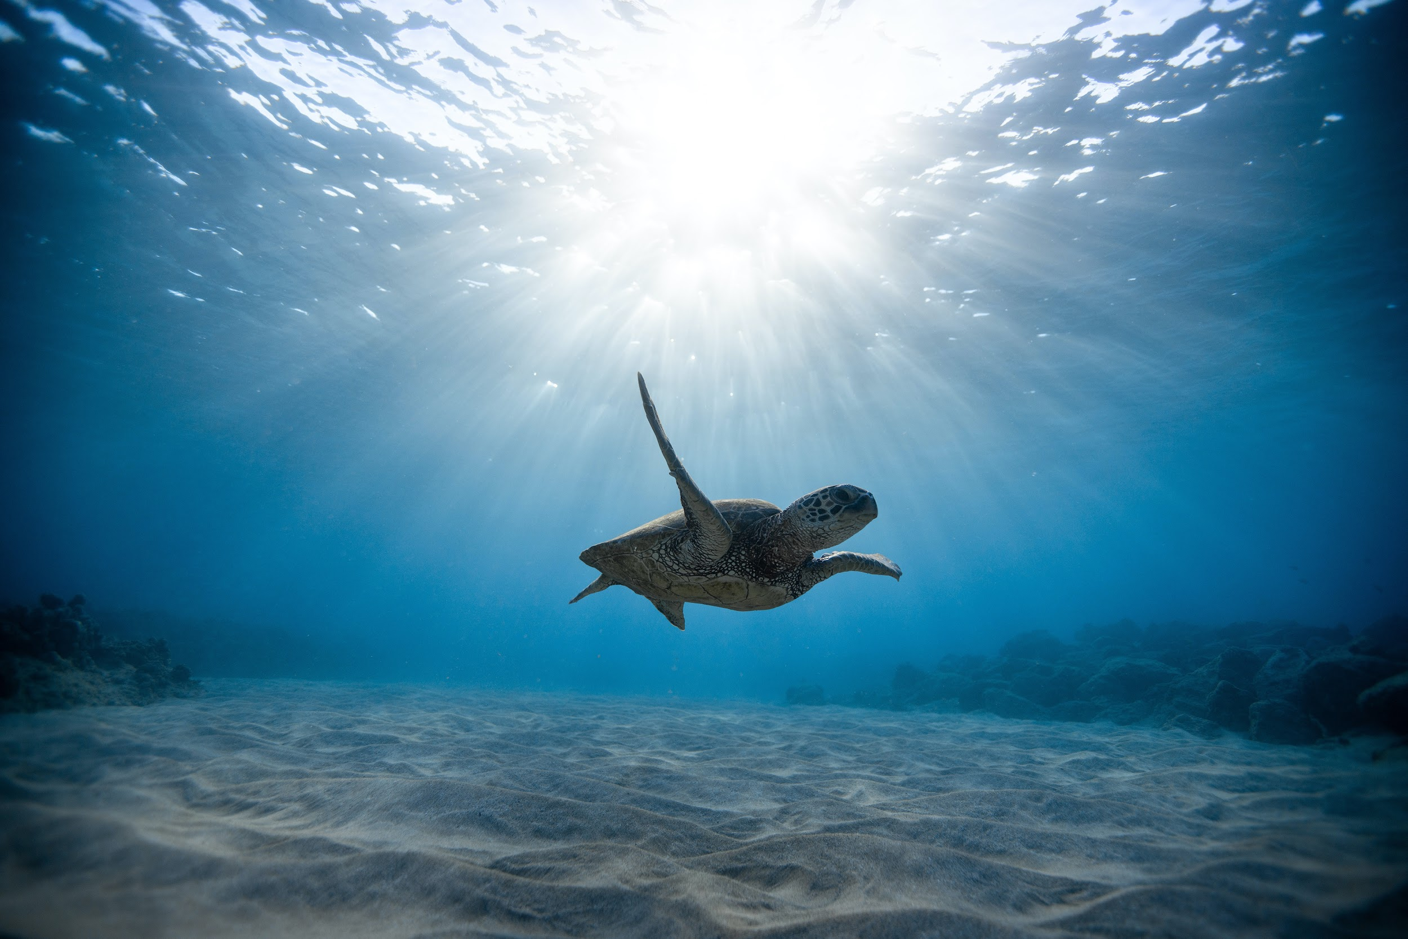
People ask: Why should I care about the ocean? Because the ocean is the cornerstone of earth's life support system, it shapes climate and weather. It holds most of life on Earth. 97% of Earth's water is there. It's the blue heart of the planet – we should take care of our heart.”
– Sylvia Earle, Oceanographer
first woman appointed chief scientist for the
U.S. National Oceanic and Atmospheric Administration

Slide 5
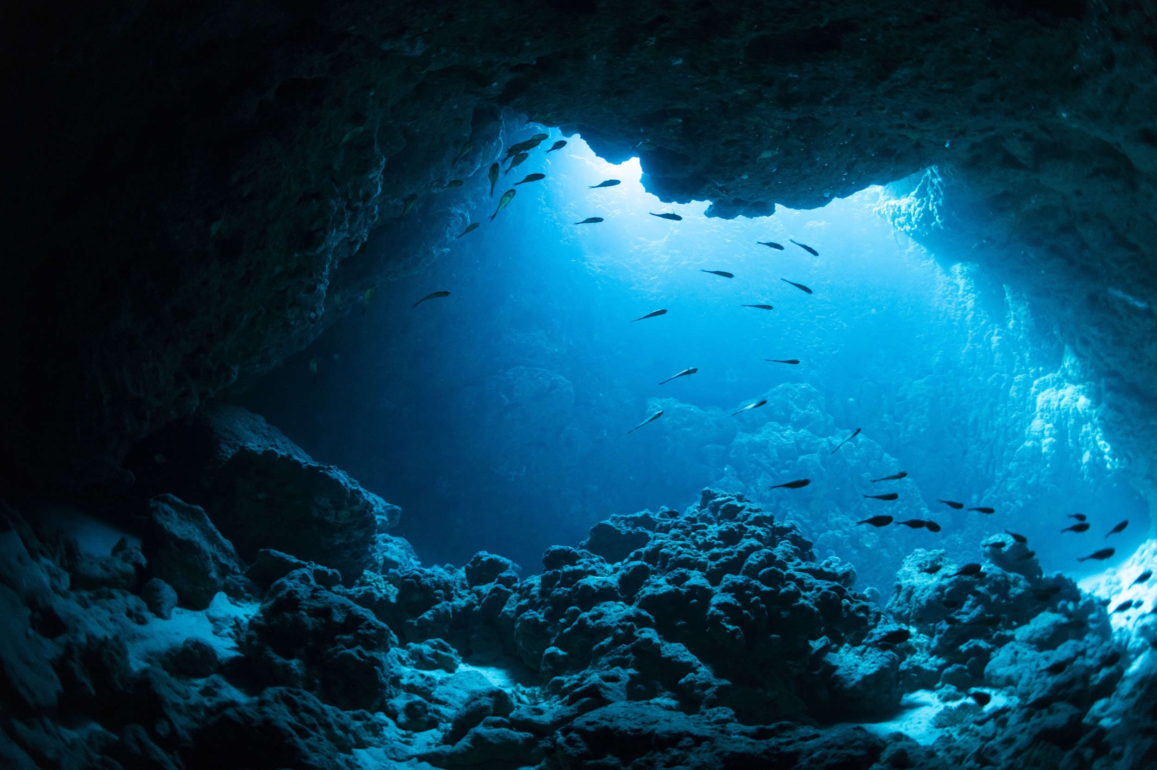
People have a deep emotional connection to the sea.
The oceans inspire, thrill, and soothe us.
Some think we owe our clever brains and the success they brought to our ancestors’ close link to the sea.
But relationship with the sea stretches back through time much further than this: all the way to the origins of life itself. We are creatures of the ocean.
– Callum Roberts, The Ocean of Life
Notes:
Additional Videos:
What It Means to Be a Marine Biologist
Becoming a Marine Biologist

Slide 6
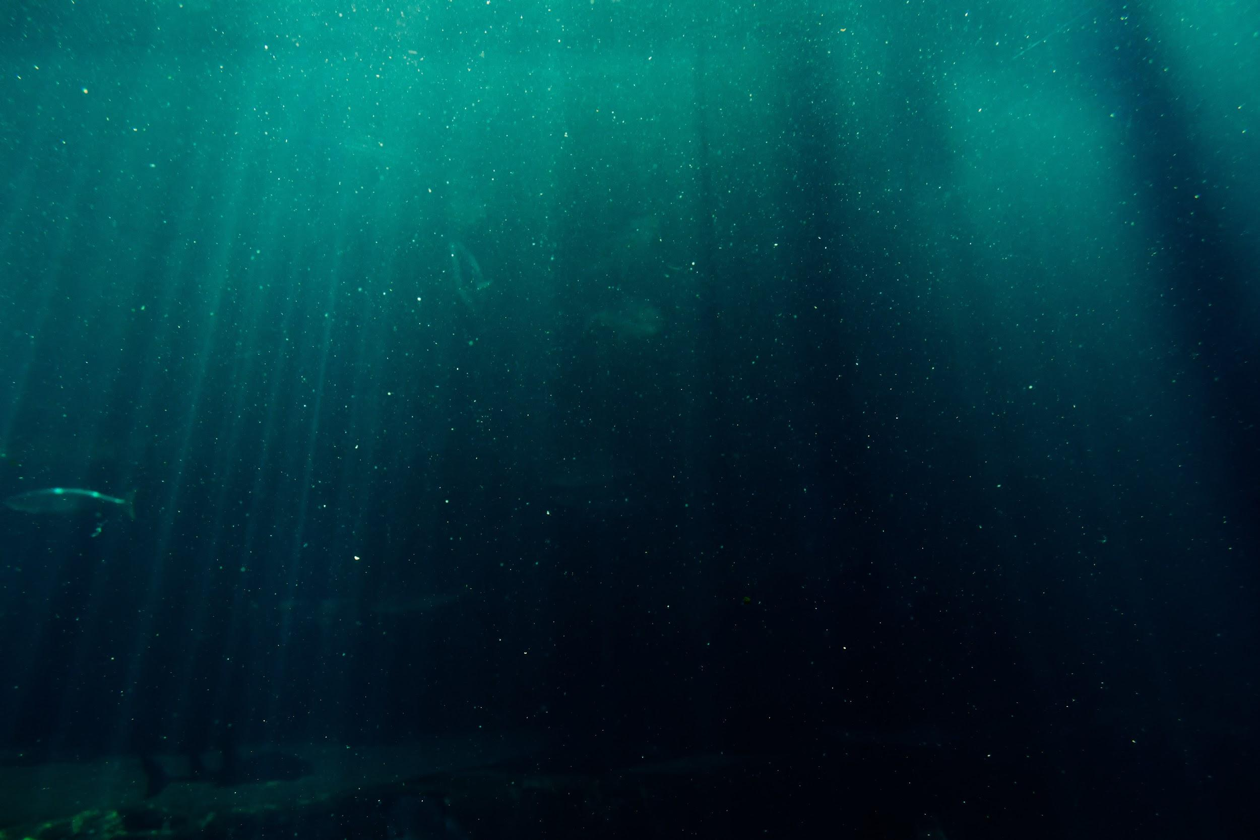
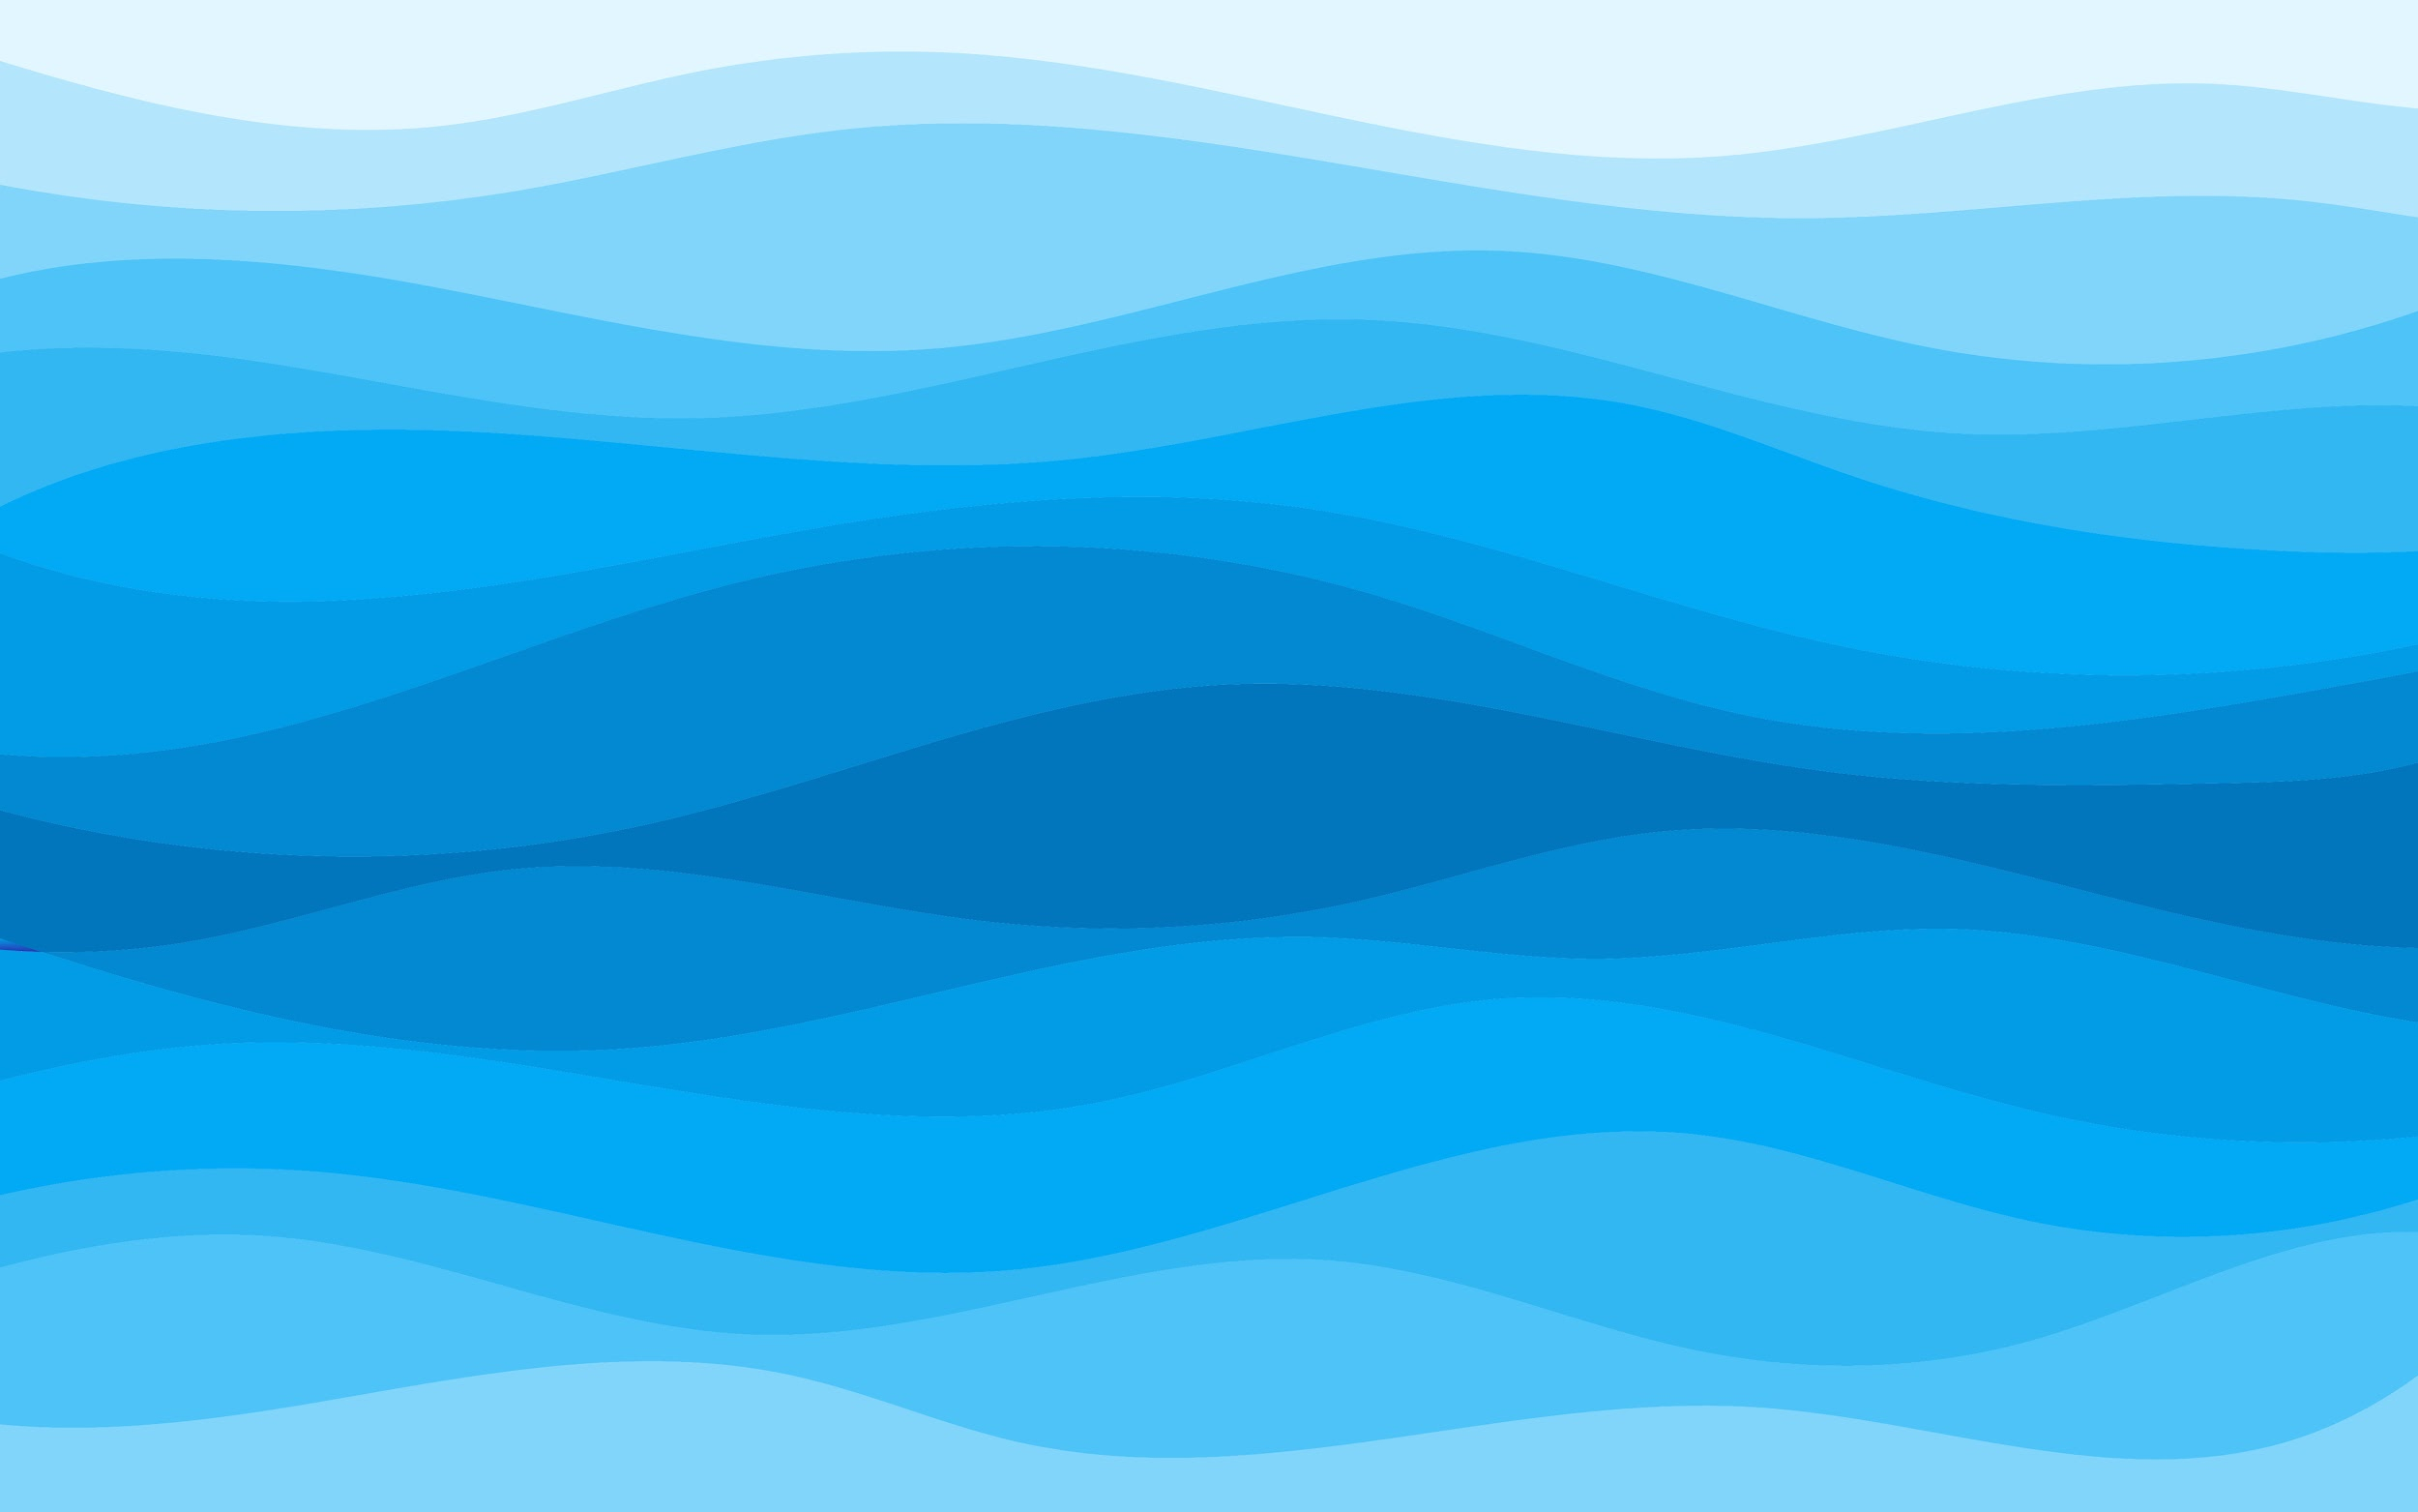
Can you guess……?
Our oceans cover more than ____ percent of the Earth’s surface?
Less than ____ percent of the planet’s oceans have been explored.
Between ____ and ____ percent of the oxygen we breathe is produced by oceanic plankton (plants, algae and bacteria that can photosynthesize).
When we’re born, our bodies are approximately _____% water. As we age, that number drops below ______%, but the brain continues to be ______ % water.
It’s estimated that 80 percent of the world’s population lives within ____ miles of the coastline of an ocean, lake, or river.
Notes:
(**this can also be done via Kahoot: here)
**If teaching online, you could create this as a quiz with students putting answers in the chat, or invite students to offer their guesses/suggestions for each statement as you go through them.
Answers:
More than 70 percent
Less than 5 percent
50 and 70
78%, 60%, 80%
60

Slide 7

Within the human body, the brain is 80% water.
Blood is 93% water.
Muscle is 75% water.
Every bone is approximately 22% water.
And, in every breath, we breathe with the ocean...
Notes:
Do we think of ourselves this way - as inseparable from the ocean?

Slide 8
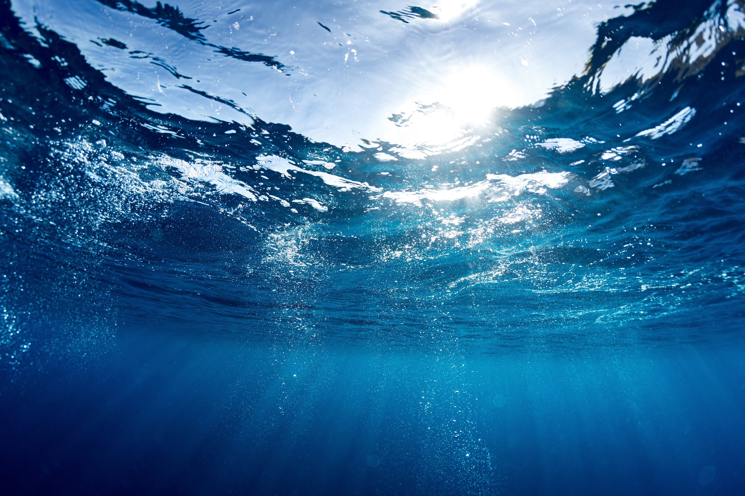

One Step Closer
Why the Ocean Matters
Notes:
https://www.nationalgeographic.org/media/why-ocean-matters/

Slide 9
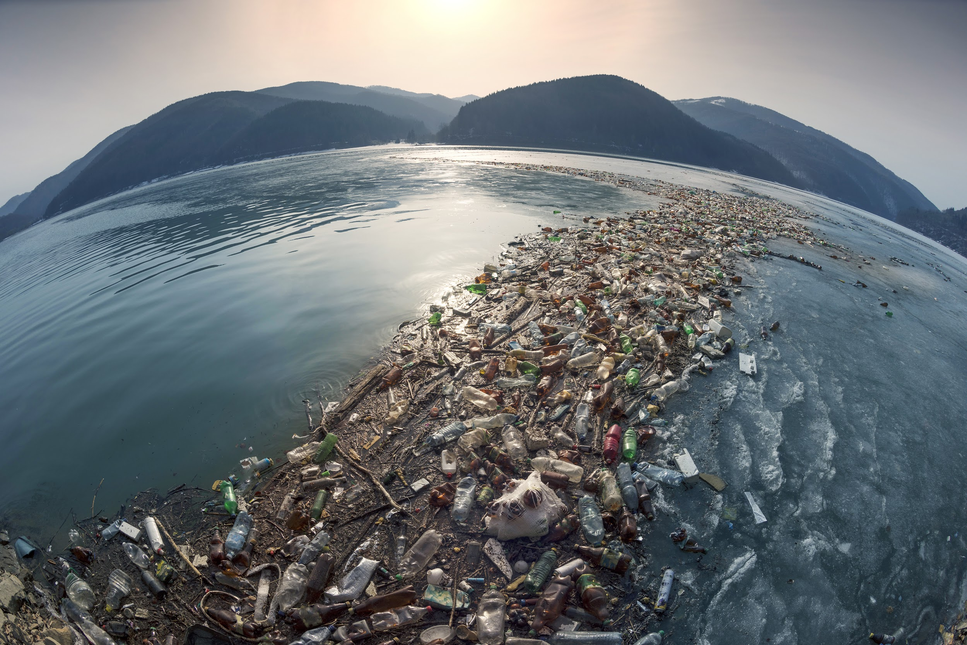
What’s happening to the world’s oceans?

Slide 10
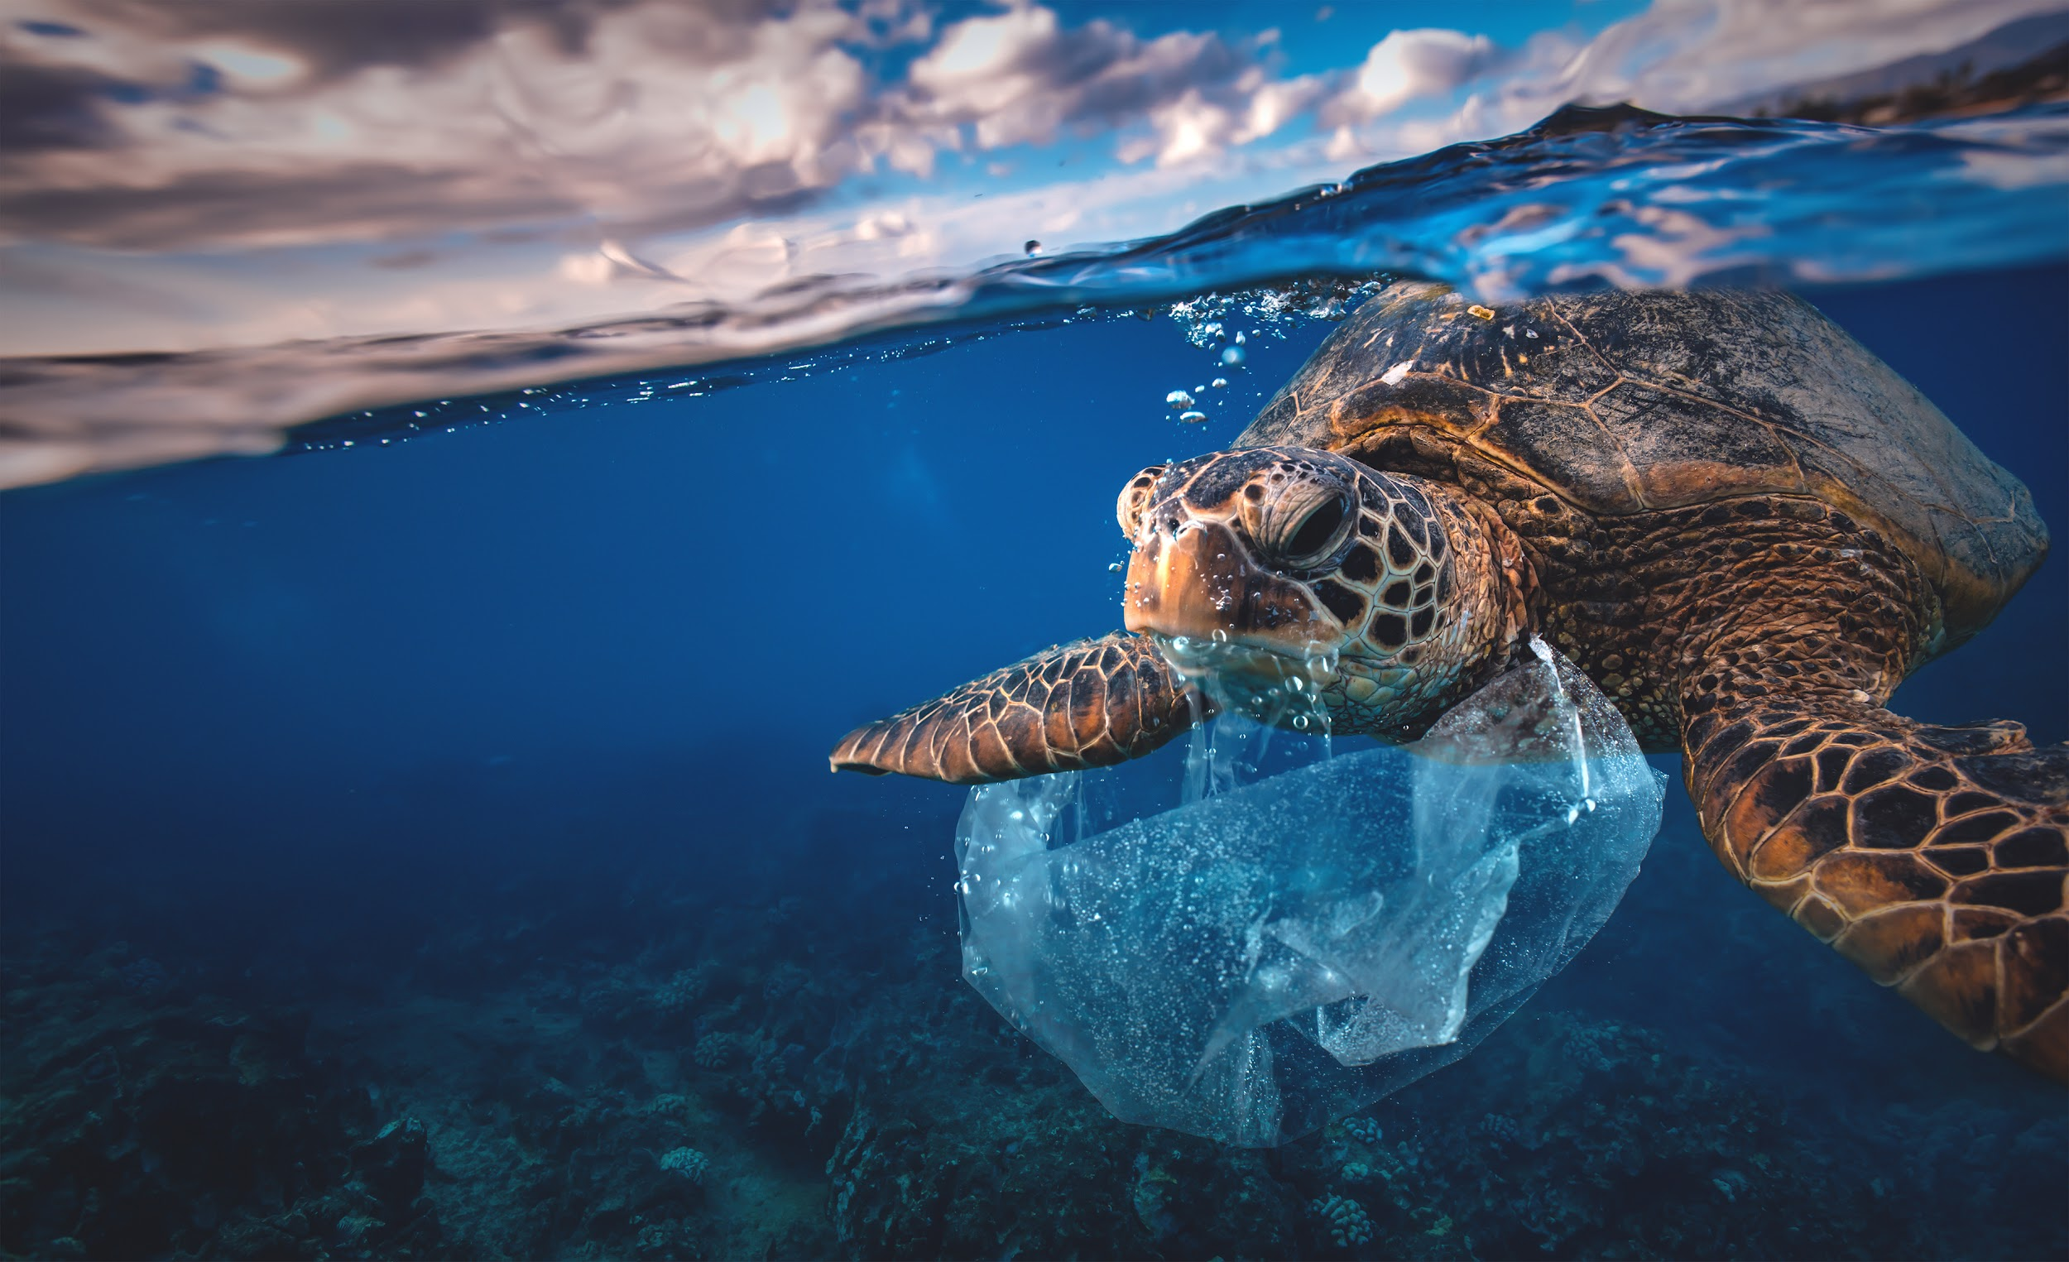
About 17.6 billion pounds of plastic is finding its way into the ocean every year. At this rate, by 2050 ocean plastic will outweigh all of the ocean’s fish.
What do you think are the most commonly found plastic items?
Notes:
(Optional Video: Big Blue and You: Surf Day and Clean Up)

Slide 11
Cigarette butts, food wrappers, plastic drink bottles, plastic bags, straws, plastic takeout containers, plastic lids, plastic utensils foam takeout containers; fishing gear/nets

Slide 12
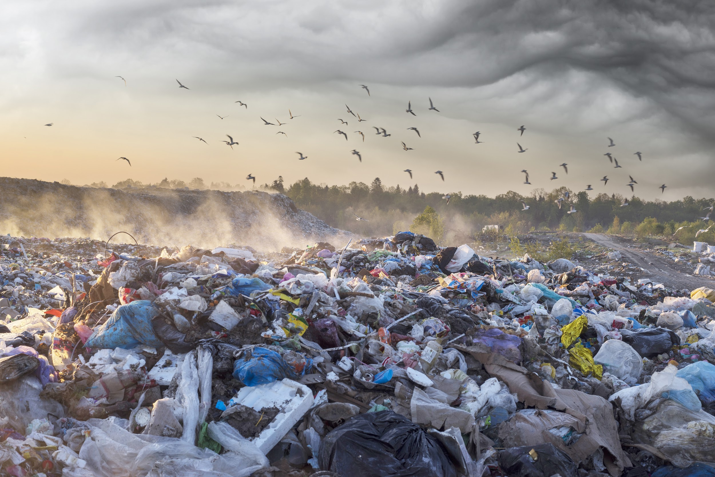
Even Little Things
Notes:
Video: Throw Away Culture (https://youtu.be/eD6inQ-z3O8)
Additional Video:
Becoming a Marine Biologist
For student research: People of color are historically underrepresented in marine science – who is not yet well known for their contributions to the field, and what can be done to change change this?
For example, who was Ernest Everett Just? Who was Samuel Milton Nabrit, and Matilene Spencer Berryman?
And read blogs and reflections on experience like: Diversity in Ocean Science. Also see Ida-Wenona Hendricks.
Celebrating Hispanic and Latinx Ocean Champions: HERE

Slide 13
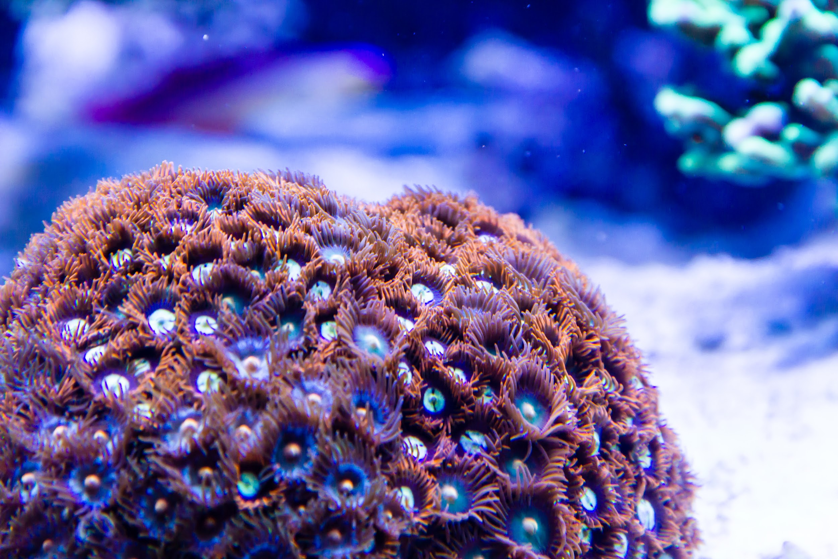
Diving Deeper...
What does MPA stand for related to ocean health? (hint: “Marine”)
What are coral reefs made of? Are they plants or animals?
What are some things people do that directly impact coral reefs around the world?
What do coral reefs need to survive?
What is “biodiversity”?
Notes:
(**this can also be done via Kahoot here)
Marine Protected Areas - areas where rules are in place to make sure the area is safe from harm
Coral polyps which secrete layers of calcium carbonate beneath their bodies; animals (because they don’t make their own food, as plants do)
Plastic pollution, chemical pollution, habitat destruction causes sediment to flow into the ocean
Sunlight, clear water, warm water temperature, clean water, saltwater
Biodiversity is the variety of living species that can be found in a particular place, region, ecosystem, planet.
Coral reefs are believed by man to have the highest biodiversity of any ecosystem (even more than a tropical rainforest!)

Slide 14
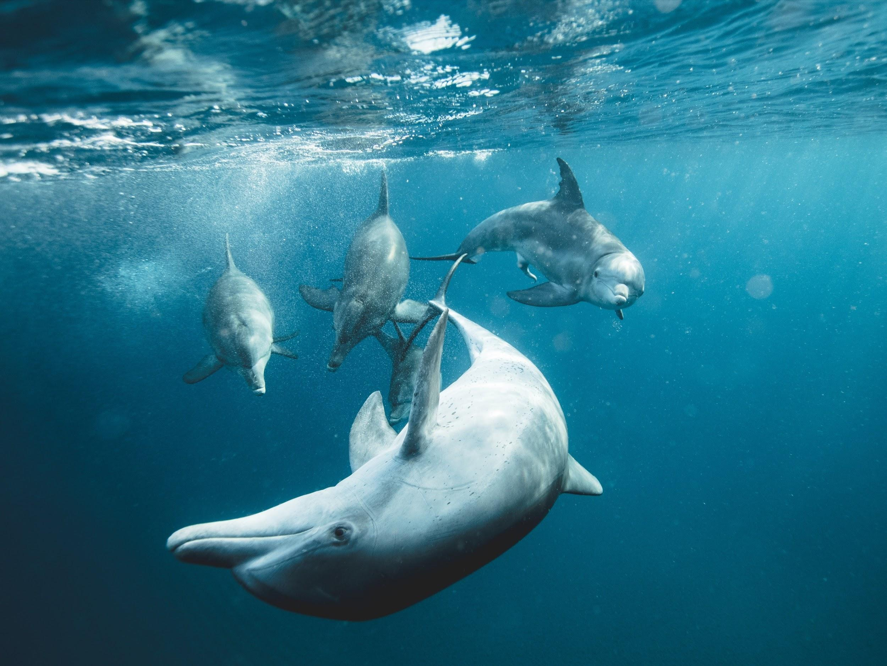
Coral Reefs of Vanuatu
Reefs at Risk

Slide 15
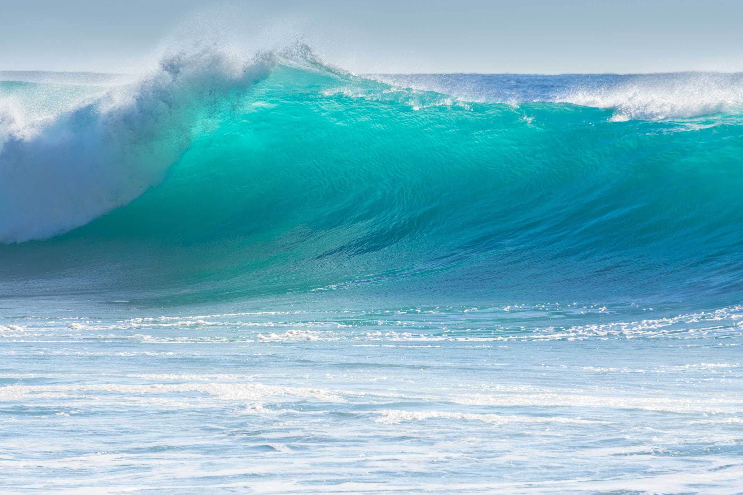


challenge:
Develop a character to create awareness about a problem facing the world’s oceans or communities affected by threats to our oceans.

Slide 16
Bonus Slides
Notes:
What It Means to Be a Marine Biologist
Becoming a Marine Biologist

Slide 17
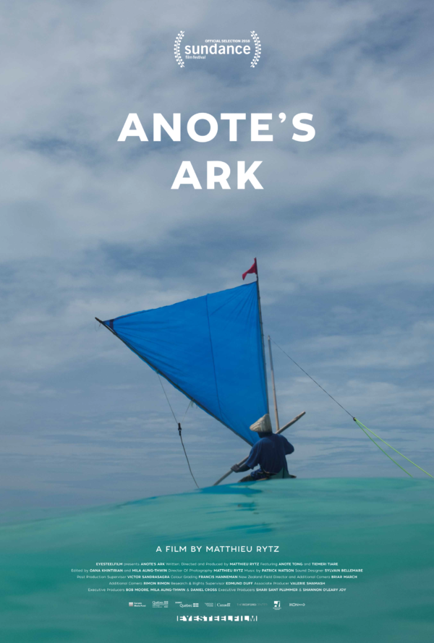
The Pacific Island nation of Kiribati (population: 100,000) is one of the most remote places on the planet, seemingly far-removed from the pressures of modern life. Yet it is one of the first countries that must confront the main existential dilemma of our time: imminent annihilation from sea-level rise.
While Kiribati’s President Anote Tong races to find a way to protect his nation’s people and maintain their dignity, many Kiribati are already seeking safe harbour overseas.
Set against the backdrop of international climate and human rights negotiations, Anote’s struggle to save his nation is intertwined with the extraordinary fate of Tiemeri, a young mother of six, who fights to migrate her family to New Zealand. At stake is the survival of Tiemeri’s family, the Kiribati people, and 4,000 years of Kiribati culture.
Notes:
Trailer linked to play button.
http://www.anotesark.com

Slide 18
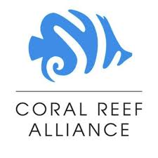
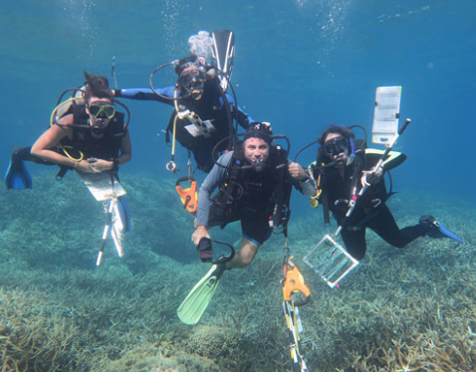
Coral Reef Alliance
Mission: Save the world’s coral reefs. We work collaboratively with communities to reduce direct threats to reefs in ways that provide long-term benefits to people and wildlife, and we are actively expanding the scientific understanding of how corals adapt to climate change and applying this information to give reefs the best chance to thrive for generations to come.
Provides (what they do):
CORAL has been delivering high-quality conservation programs that have made a difference in the world for 25 years.
Establish healthy fisheries for reefs and prevent overfishing.
Protect coral reefs from land-based pollution (restore watersheds and vegetation, build awareness about importance land practice to reefs).
Advance research and efforts for coral reef restoration (re-growth).
Generate new partnerships between scientists and communities.
The fate of coral reefs may decided in the next 25 years, but if the global coral reef conservation community can establish 45 Adaptive Reefscapes around the world by the year 2045, we estimate that we can save enough corals that they can continue to build reefs and provide benefits to people and wildlife throughout the world.
Notes:
Click logo for website

