Slide 1


Slide 2
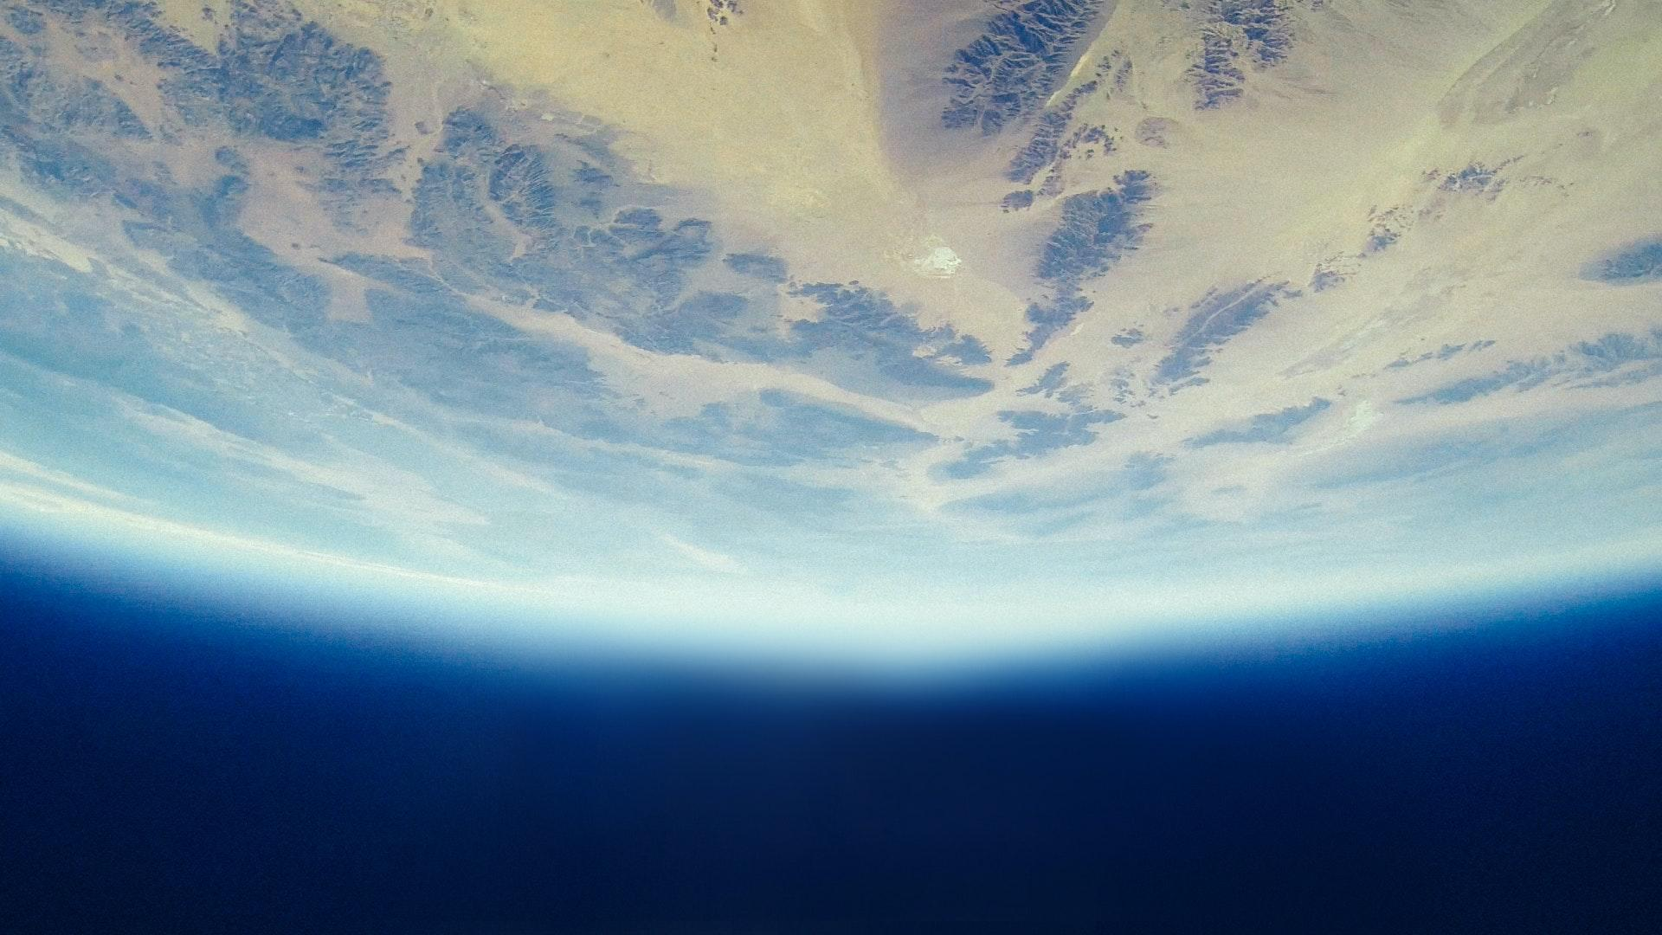
ch.2
earthrise
awakening

Slide 3
ch.2
awakening
hope for the future

Slide 4
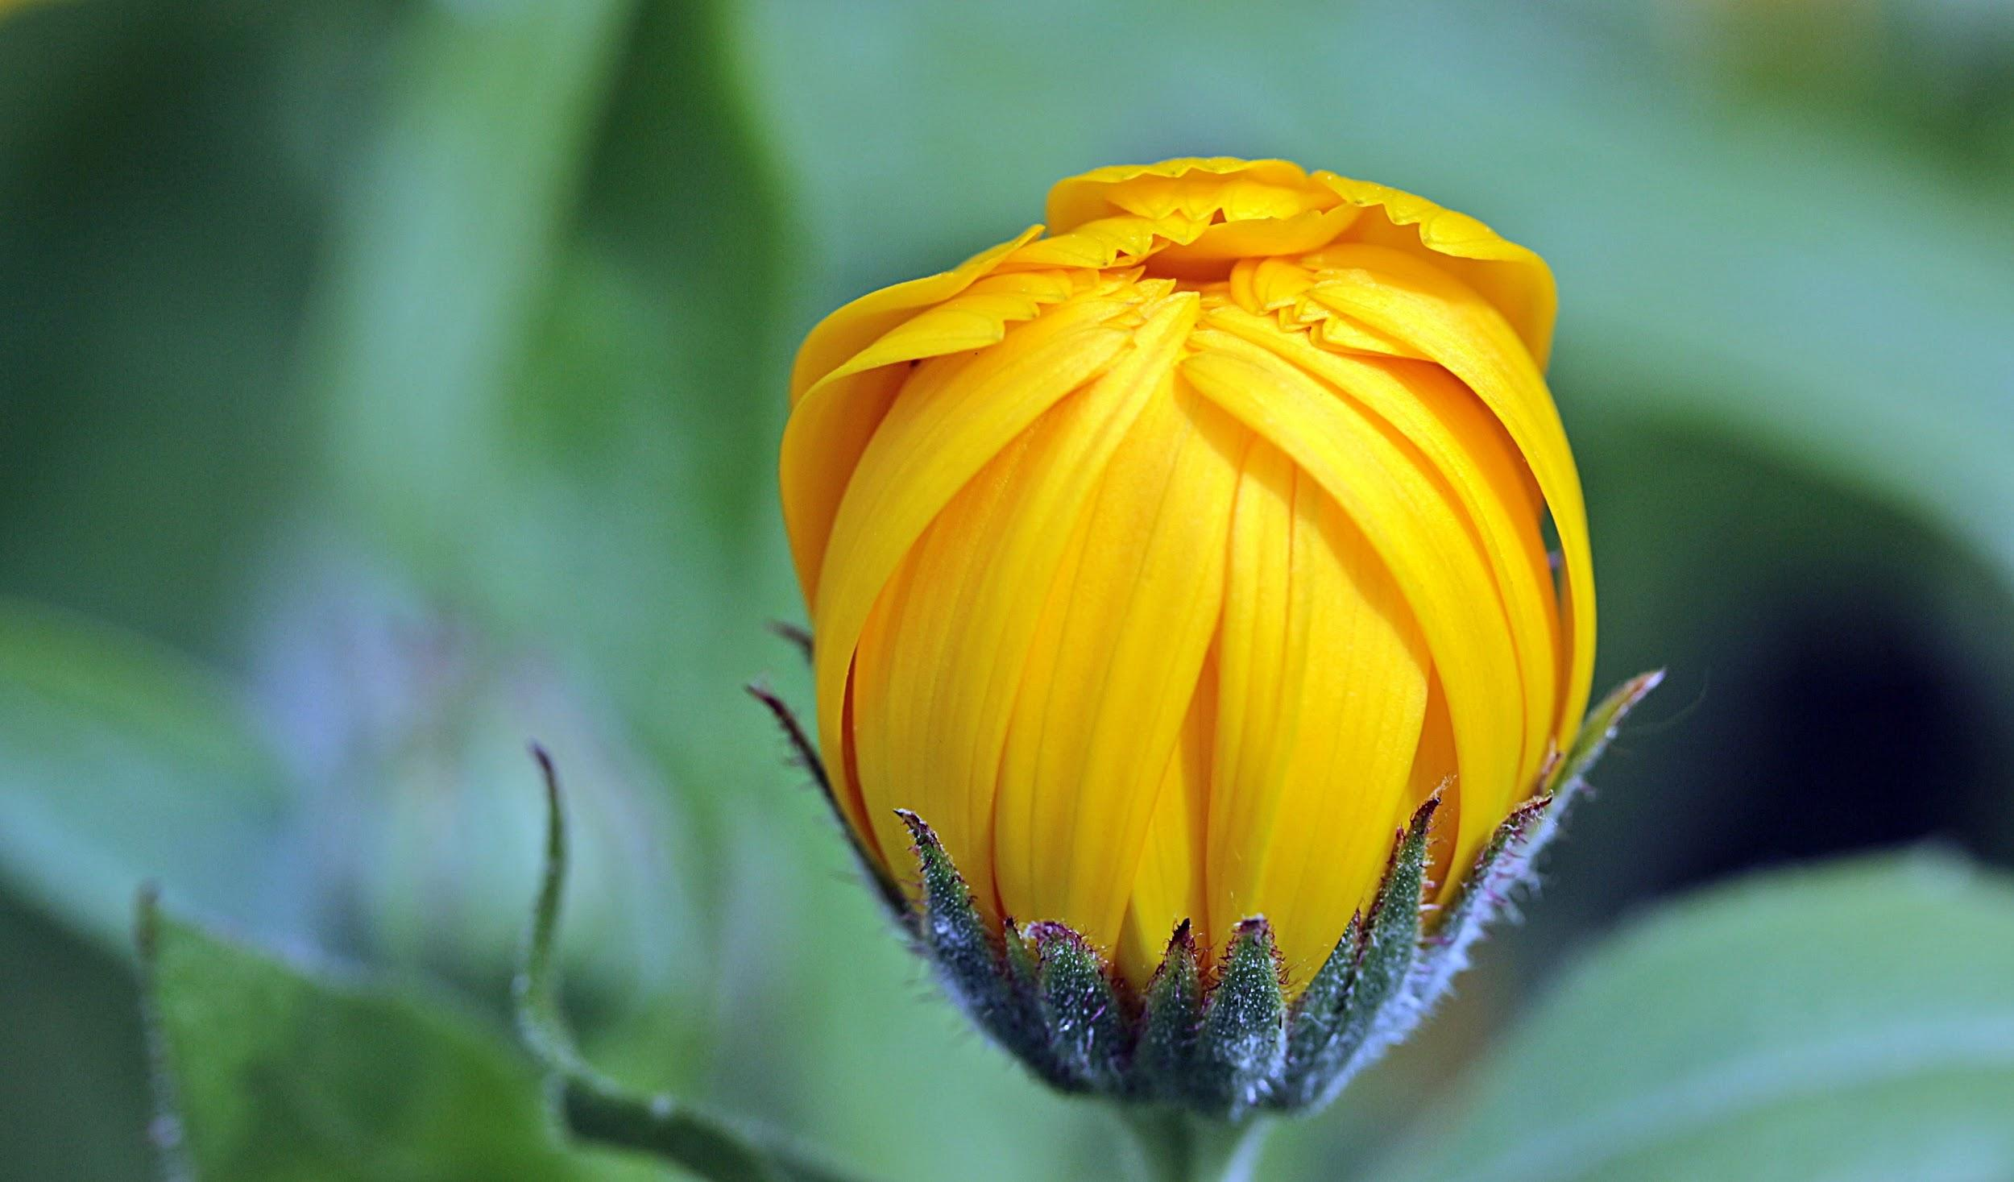
“The world cannot be discovered by a journey of miles...but only by an inner journey, a journey of one inch, very arduous, and humbling, and joyful.”
- Wendell Berry
Blossoms of Change
Notes:
Your story ripples into the whole world…

Slide 5
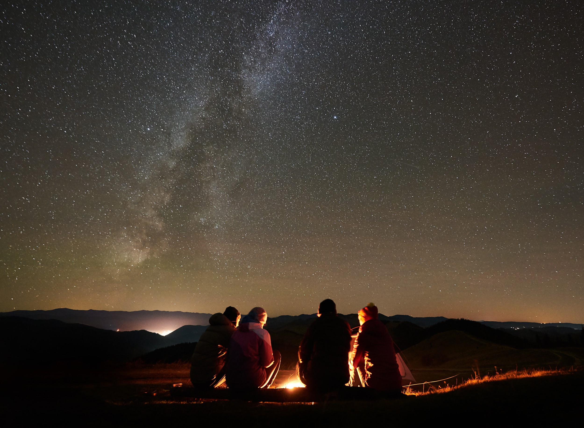
Ripples of Change

Slide 6
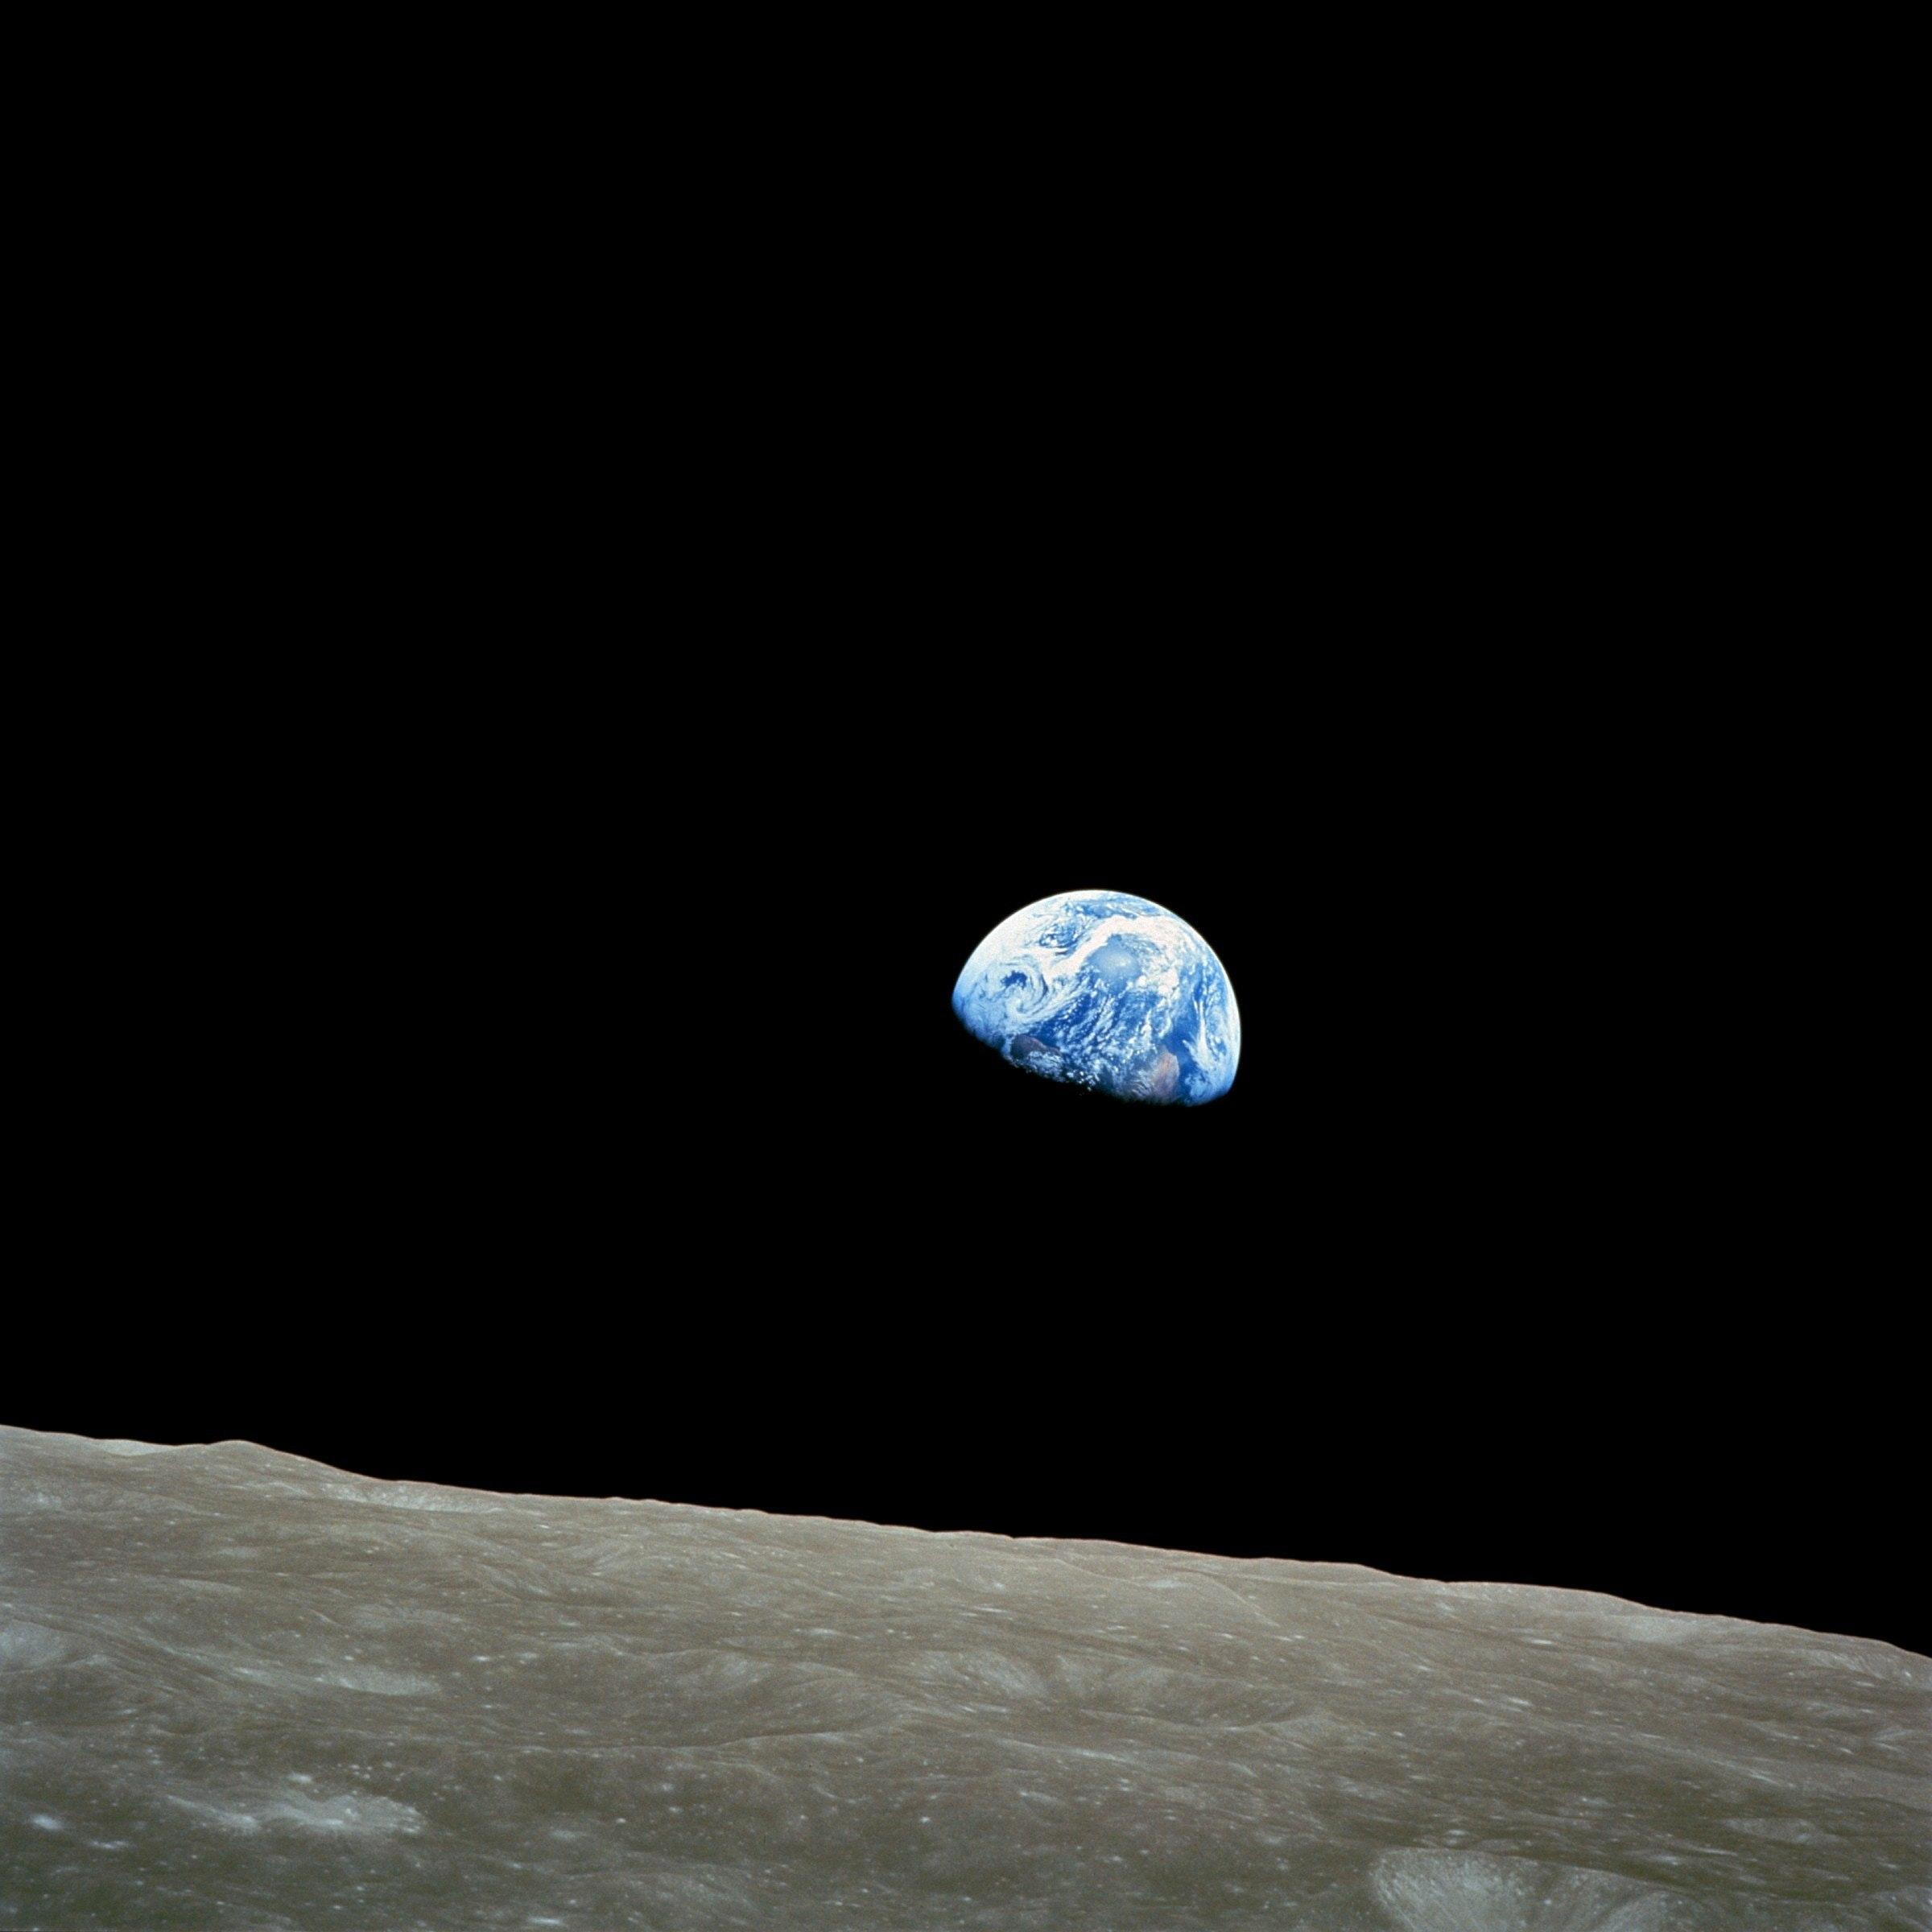
What are the first 3 words that come to you when you see this image?
(try not to edit yourself, just see what first arises for you,
and be curious)
Notes:
You could invite students to share words in the chat and/or use a Google Form: https://forms.gle/2GRbcxBccYXqtegRA

Slide 7
Does anyone know the story of this image?
What could be the story?
(and whose imagination brought us here, to this vantage point)
Notes:
This is a photograph taken by astronauts on the Apollo 8 mission to the moon in 1968 (Bill Anders, Frank Borman, and Jim Lovell), and later given the name “Earthrise.” The “Earthrise” photograph is often referred to as “the image that shared the world,” because it was the first photograph that showed the Earth from space (sort of like Earth looking in a mirror).

Slide 8

an opening invitation
Notes:
https://youtu.be/_wRmNY5JkVk

Slide 9
over 50 years later...
How might we understand and act differently
in the world right now?
Are people relating to the Earth as one ecosystem?
(Does technology help us see and experience this unity?)
Notes:
52 years after this photograph was taken, how might we build on “Earthrise”?
What might it mean to us and the world right now?
Are people relating to the Earth as “one ecosystem”?
As “shared home”?
Why? Why not?
With technology to see images like this often (ex. Google maps, Google Earth, NASA websites)....
Are we going deeper, understanding of the Earth and each person’s relationship to it?
Are we creating new images that inspire and encourage us?
What are we focusing on?

Slide 10
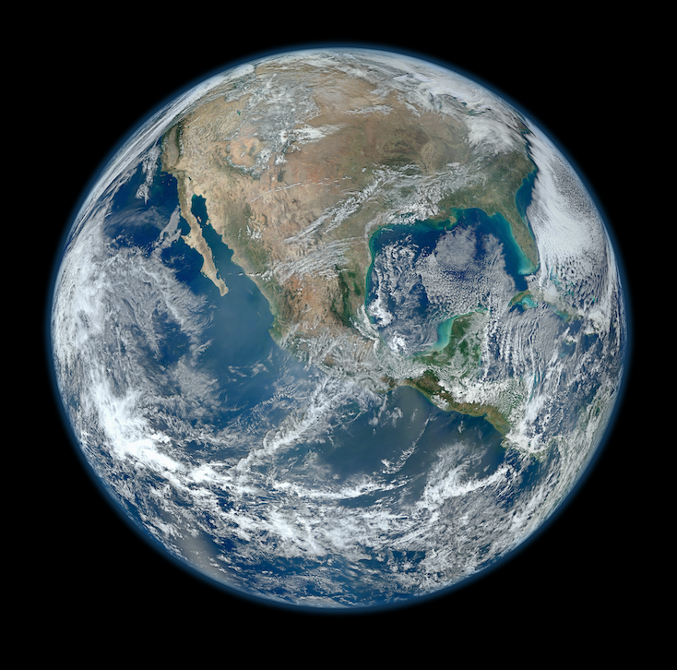
Notes:
* A short video you might use to illustrate the scientific story of Earth “Earth 101,” National Geographic

Slide 11
What do we mean when we say “environment”?
Notes:
You might invite students to write down (maybe share in the chat if online) the first 3-5 words that come when they hear the word ‘environment’”? (*again without edits; the first words that come to you)
Any patterns in the words that can be found? Where is our attention most focused?

Slide 12
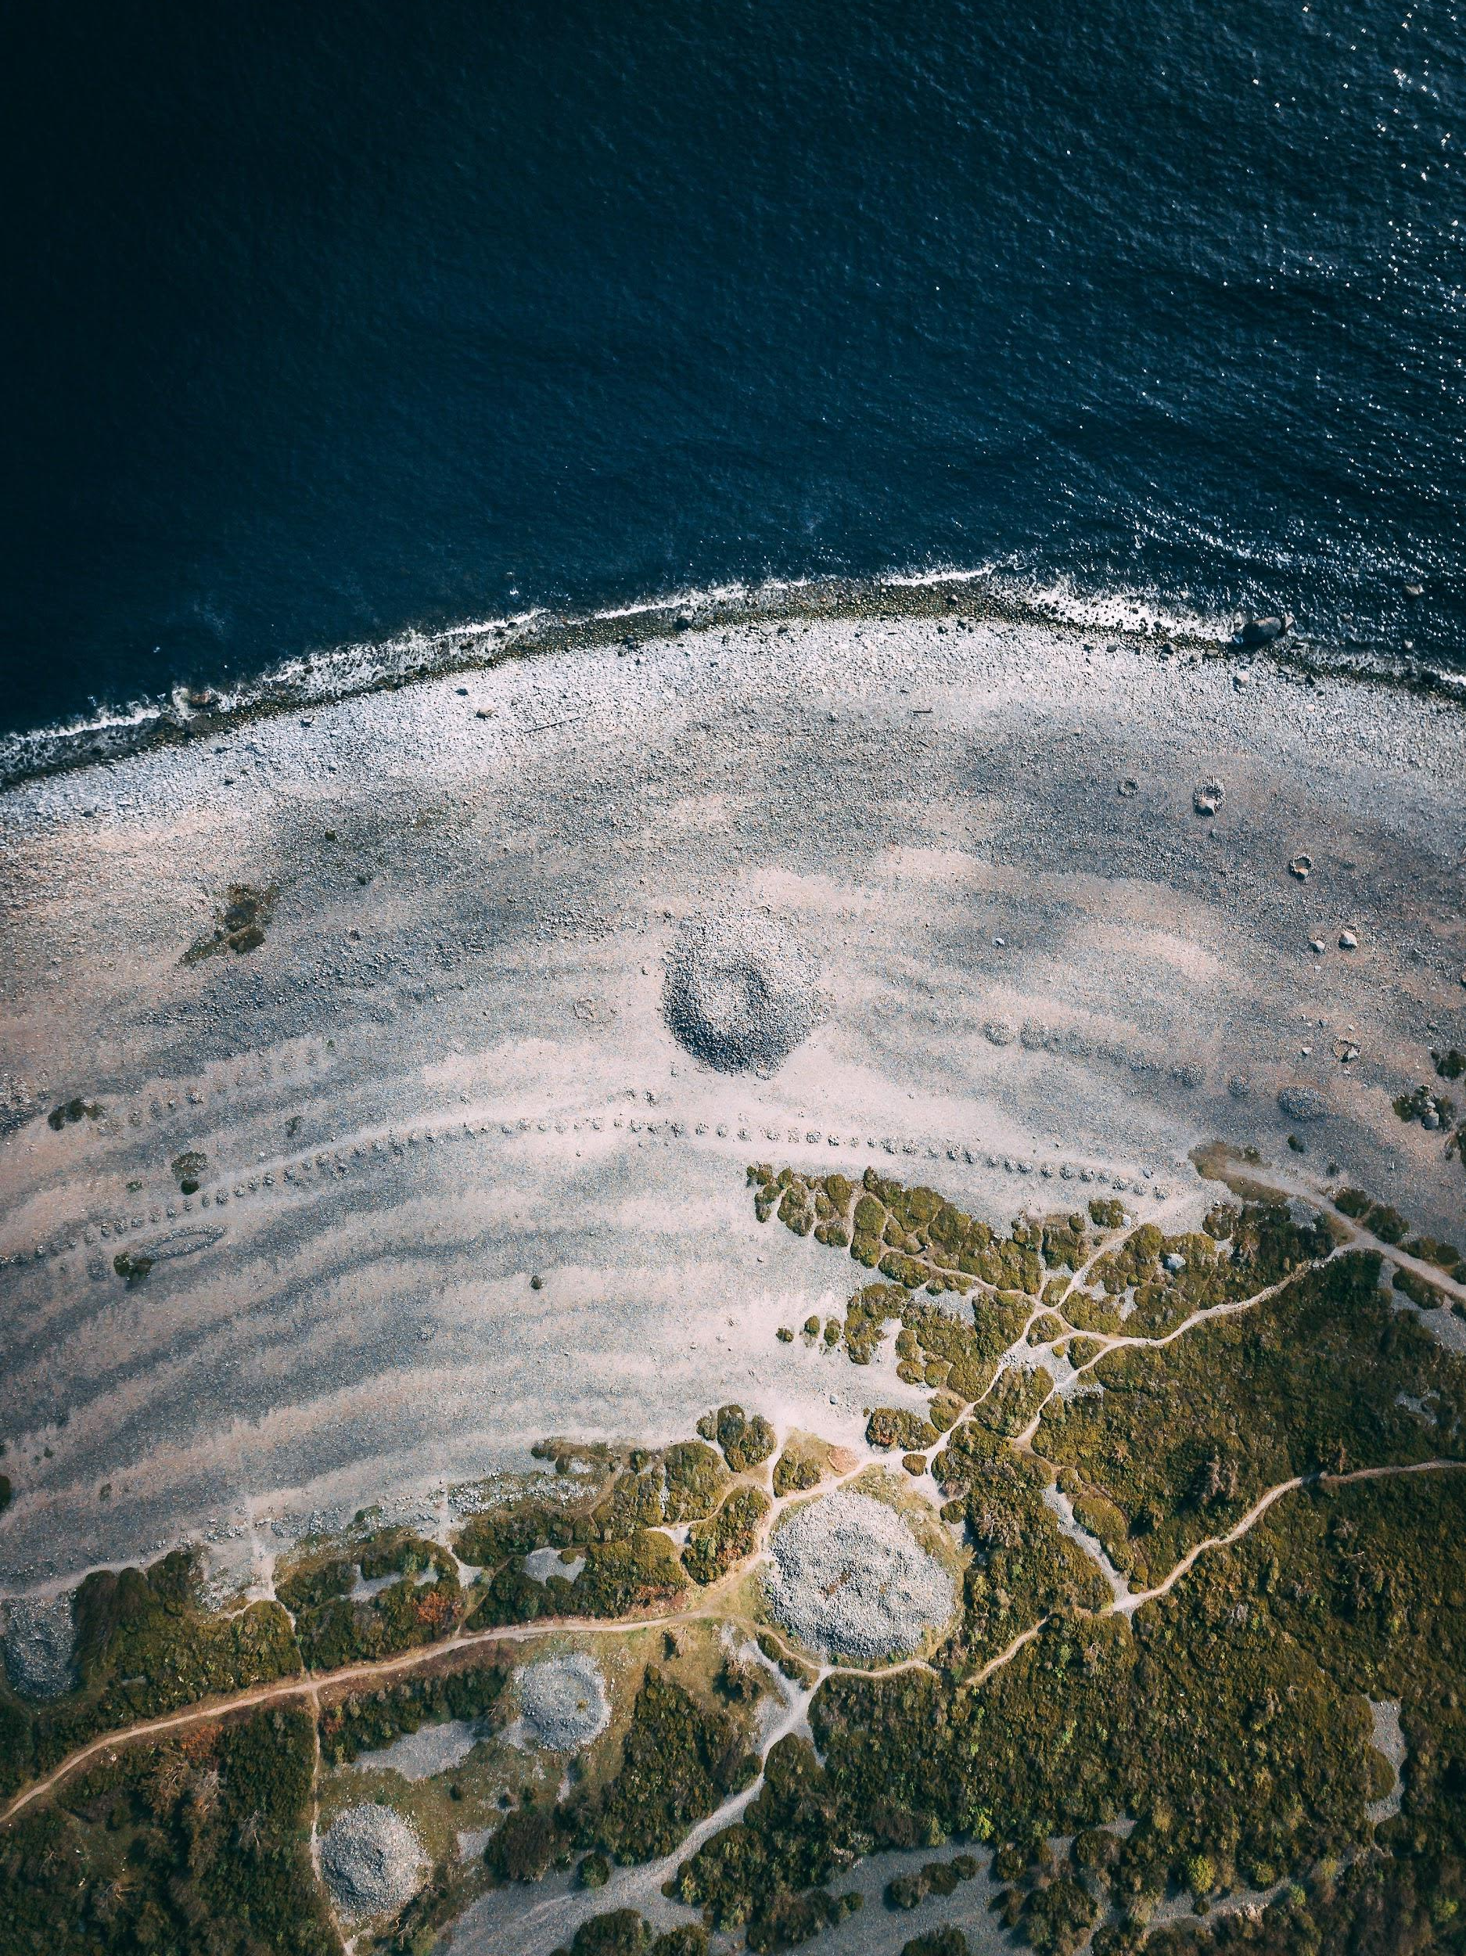
“go further”
What do we include?
Where are the boundaries and borders?
What do we mean when we say “environment”?

Slide 13
Who is an “environmentalist”?
An “environmentalist” can be a profession, and is often associated with only a small section of people, but here is the definition in the dictionary:
“An environmentalist is a person who is concerned with and/or
advocates for the protection of the environment,”
of and from which we all emerge.
Notes:
What might be some of the impacts (results) of having a narrow idea of who is an “environmentalist”? Impacts on the Earth? On our communities?
Who is telling the story of Earth and Nature/natural resources? (*How could you research this?)
Which voices are not being heard?
Why does the “environment” need protection?

Slide 14
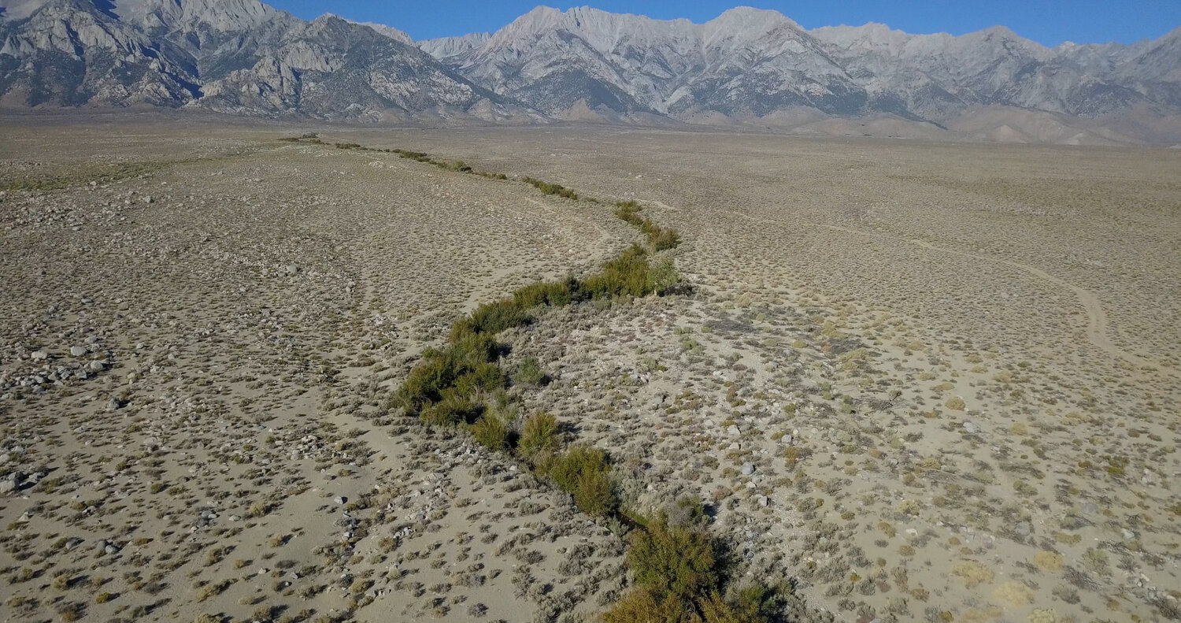
Island Home
Manzanar Diverted

Slide 15
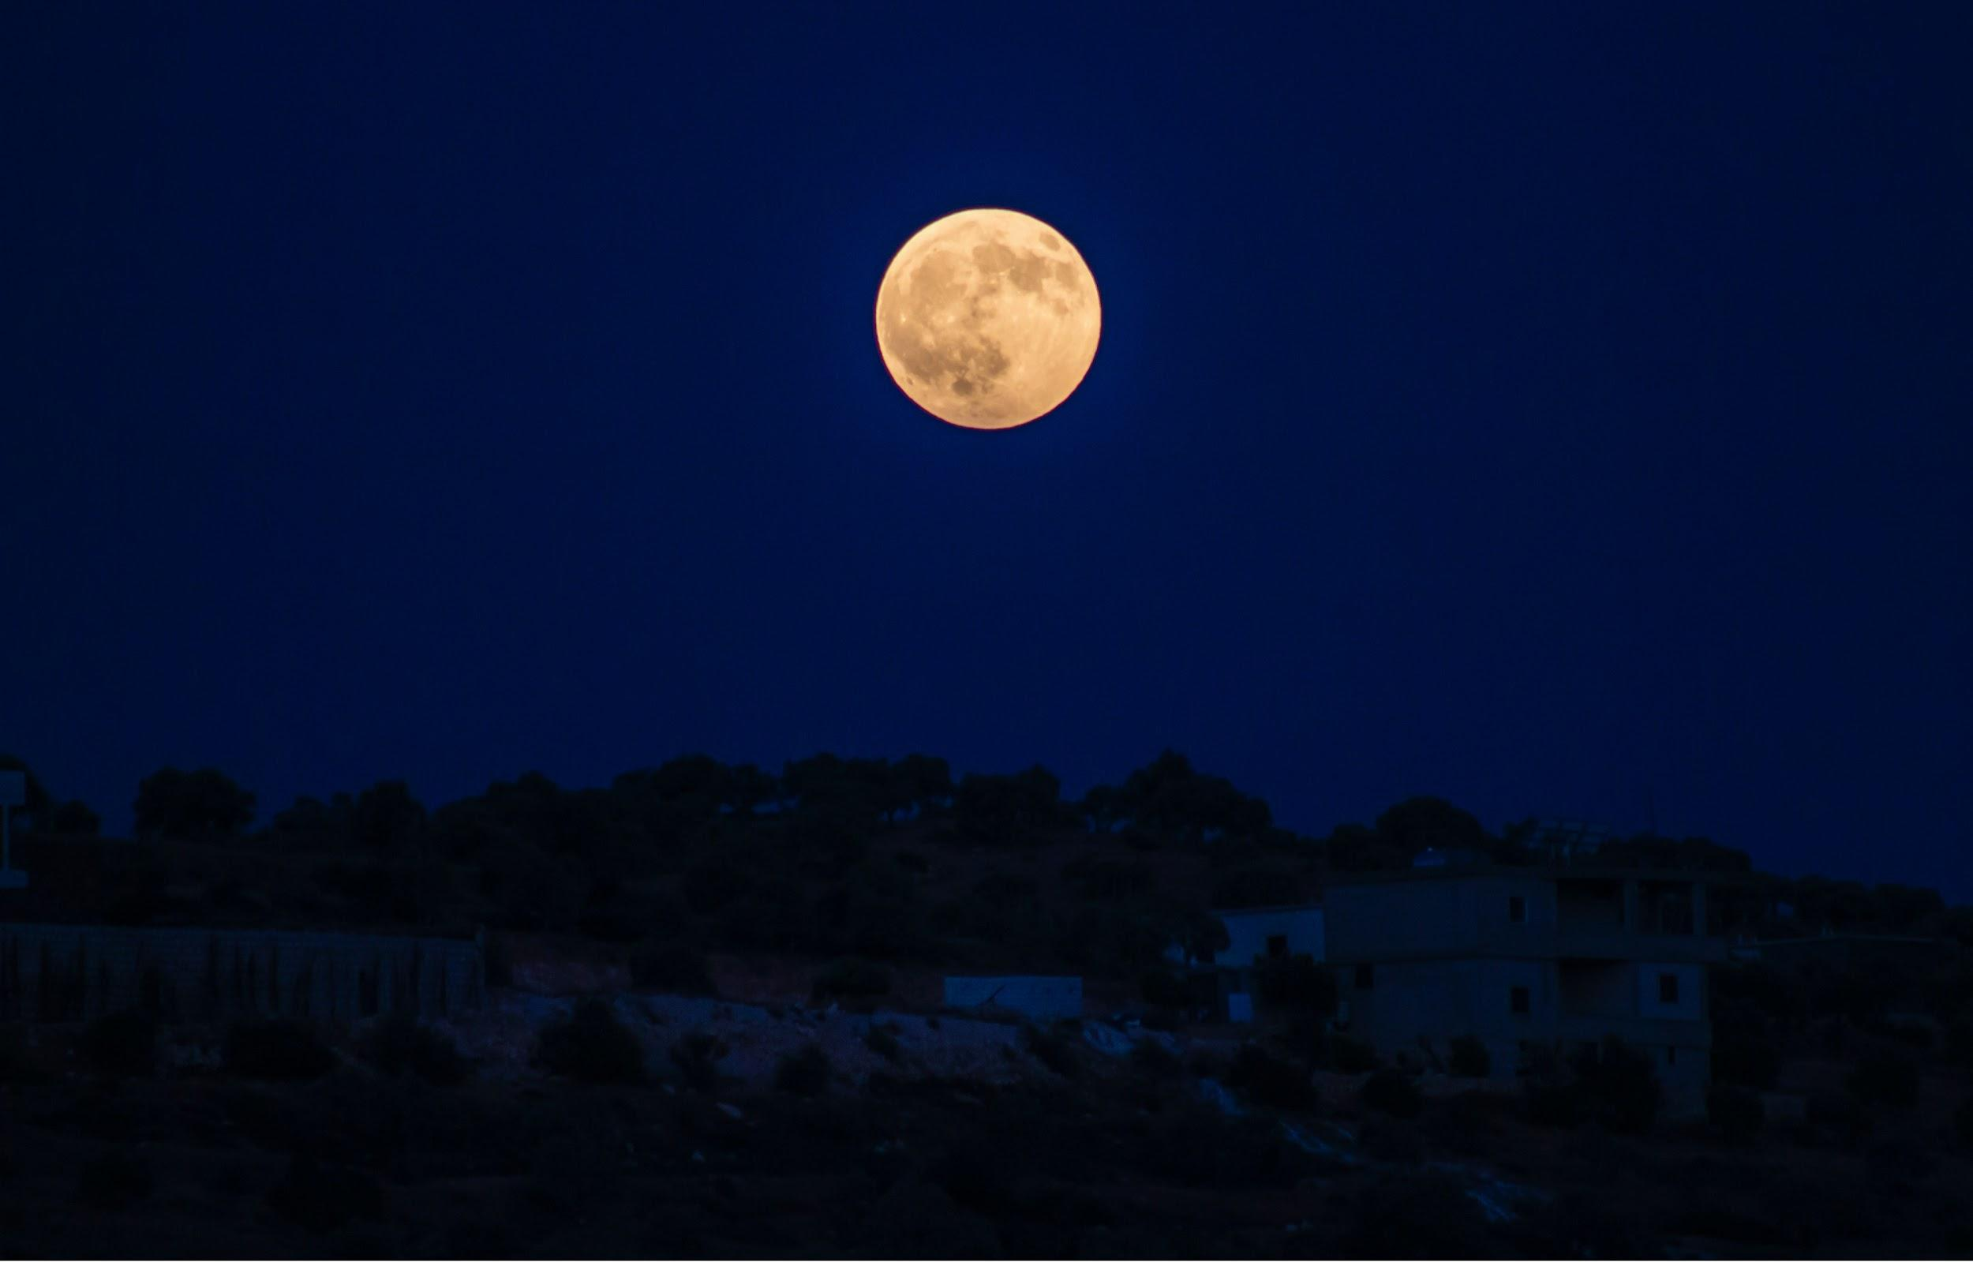
“It really boils down to this: that all life is interrelated.”
– Martin Luther King Jr.
Notes:
Full quote: “It really boils down to this: that all life is interrelated. We are all caught in an inescapable network of mutuality, tied into a single garment of destiny. Whatever affects one destiny, affects all indirectly.”

Slide 16
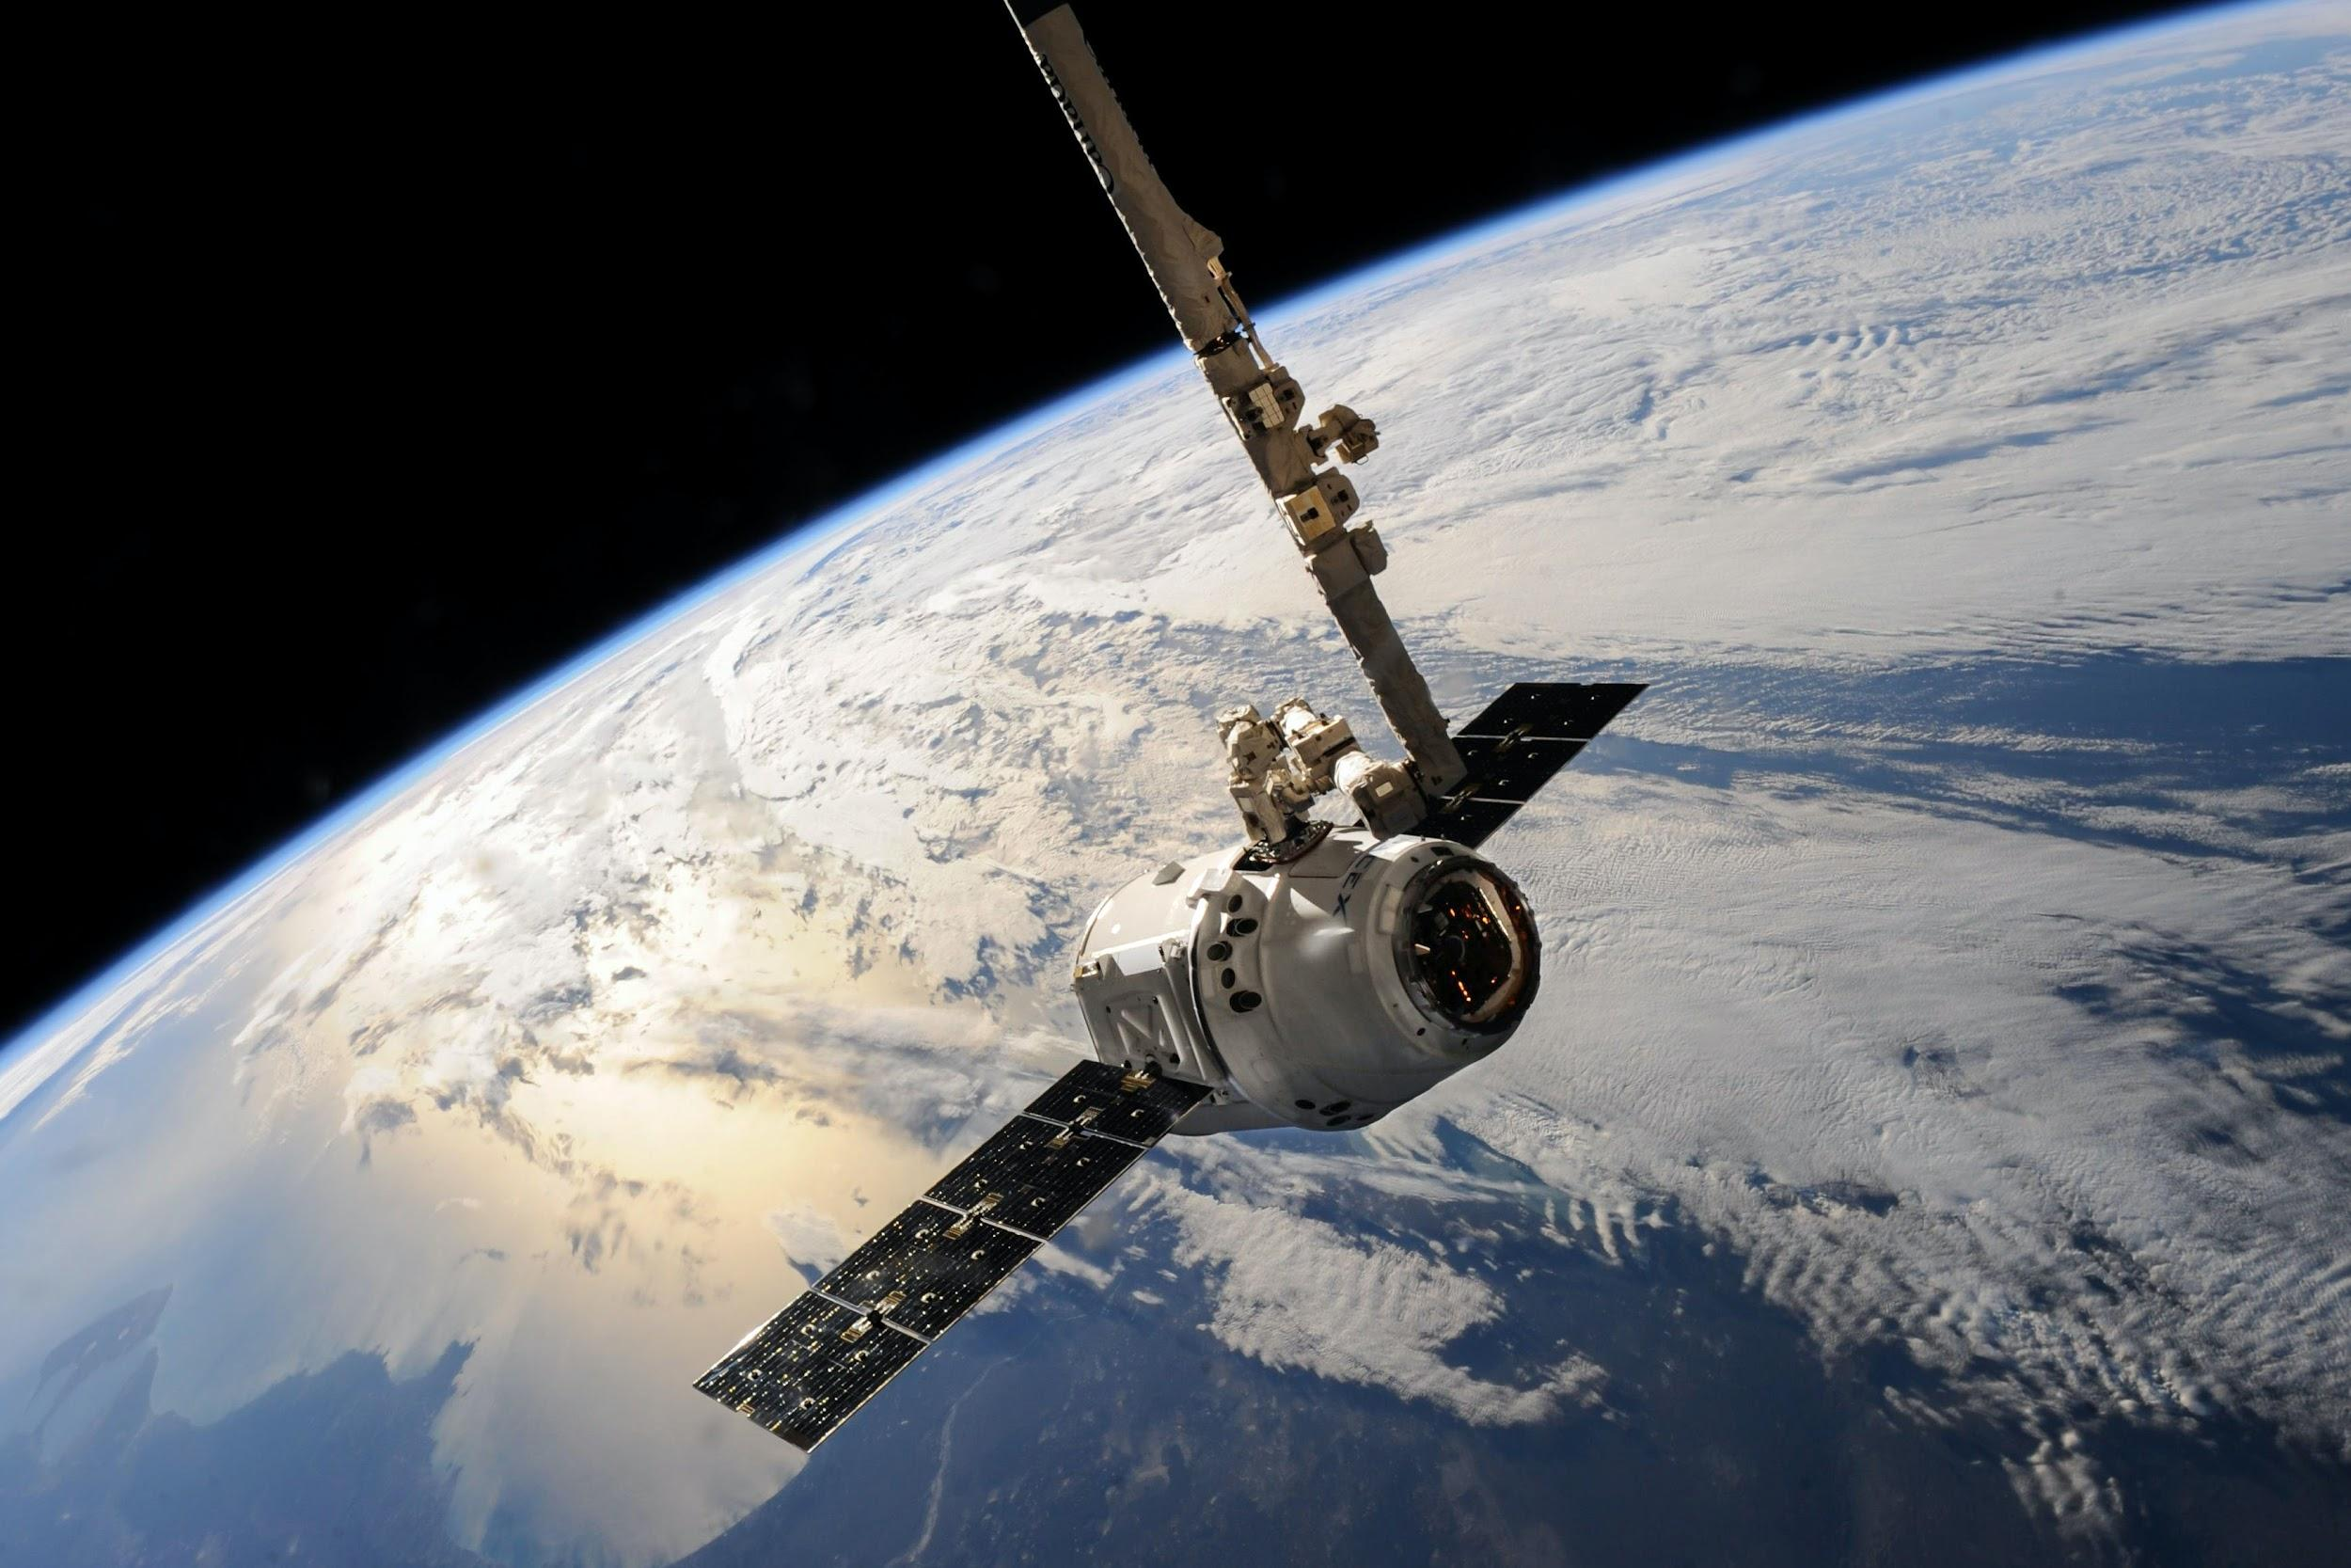


challenge:
Change the perspective, change the story

