Slide 1


Slide 2
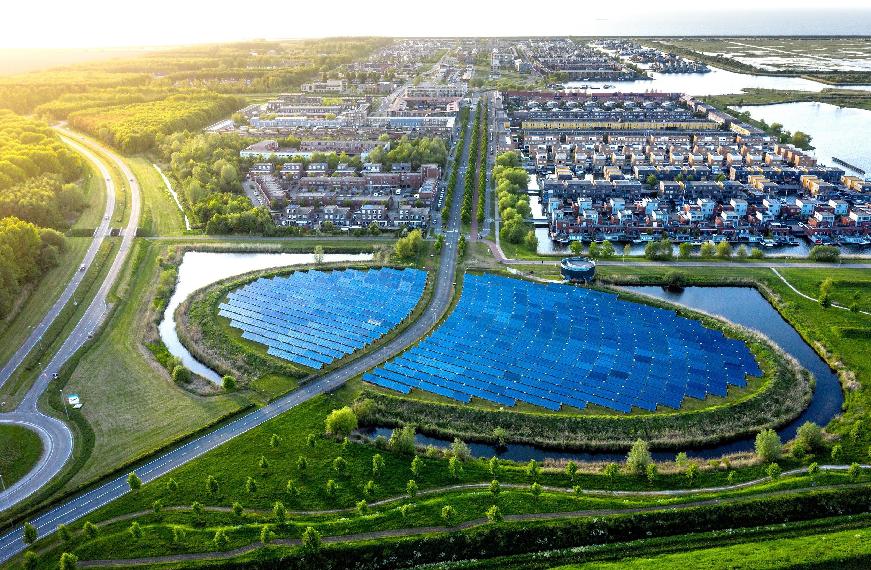
ch.10
Redford Center Stories Challenge

Slide 3

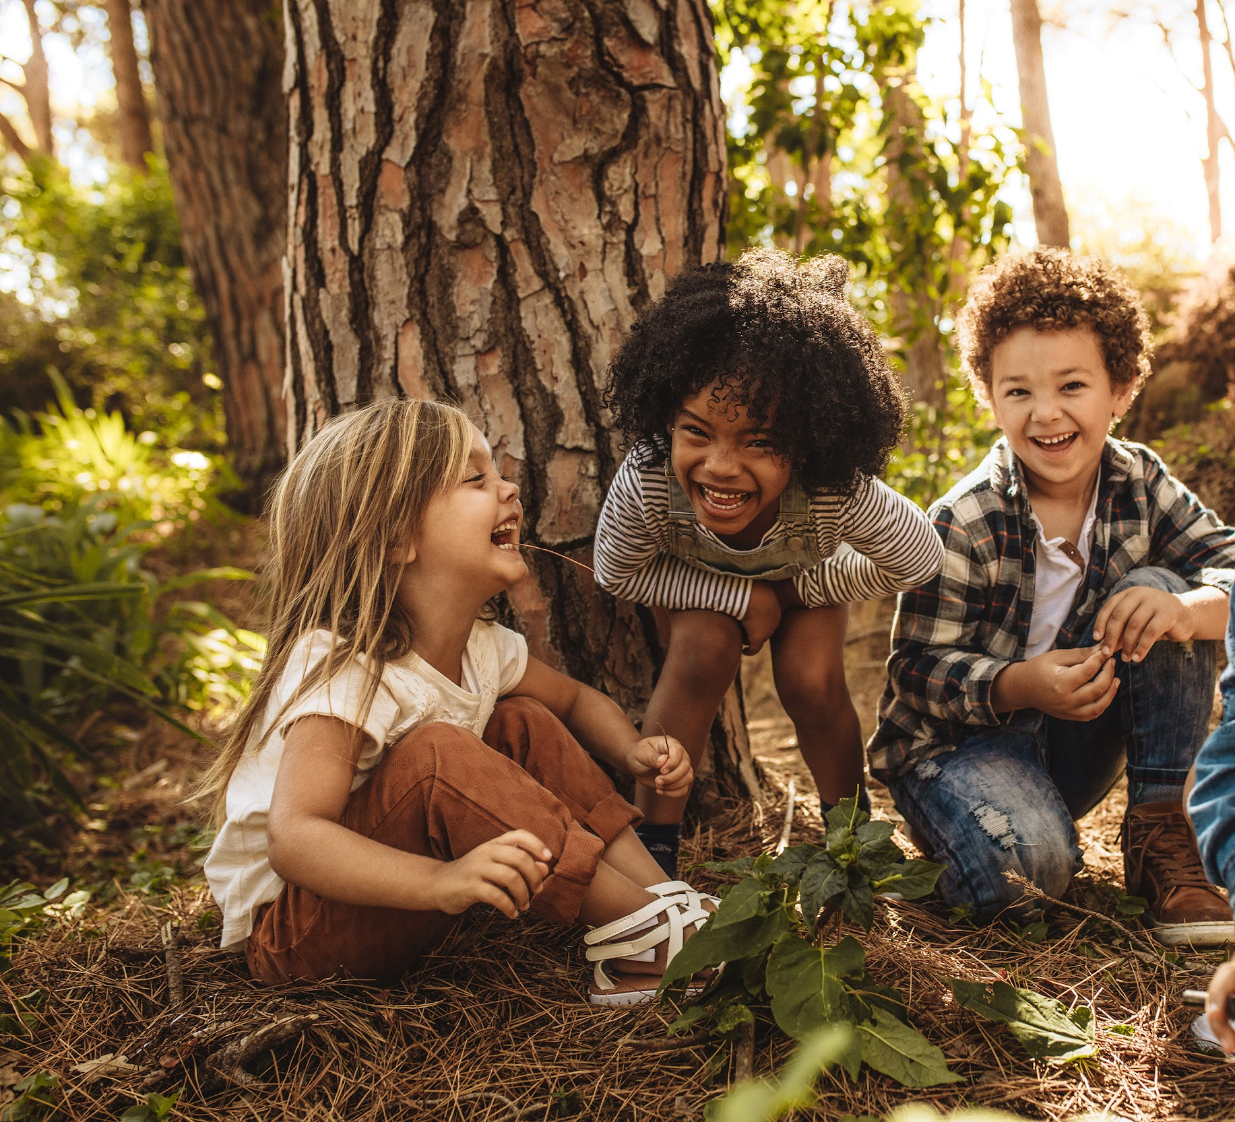
“The urgency of climate change and many of the related environmental challenges we face mandates that we saturate our culture with stories that inspire action...As the next few decades will be critical in terms of minimizing the impact of climate change, it’s particularly important that we support and promote the voices of our youth.”
– JAMES REDFORD
Co-Founder, The Redford Center

Slide 4
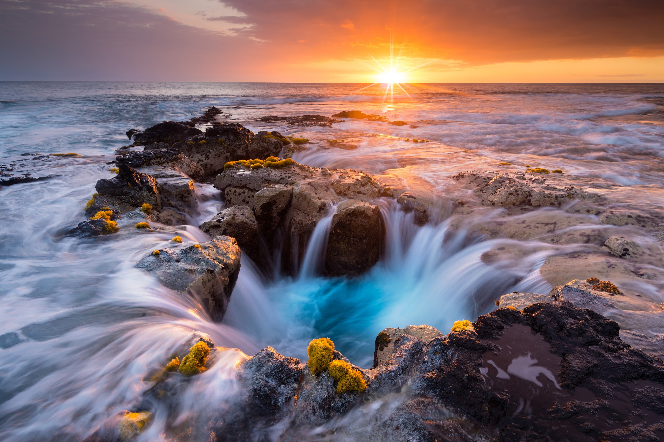

Speak to young people in a language they’re using.
Give them platforms and bandwidths to tell the stories that are meaningful to them.
The people I’ve been working with the last few years, whom I admire,
have great respect for the potential of integrating these technologies…
How we see the world is how we tell our story.
I want my life to be devoted to the way people see their lives as rich and valuable,
and an integral part of humanity’s story.
If one story is missing, the tapestry is incomplete.
—Dr. Elizabeth Lindsey
Cultural anthropologist
first female National Geographic Explorer
E.O. Wilson
Notes:
Interview with Dr. Elizabeth Lindsey: https://www.mauimagazine.net/mapping-human-story/
Learn more about Dr. Lindsey and her work: https://www.elizabethlindsey.com

Slide 5
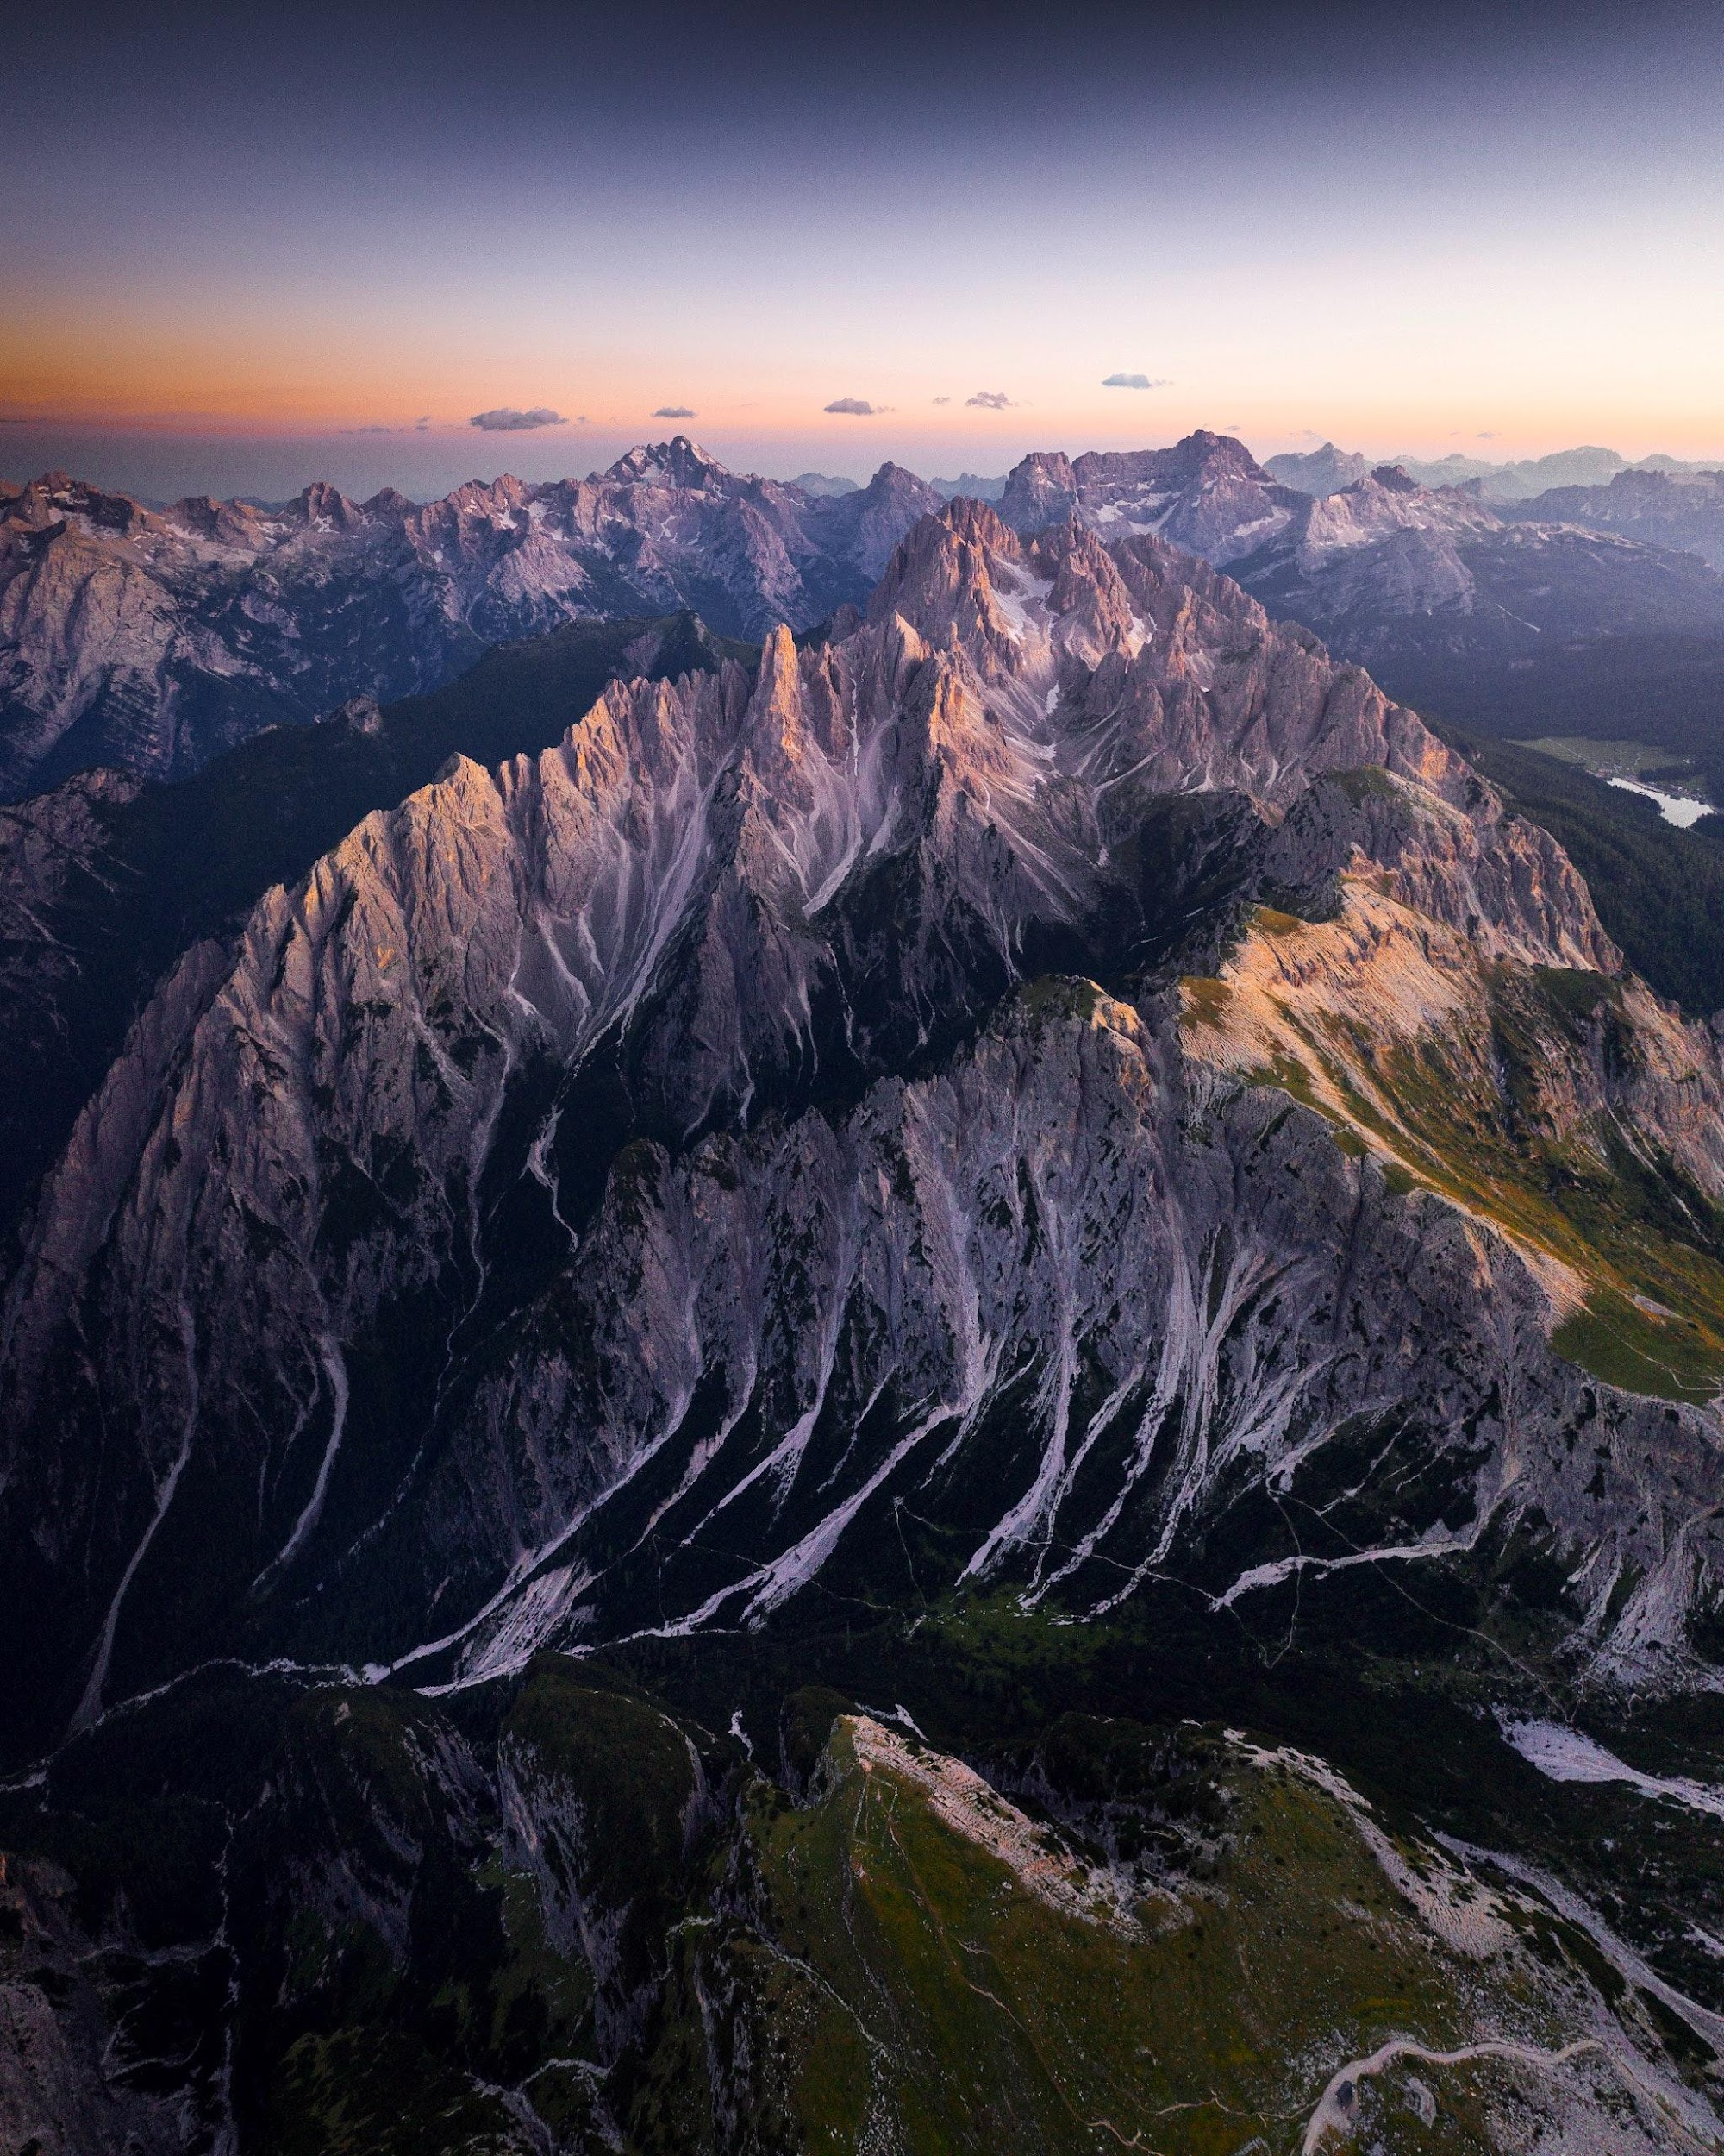



REDFORD CENTER STORIES CHALLENGE
Young people across the globe are bringing an infusion of energy to the movement for environmental justice — and we invite students to be a part of it! The Redford Center invites young people to tell their story, raise their voice, and help change the conversation about what environmentalism and environmental justice looks like through short video format
(90 seconds or less) so we can move more people into action.
The Ripple

Slide 6
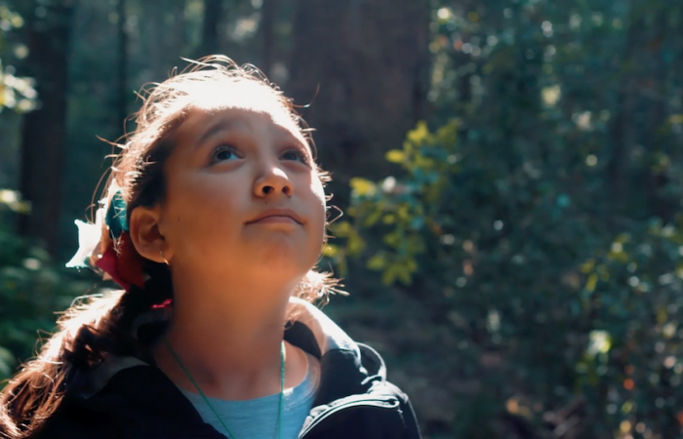
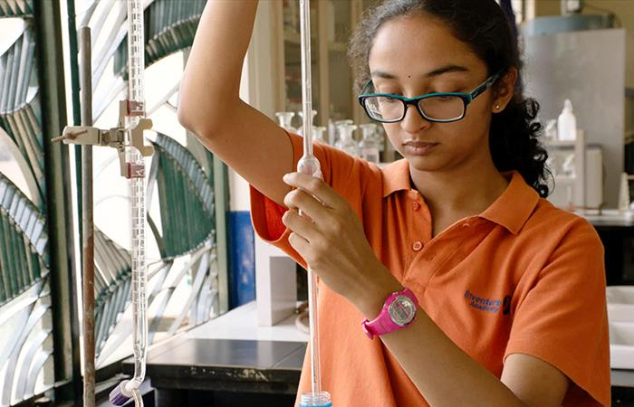
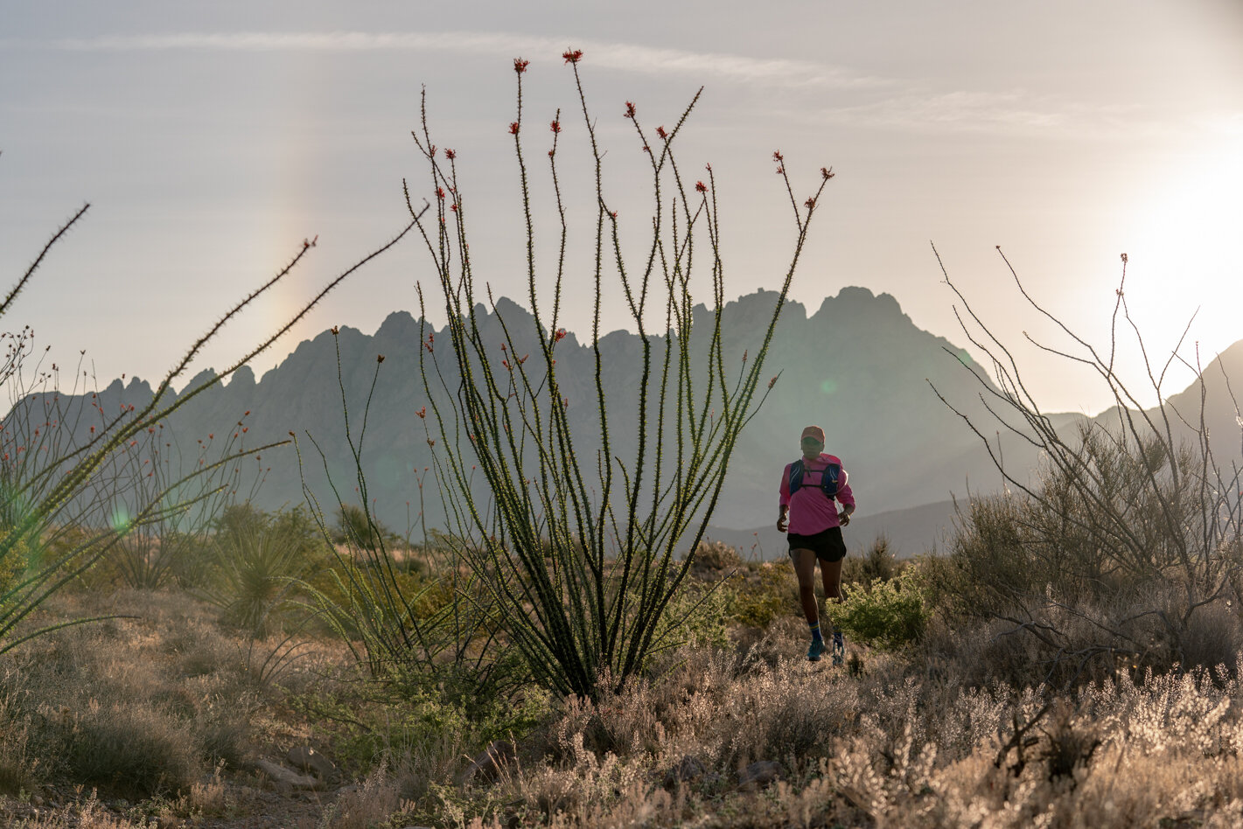
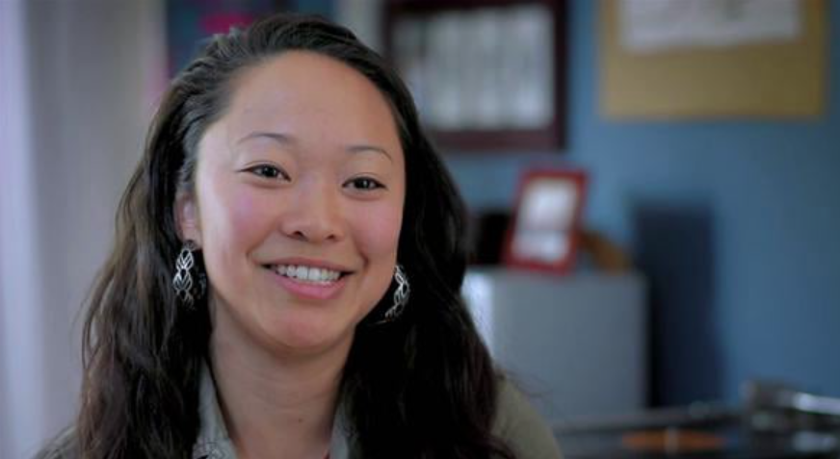
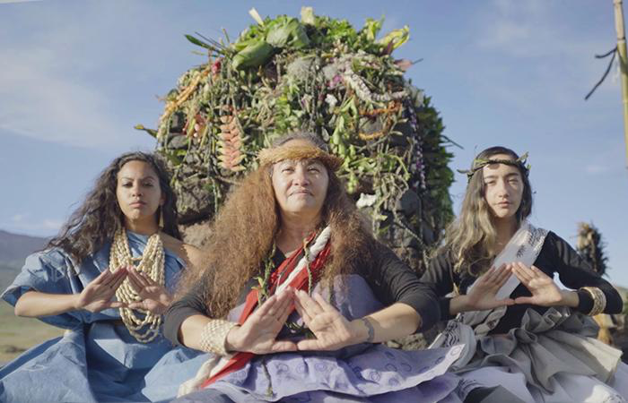
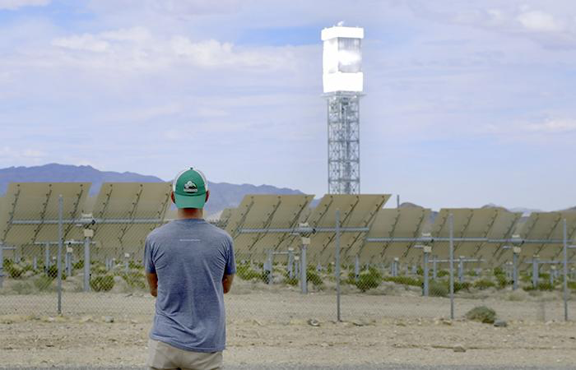
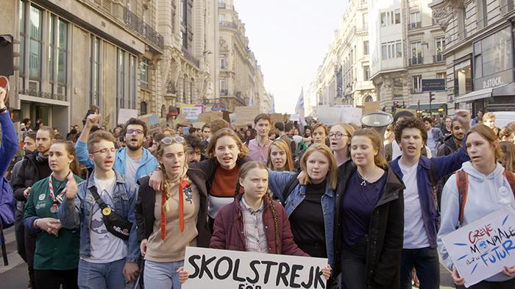
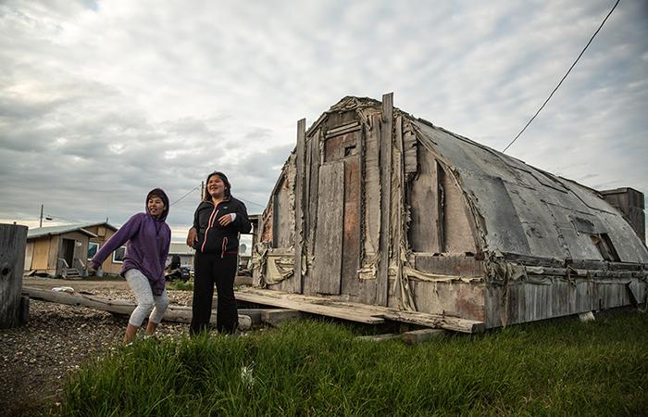
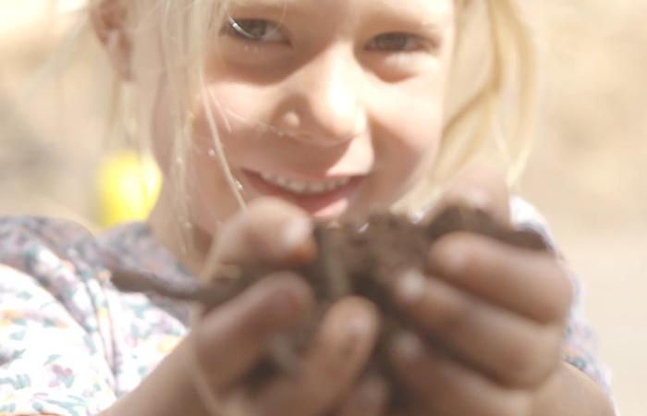
The Nature Film
Inventing Tomorrow
Standing Above the Clouds
This Land
Standing Above
the Clouds
Happening: A Clean Energy Revolution
Art of Activism: Ellen Choy
Notes:
The Nature Film: https://redfordcenter.org/films/nature-film
Inventing Tomorrow: https://www.pbs.org/video/lesson-plan-clip-2-inventing-tomorrow/
This Land: * Clean Version
Art of Activism: Ellen Choy: https://youtu.be/3EbY7iUFtuo
Standing Above the Clouds: https://vimeo.com/363397315; PW: maunakea
Happening: https://happeningthemovie.com

Slide 7
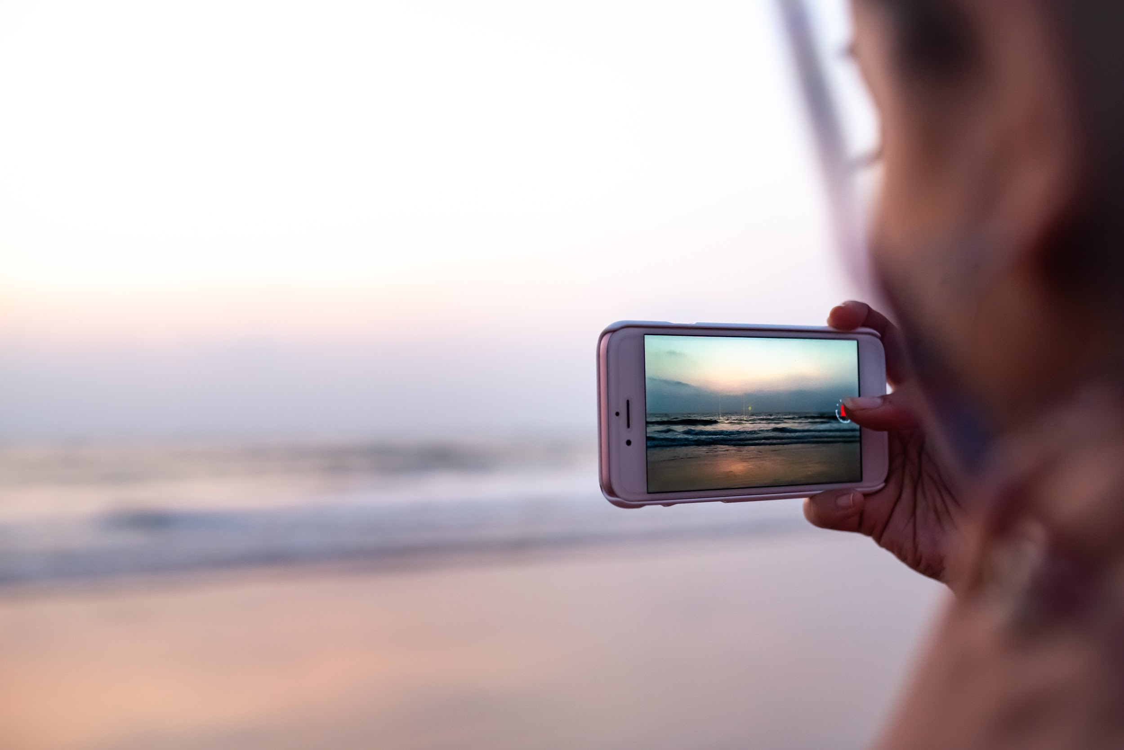


Join activists, filmmakers, scientists, and students from across the world in telling stories of what is, and what can be…
This year’s Redford Center Stories Challenge theme: environmental justice - bringing forward a more just, healthy, beautiful world.
We invite students to make their own original
90-second video/film.
Notes:
See prompts on the next three slides (Note: prompt #3 is an open prompt, so follow your inspiration!)
Click HERE for downloadable prompts sheet, English/Spanish.

Slide 8
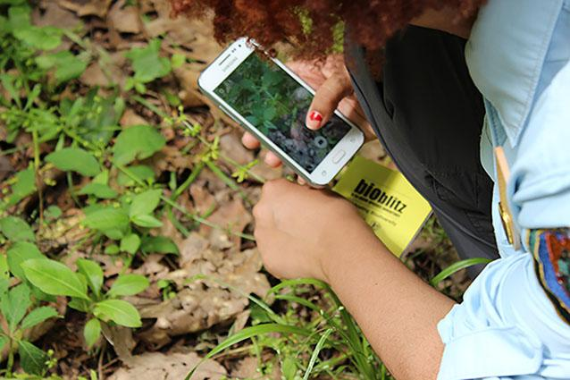
1
The future I envision is….
What do you envision for the future of our world and our environment? A vision statement is a powerful thing to imagine and share with others so that communities can come together who share similar goals and missions. They can be inspiring and energizing to collective action.
The Redford Center envisions a world in equitable balance, where human and planetary health and justice are fundamental values driving action. What future do you envision? How can we work to make it a reality? It might be a letter/poem from your future self that tells us how you responded to the moment we are in.
Notes:
Click HERE for downloadable prompts sheet, English/Spanish.

Slide 9
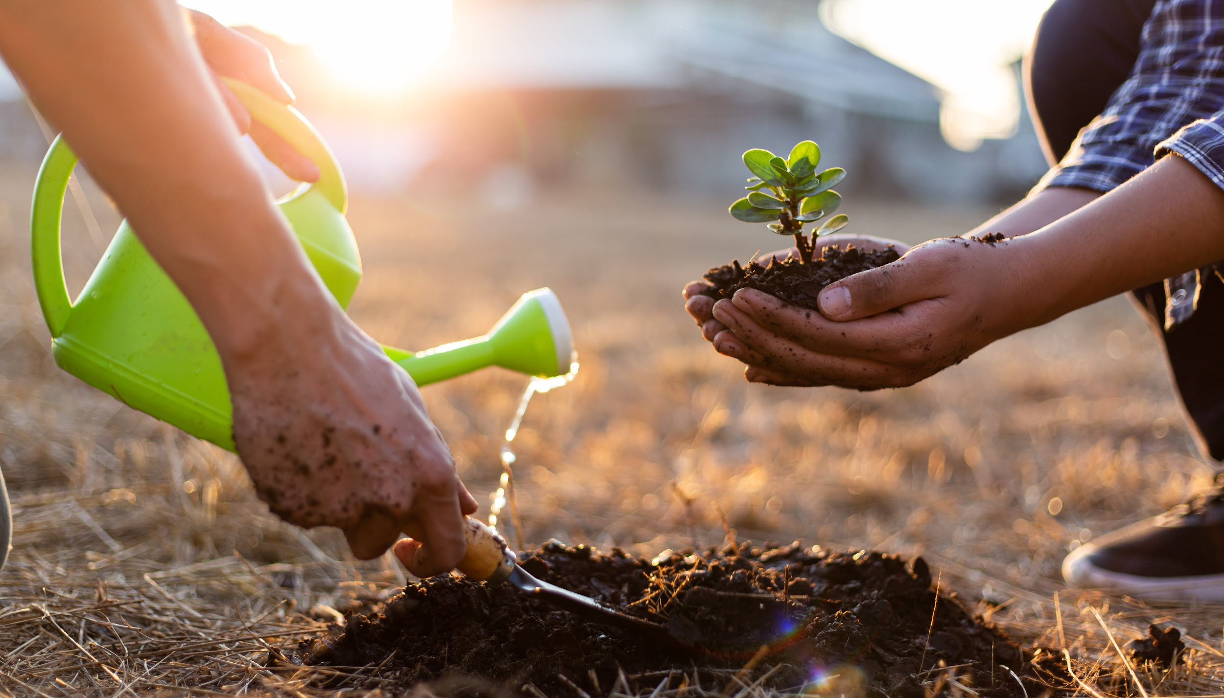
2
I’m an environmentalist because…
This is your opportunity to stake your claim as an “environmentalist.” What are you fighting for? How are you investing in environmental justice, protection, and/or regeneration? What are you doing to meet the moment? You might share a story you’re moved to tell from your own community that reflects what environmentalism and climate justice looks/feels like.
Notes:
Click HERE for downloadable prompts sheet, English/Spanish.

Slide 10
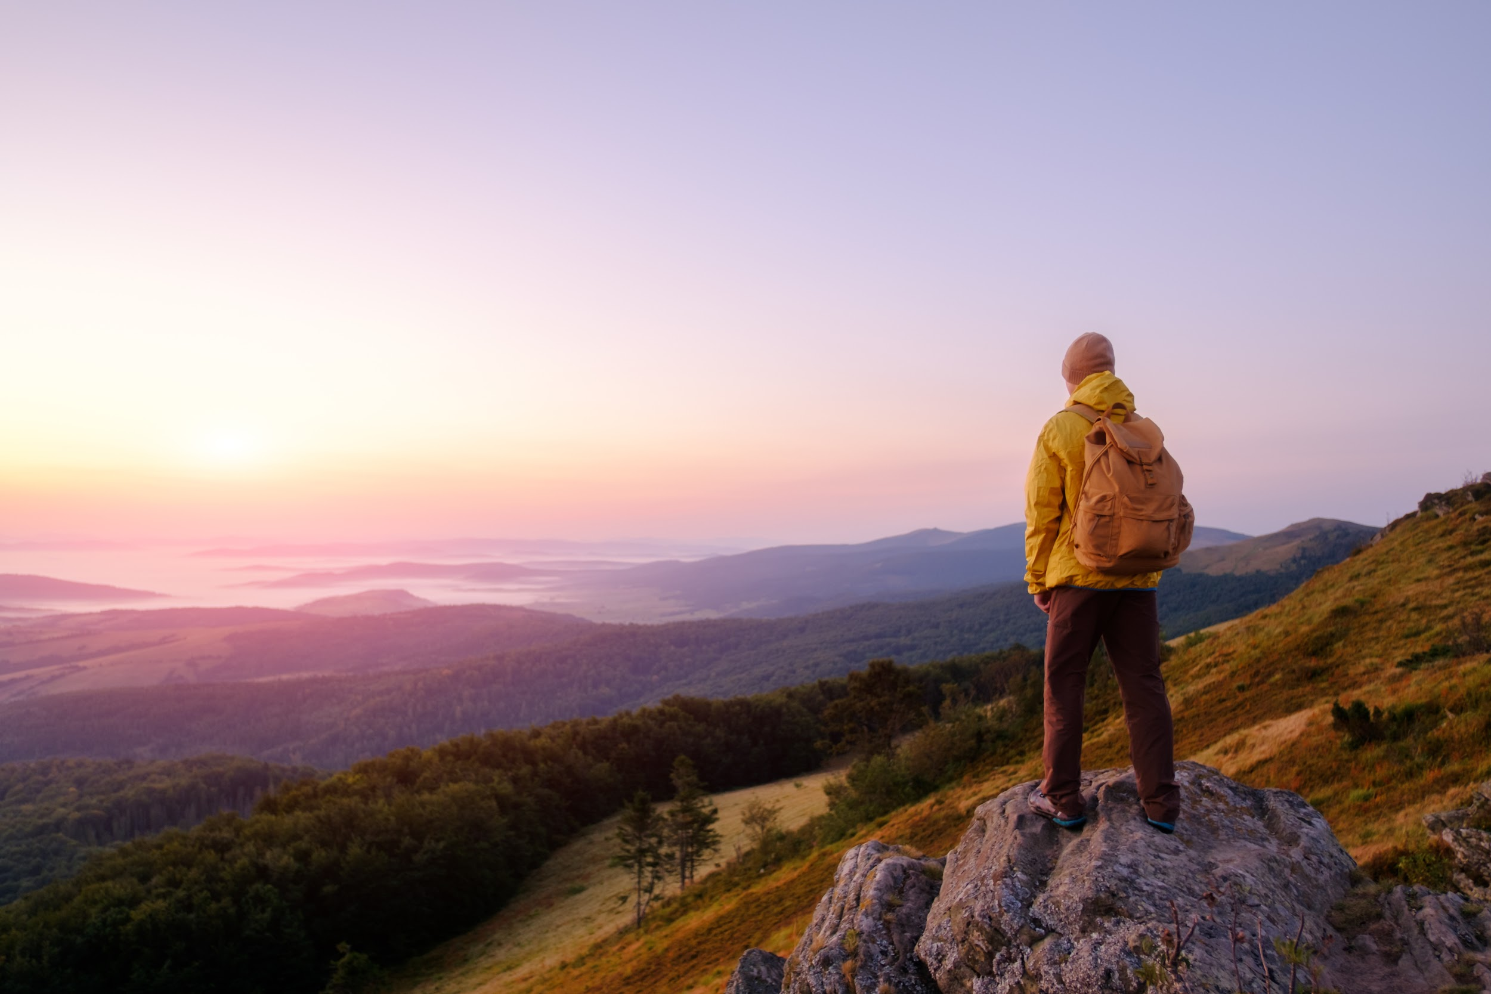
3
A call to action.
Create a public service announcement (PSA) that creates awareness about, or shows the importance and impact of, a problem facing the environment, or the communities most impacted by the climate emergency. What do you want your audience to feel and to know? What behavioral change do you hope to people will make, and how can you help inspire this change? You might take the opportunity to tell the story of your environment (the good and the bad). Research/identify threats to your home town + solutions to address these threats. What solutions have been tried? What are things individual people can do? What systemic changes are needed? Provide a suggested solution and a tangible way to take action.
Notes:
Click HERE for downloadable prompts sheet, English/Spanish.
You might share a story you’re moved to tell from your own community that reflects what you think is something worth sharing about what environmentalism and climate justice looks/feels like. It might be a letter/poem from your future self that tells us how you responded to the moment we are in. What did you do in 2021 to meet the moment/create a different future?

Slide 11
Questions to ask yourself in making your film:
What story do I want to explore/tell?
Who would I like my audience to be?
What would I like the audience to feel/experience?
What would I like the audience to do?
Notes:
Also see student checklist.

Slide 12


Steps you might consider:
1. Identifying the FOCUS/STORY/SCRIPT
Is there research you need to do/interviews?
How might certain data strengthen your narrative?
What’s one new thing you hope your audience learns?

Slide 13
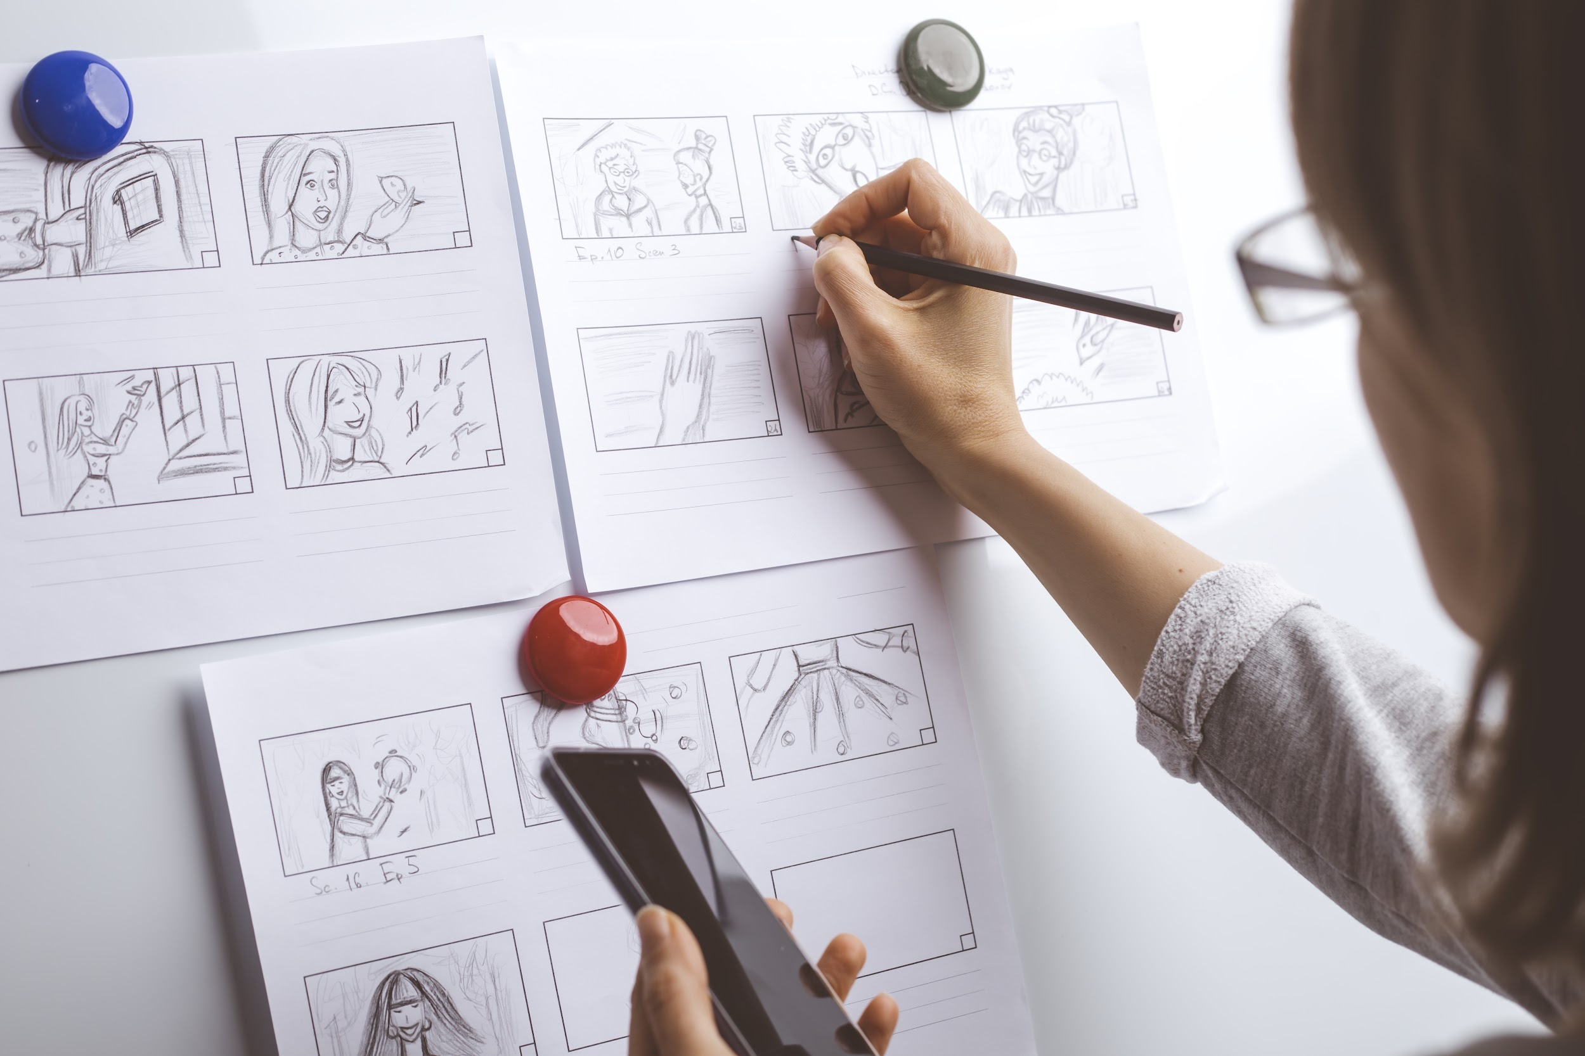
Steps you might consider:
2. STORYBOARDING (mapping)
Beginning - “establishing shot”
Middle - journey you take people on
End - what people are left with?
Click HERE for an example you can print/use
Notes:
For many people bringing an idea into the world, there is an important step between idea and creation for films, novels, comic books, and other mediums that require planning out scenes: making a storyboard. A storyboard is a visual outline of a film (including for short and feature film, across genres). It’s an important part of the preproduction process and consists of a series of images or notes that show/describe in short form everything that’s going to happen in the finished piece. Storyboards might be drawn by hand, or be written as notes like Post-Its (or you might consider having students use a program like Jamboard).
As/once different moments, elements, or things you want to include to illuminate your idea become clear enough to draw/write down, you might play with their order, arrangement. You can ask yourself: Is there a clear beginning, middle, and end?
Beginning - “establishing shot” (what do you want people to come in on/experience first?)
Middle - journey you take people on (what change, transition, possibility are you exploring?)
End - what people are left with? (what’s the thing you hope people take away?)

Slide 14
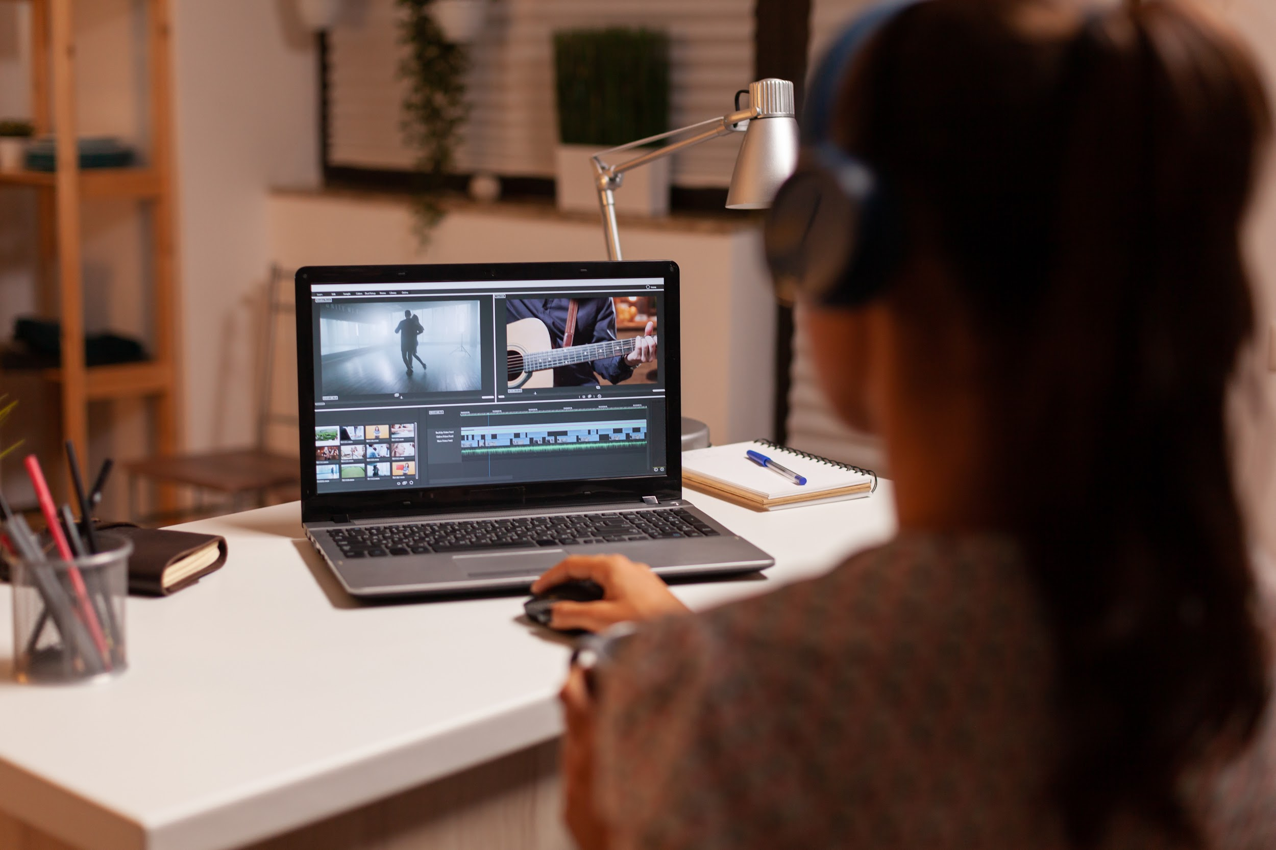
Steps you might consider:
3. SOUND
How can your message be heard in the
best way? Where should there be sound,
and where should there be quiet?
* You can record a track of your voice on a Voice Memo app, or as part of a camera recording.
Notes:
“Five Minute Film School,” Michael Hernandez: https://vimeo.com/395103646
It’s tempting to think of a video/film as a visual experience, but in many/most cases, even more important than the visuals is the quality of sound. You want each word spoken (if there are words) to be clear and easily audible. If there is music, is it coming across clearly? If you mix music and voice, how can they support each other, instead of one overriding the other?
How can your message be heard in the best way?
Where should there be sound, and where should there be quiet? How will you know?
Do you want to include natural sounds? The sounds of nature, water, birds, a city?
If you imagine your audience includes people who don’t speak the same language as you, what might be the role of sound in communicating your message?

Slide 15
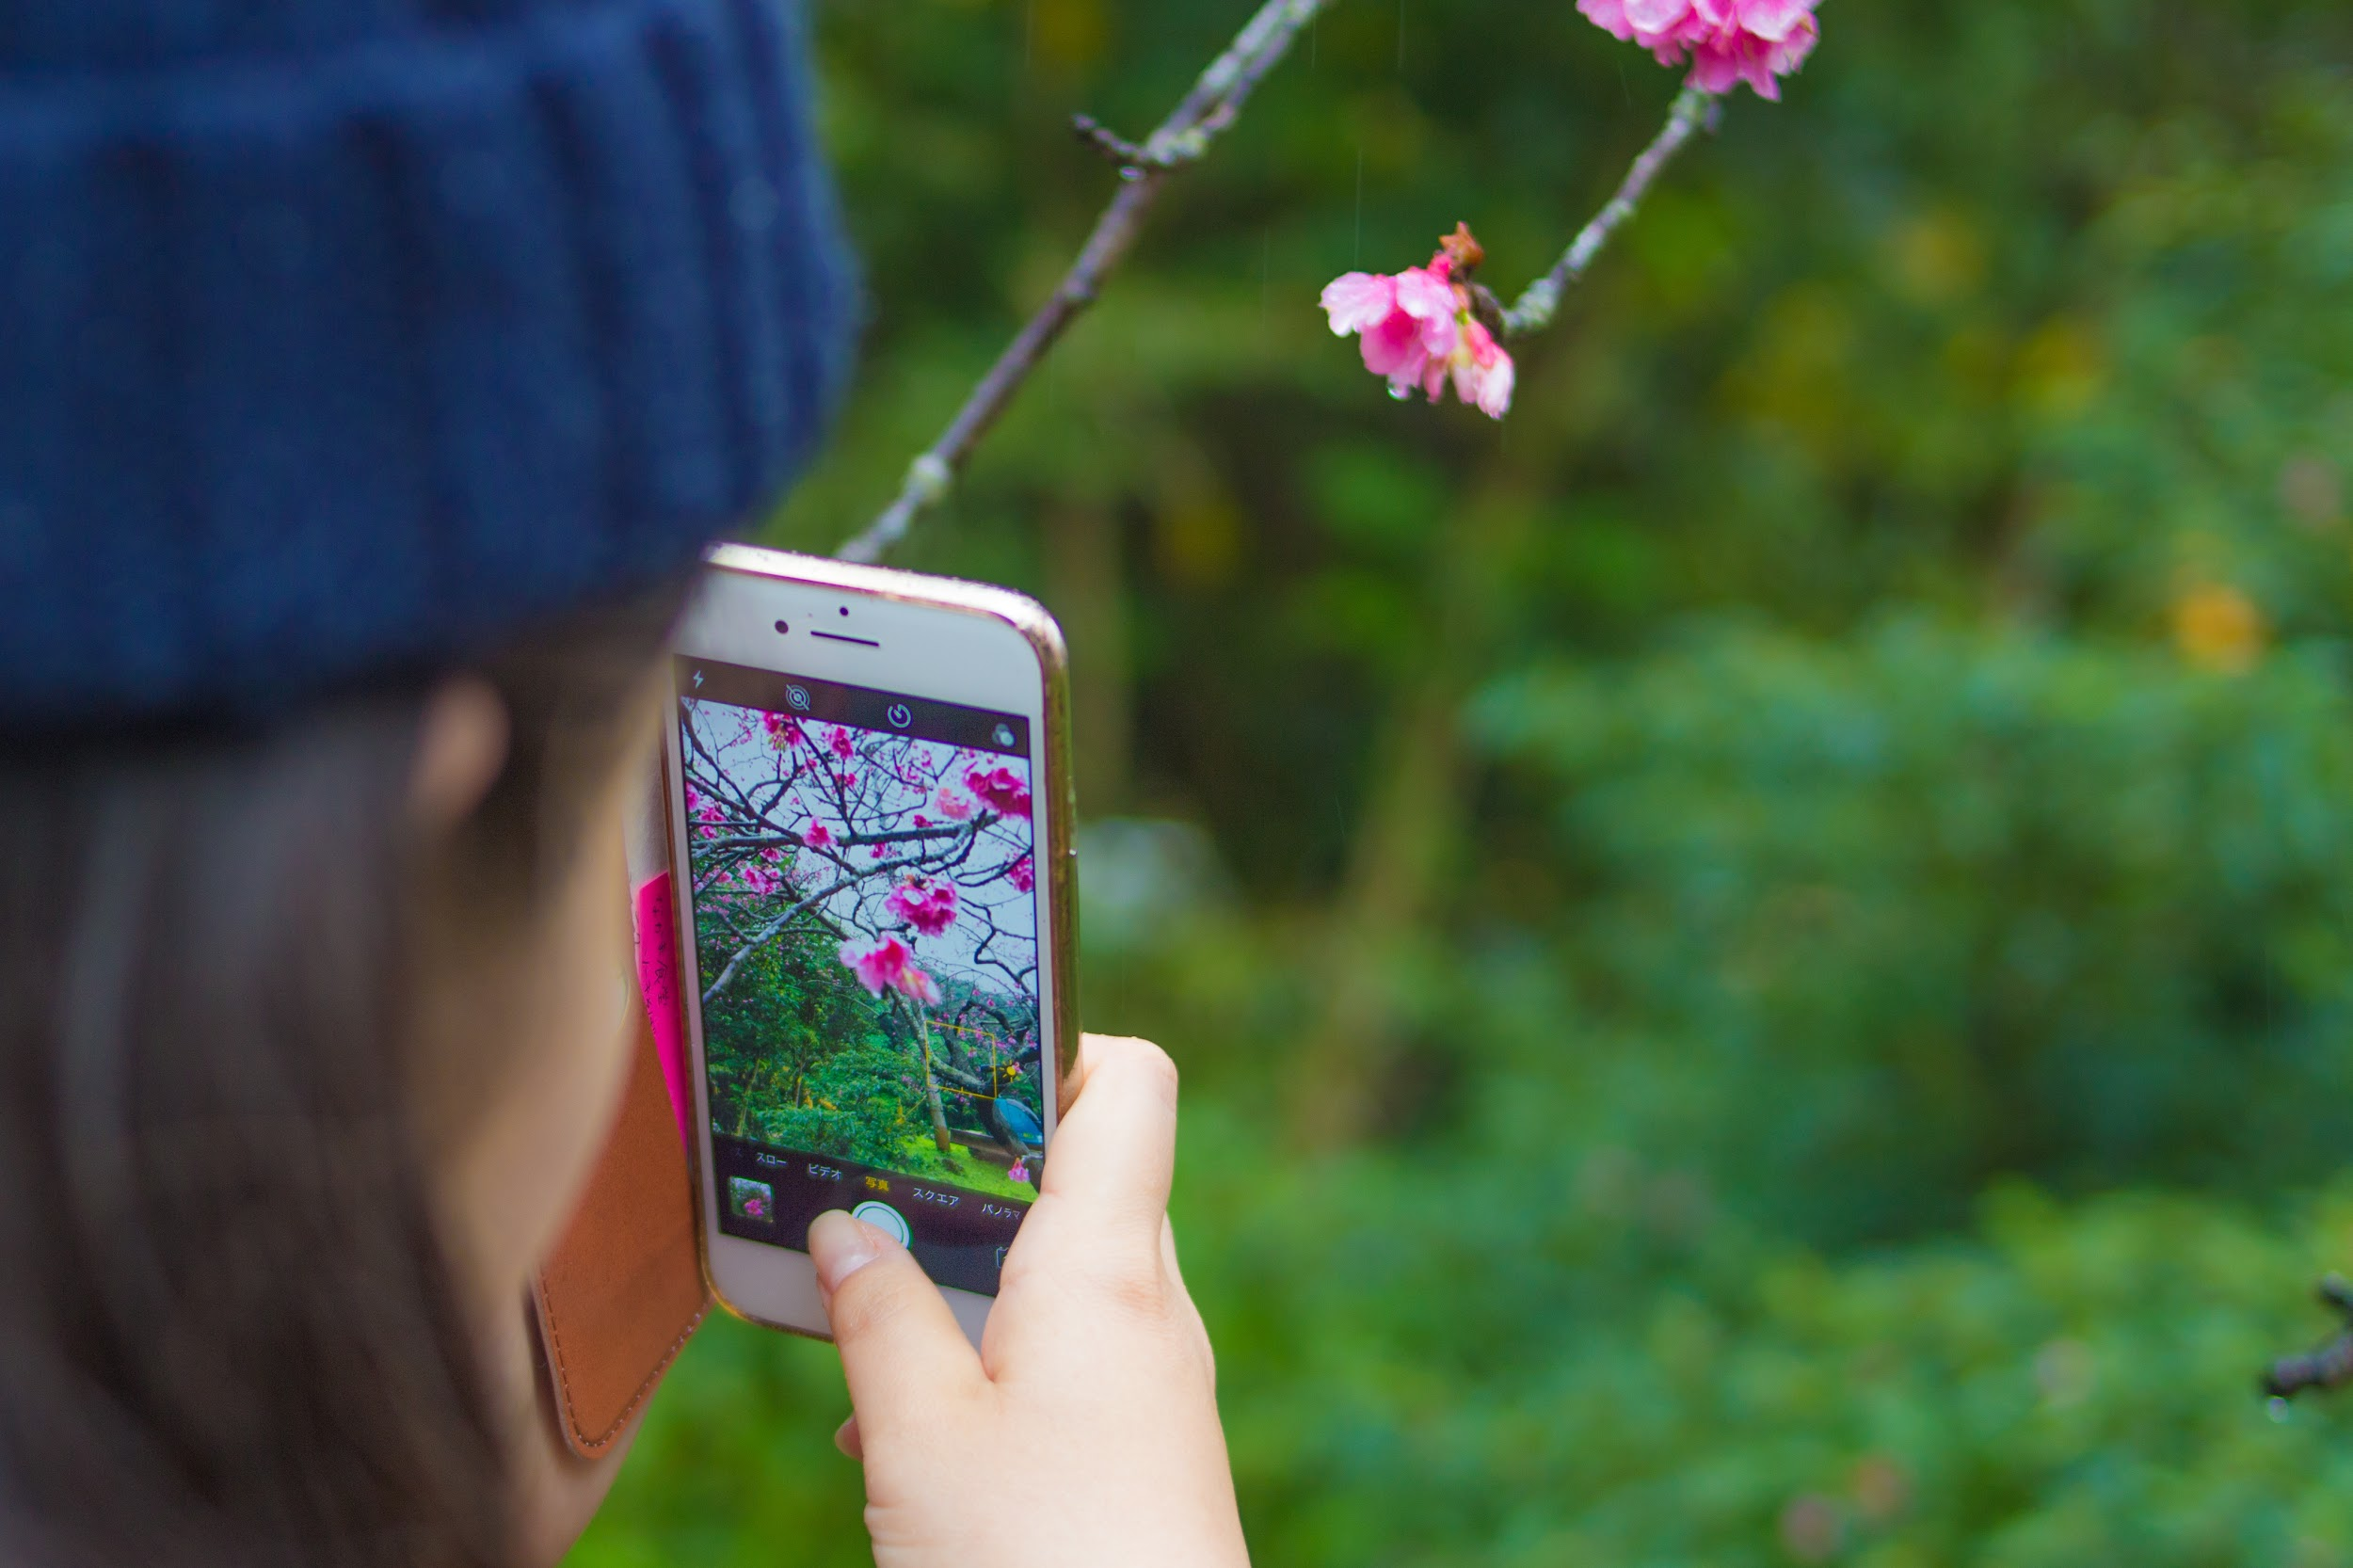
Steps you might consider:
4. FILMING
What images support your story and message? When do you want to move and be still? What angles of view can you explore?
Notes:
“Five Minute Film School,” Michael Hernandez: https://vimeo.com/395103646
When you are ready to film, how will you think about the composition of your images, footage? How do you want the camera to relate to the subject – as an extension of the subject, as an observer of the subject?
What images support your story and message?
Whose point of view is featured in the story? Who/what is the narrator?
Will the narrator be sharing a first-person point of view? Why or why not?
How is this reflected in what is going to be shown?
When do you want to move and be still?
When might you want to be close in/far away from the focus of your narrative?
What angles of view/perspectives can you explore?

Slide 16
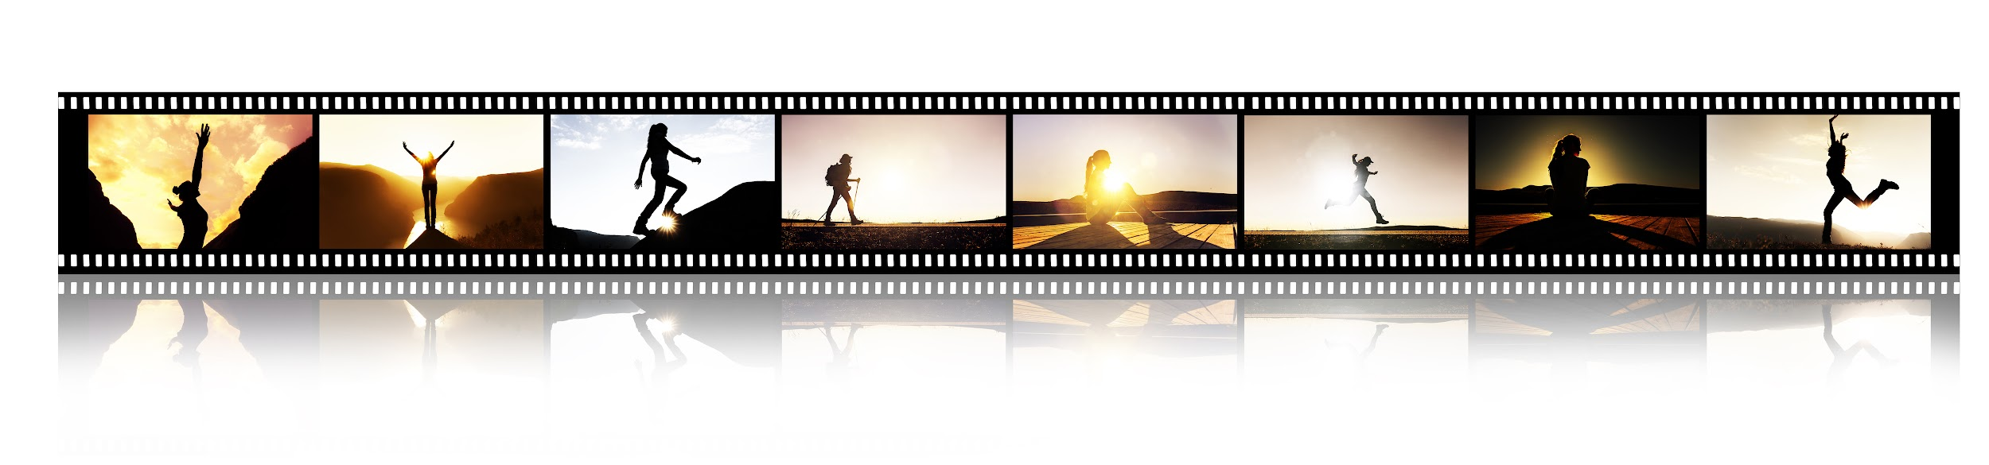
Steps you might consider:
5. EDITING/REVISION
Is the heart/purpose of the story clear?
What don’t you need to tell the story?
What might you change? Or add?
Is the beginning, middle and end clear?
Notes:
“Five Minute Film School,” Michael Hernandez: https://vimeo.com/395103646
Is the heart/purpose of the story clear? What don’t you need to tell the story (what can you cut, omit, create or communicate in a different way? What might you change? Or add to give more detail, more feeling to what’s being shared? Is the beginning, middle and end clear? (Students can also make more than video video if they want to do that; or make one individually and one in a team, if possible.)

Slide 17
Some foundational elements for The Redford Center’s original storytelling work:
Solutions-focused stories to offer a more hopeful view of the future and to help audiences understand how they can play a role.
Telling stories through characters so that audiences can see themselves in the story and also be educated on how the issue affects them.
Prioritizing entertainment and working to make the film surprising, inspiring, beautiful, emotional, musical, hip, fun, and more (you’d want to watch it).
Leaving people with a sense for new actions they can take in their own life.
Creating nonpartisan stories, meaning that the story doesn’t align with one political ideology but rather appeals to universal values.
Showcasing unlikely stories so that all audiences, even those that don’t readily identify as environmentalists, see themselves as part of the story and the solution.

