Slide 2
ch.1
Wisdom and Wonder
a foundation for justice

Slide 4
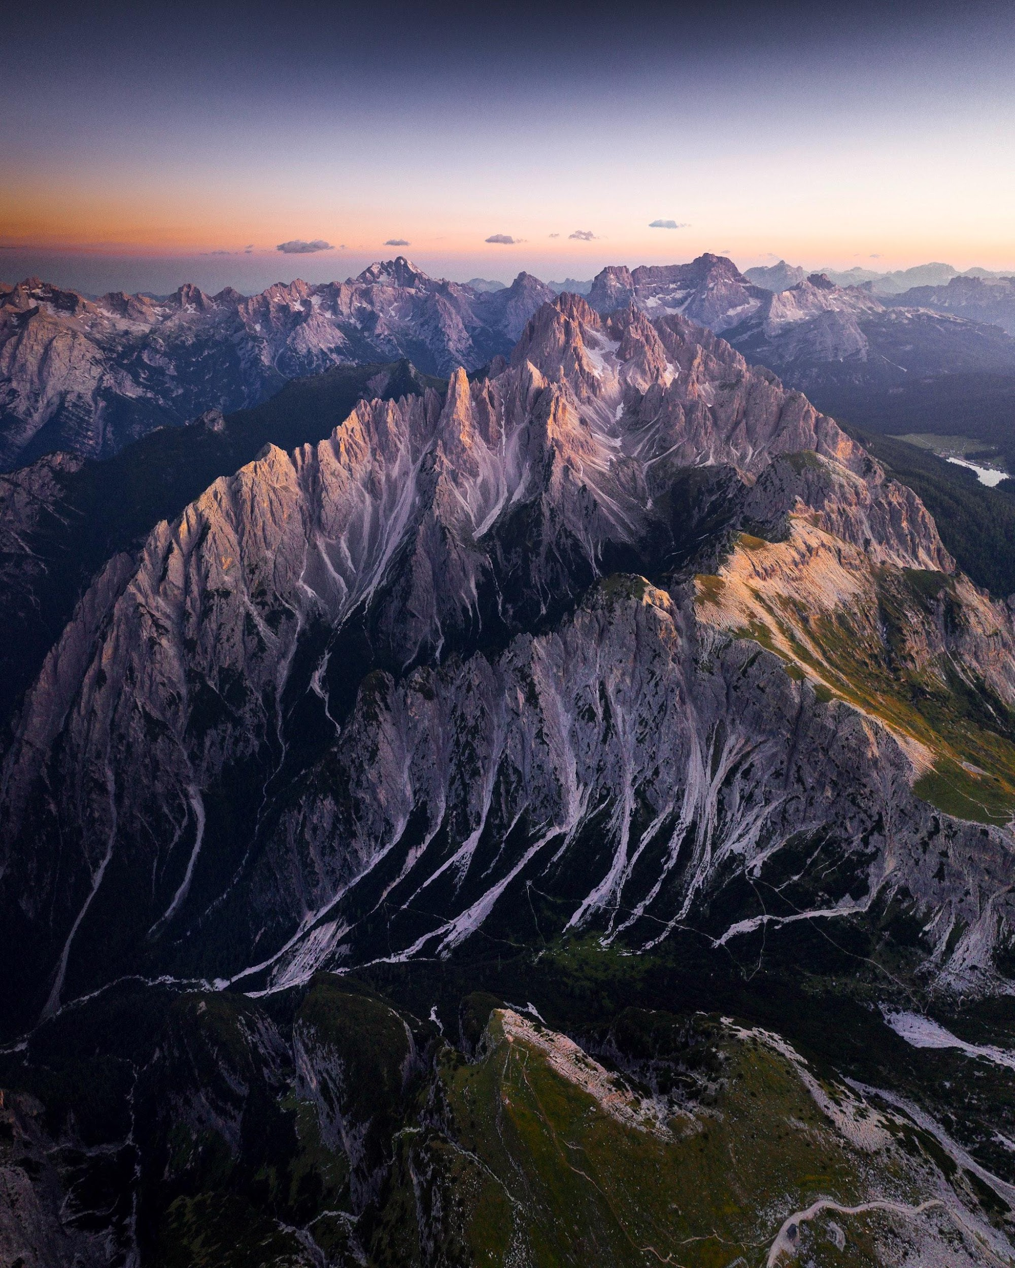
THE REDFORD STORIES PROJECT invites young people to join a journey of learning that puts them in the director’s seat to discover and articulate their own wisdom as authors of humanity’s collective narrative and activate the power of storytelling to impact environmental justice and regeneration.
This project seeks to amplify new visions and voices for a just, inclusive, hopeful, and healthy world, today and in the future, including through the creation of 90-second films to be showcased in April on Earth Day.

Slide 5
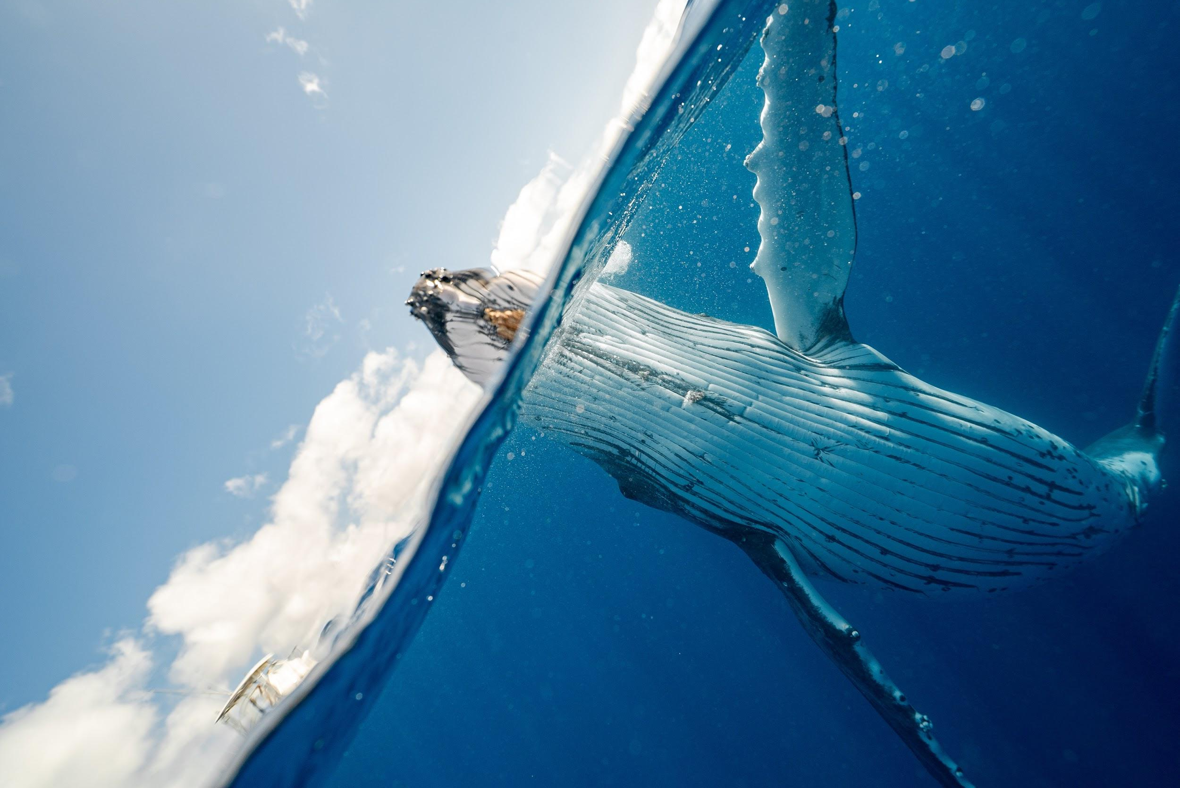
Xiye Bastida reminds us that:
“We must meet
the greatest challenge
of our lives with
stubborn optimism.”
Notes:
What is the greatest challenge of our lives in your opinion? How does Xiye explain the challenge? How we understand the meaning of “stubborn optimism”? What do we do when there is a challenge? Who are the people to work together to overcome/transcend this/these challenge(s)?

Slide 6
Imagine the Future
Xiye Bastida
Notes:
What is the greatest challenge of our lives in your opinion? How does Xiye explain the challenge? How we understand the meaning of “stubborn optimism”? What do we do when there is a challenge? Who are the people to work together to overcome/transcend this/these challenge(s)?

Slide 7
How does Xiye tell the story she wants to tell in this video?
How is Xiye framed in the video?
What elements does she include that most stand out to you?
(images, her voices, music/sound, moving images?)
Do you notice any images that feel similar to things you notice
in your own community?
Can you notice when the focus is on big ideas, and when it’s on small details?
What does Xiye hope people will be inspired to do?
Notes:
Edit and adapt

Slide 8
Adaptation: Floating Gardens of Bangladesh

Slide 9
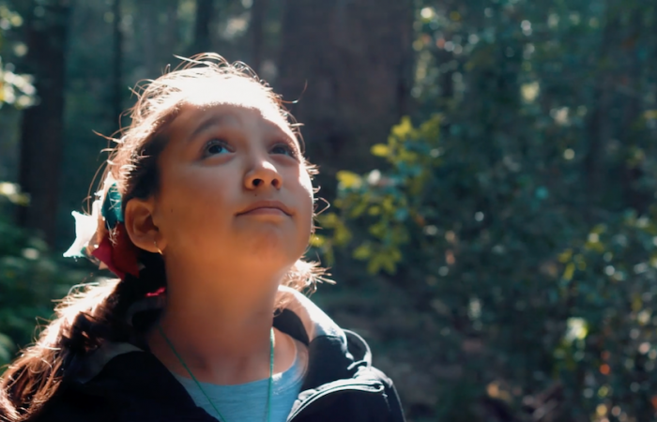
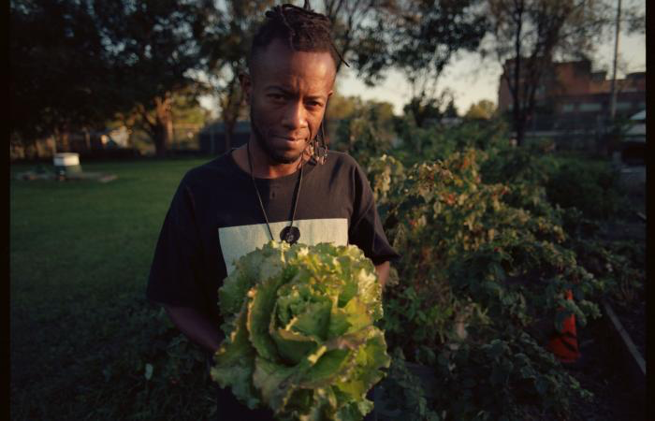
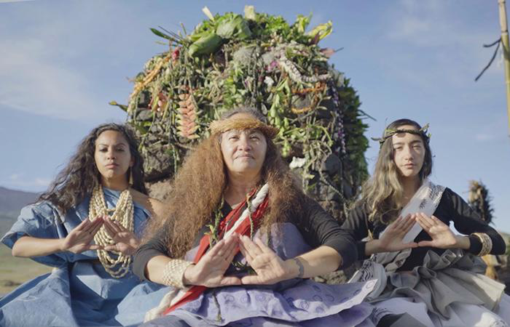
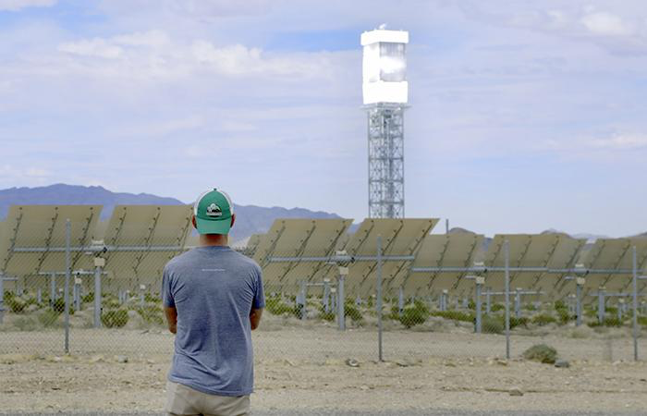
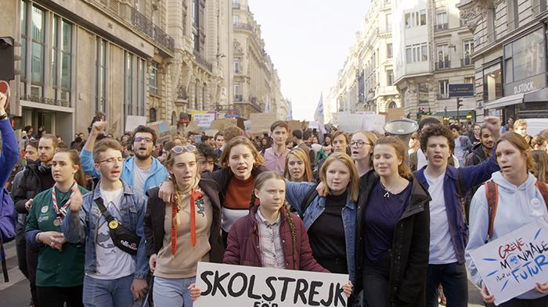
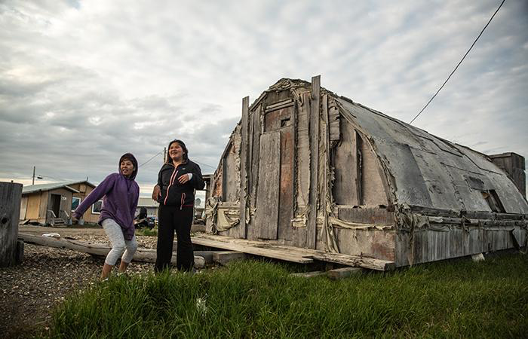
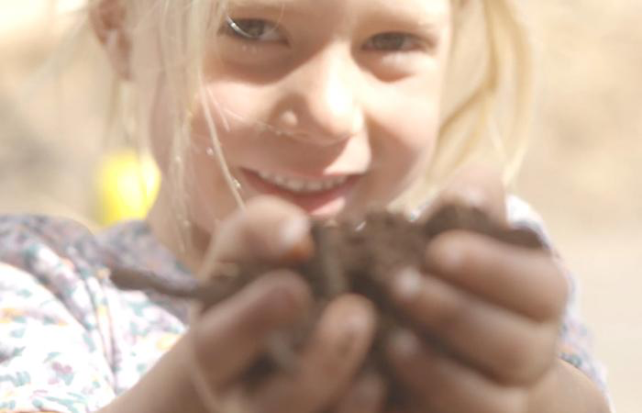
The Nature Film
Inventing Tomorrow
Food for the Rest of Us
Youth V. Gov
Standing Above the Clouds
Happening: A Clean Energy Revolution
Notes:
Video Link: https://youtu.be/pACJF9Hnhas (to overview video)
** Note: Other Videos pictured here are not linked in this slide - they appear across the curriculum and will be linked in various lessons.

Slide 10
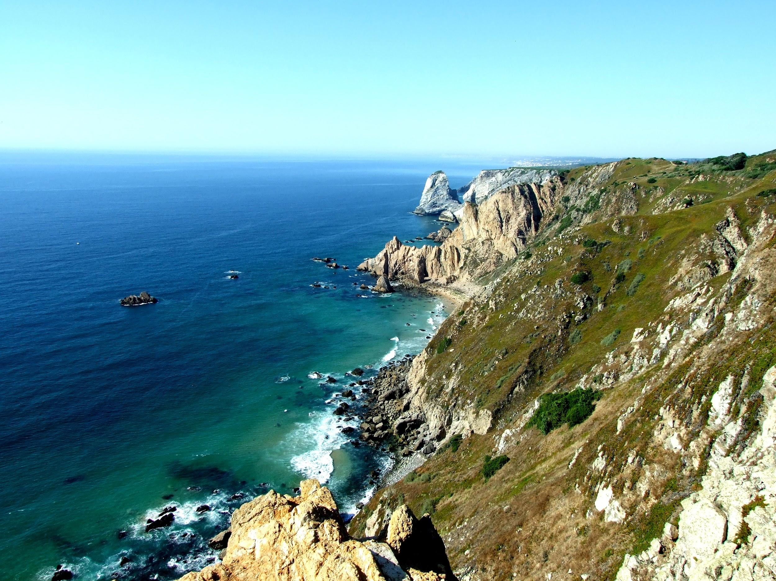
Challenge Prep 1
Imagining is the First Step: Vision Board Exercise

Slide 11
Bonus Slides

Slide 12
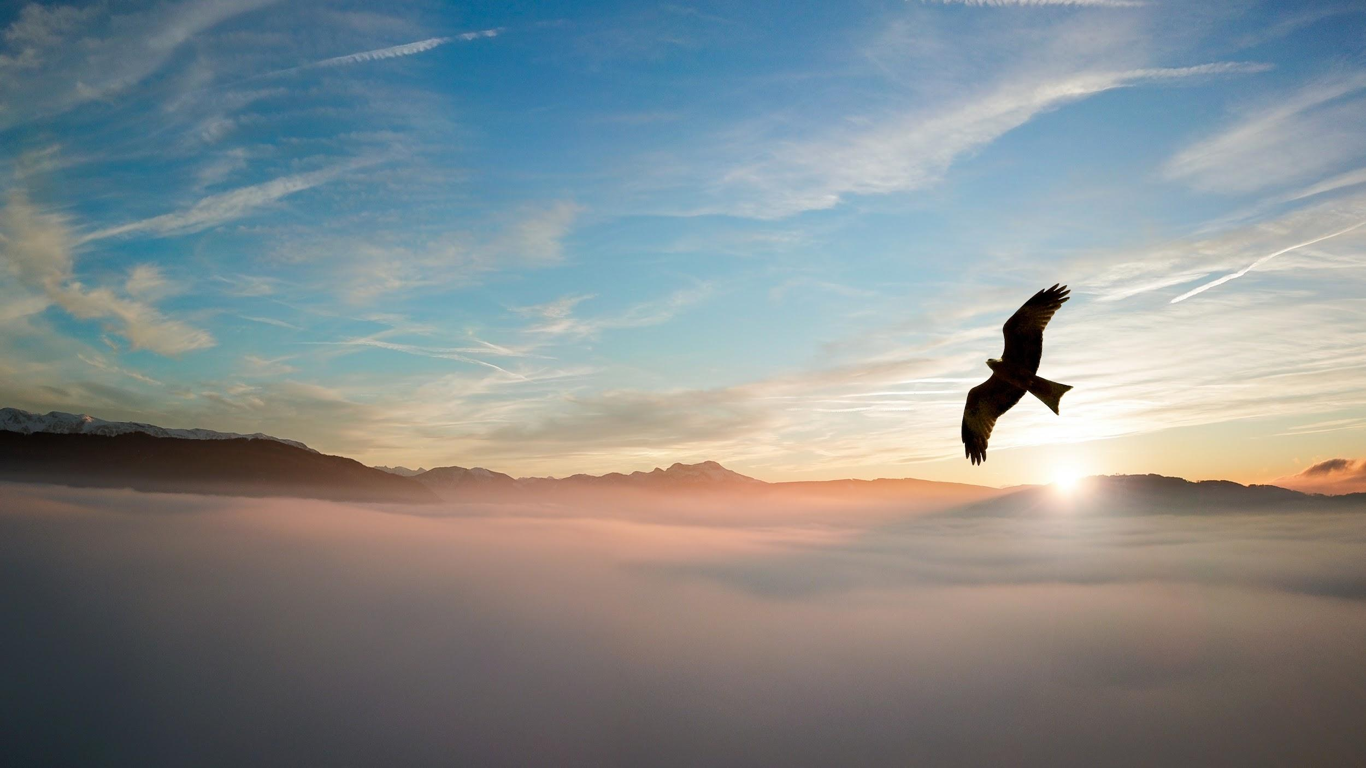
When I listen to the sky…
hush
motion
stories
alive
(color)

Slide 13
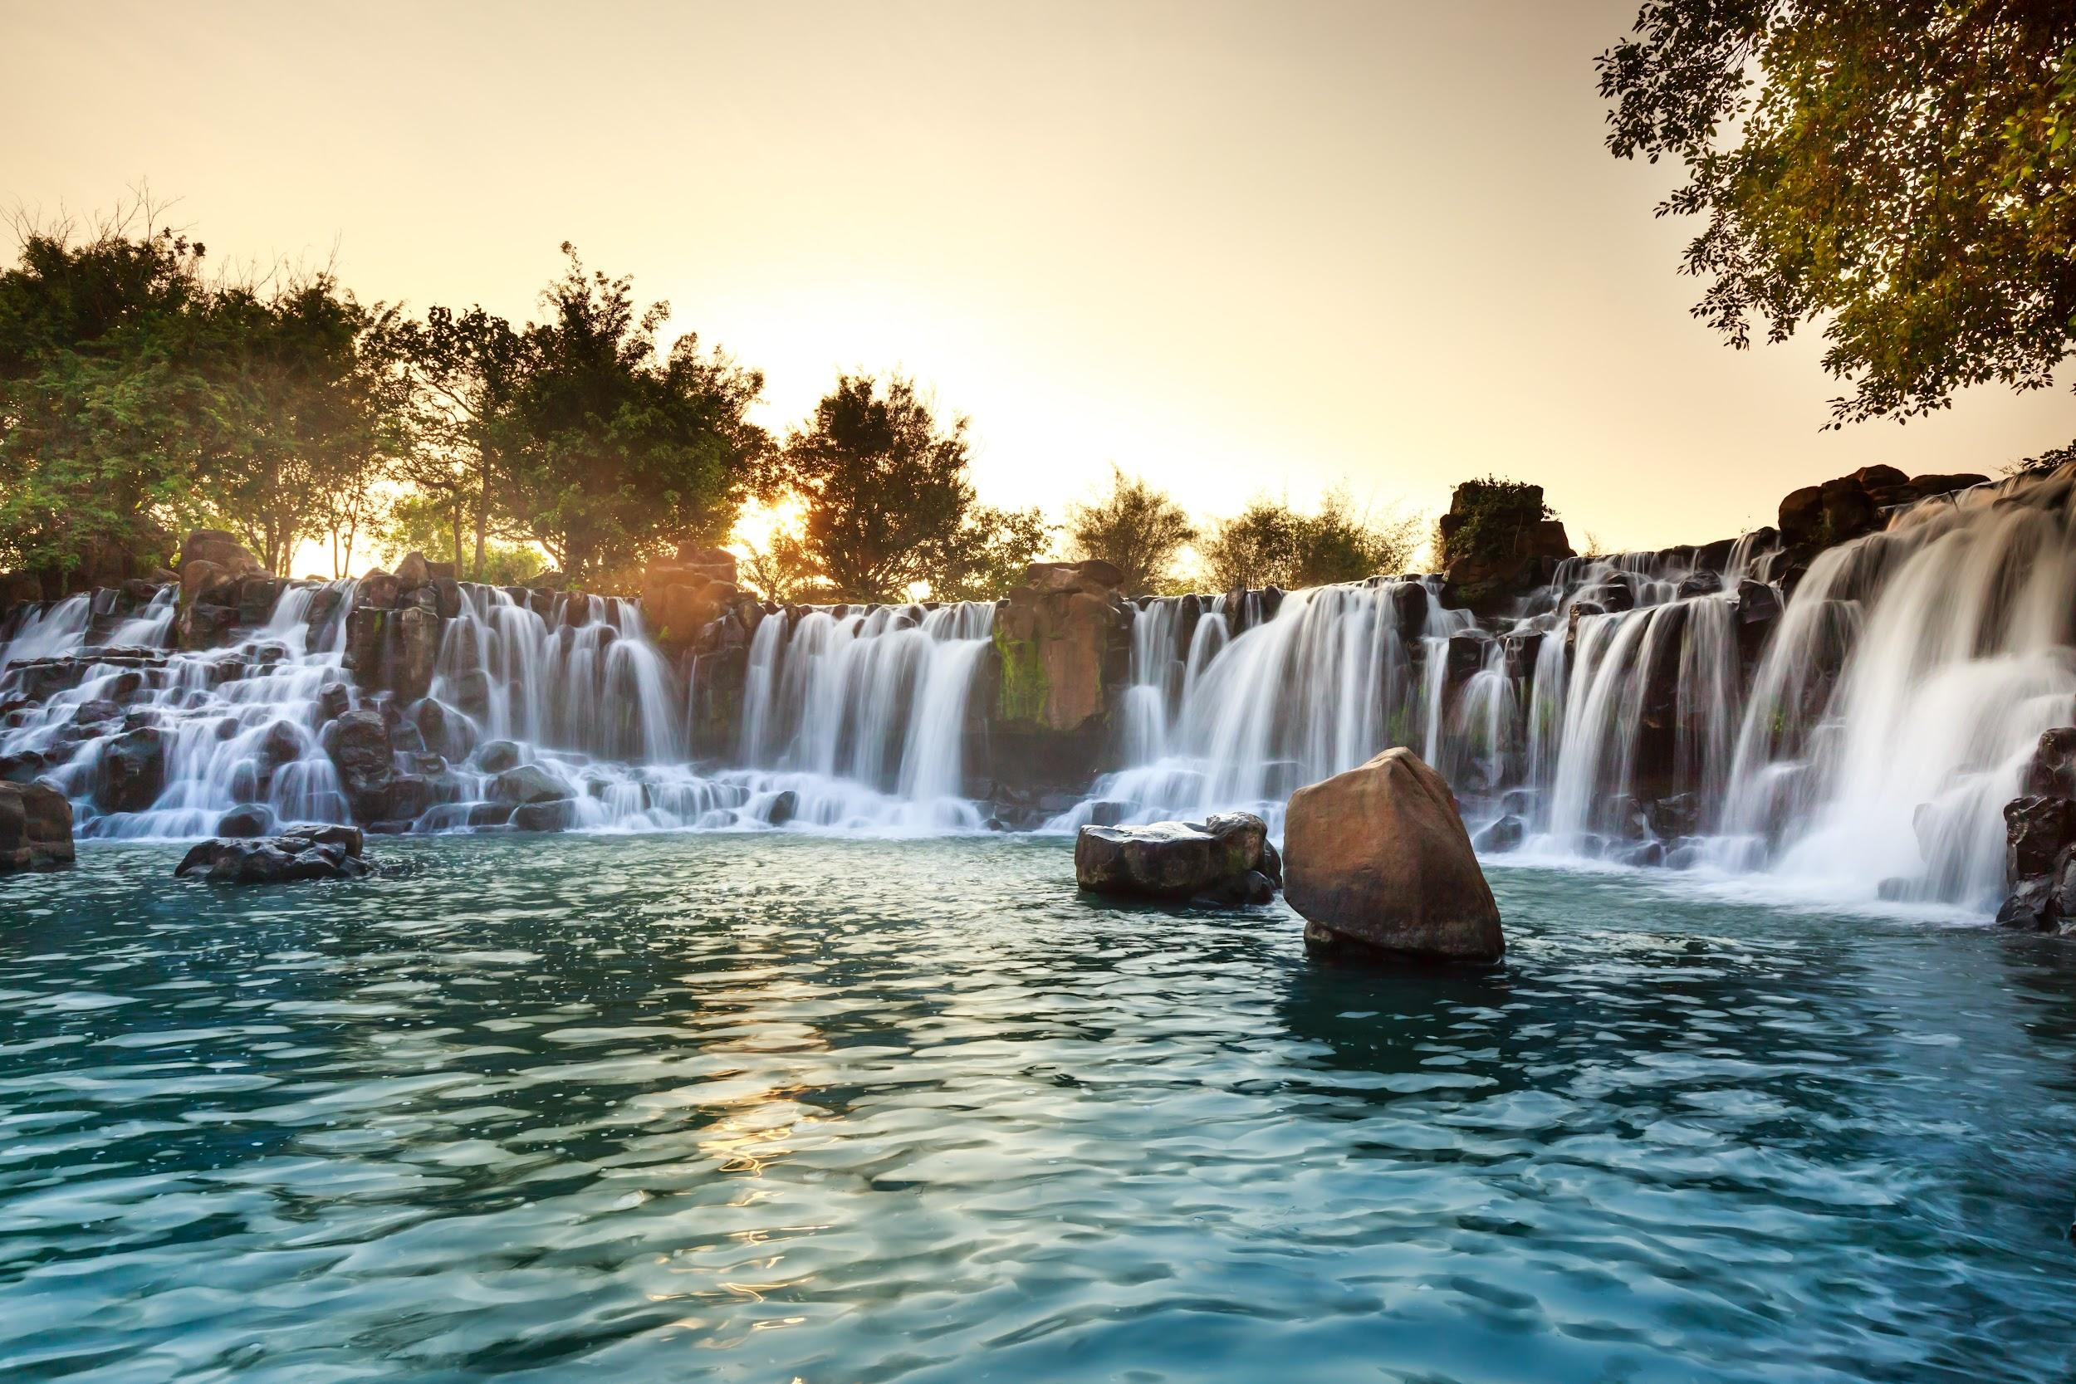
Those who dwell among the beauties and mysteries
of the earth are never alone or weary of life.
– Rachel Carson

